Slide 1
Hazing Awareness Training training the trainers

Slide 2
What is Hazing?
Definition:
Hazing means any intentional, knowing, or reckless act by a person acting alone or acting with others that is directed against another when both of the following apply:
The person knew or should have known that such an act endangers the physical health or safety of the other person or causes severe emotional distress.
The act was associated with pledging, being initiated into, affiliating with, participating in, holding office in, or maintaining membership in any organization.

Slide 3
Hazing cont...
Hazing includes but is not limited to any of the following acts associated with pledging, being initiated into, affiliating with, participating in, holding office in, or maintaining membership in any organization:
Physical brutality, such as whipping, beating, paddling, striking, branding, electric shocking, placing of a harmful substance on the body, or similar activity.
Physical activity, such as sleep deprivation, exposure to the elements, confinement in a small space, or calisthenics, that subjects the other person to an unreasonable risk of harm or that adversely affects the physical health or safety of the individual or causes severe emotional distress.
Activity involving consumption of food, liquid, or any other substance, including but not limited to an alcoholic beverage or drug, that subjects the individual to an unreasonable risk of harm or that adversely affects the physical health or safety of the individual or causes severe emotional distress.
Activity that induces, causes, or requires an individual to perform a duty or task that involves the commission of a crime or an act of hazing.

Slide 4
Definitions you should know
Organization: is a fraternity, sorority, association, corporation, order, society, corps,
cooperative, club, service group, social group, band, spirit group, athletic team, or similar
group whose members are primarily students at, or former students of, a postsecondary
education institution, including the national or parent organization of which any of the
underlying entities provided for in this definition is a sanctioned or recognized member at
the time of the hazing.
Pledging: is any action or activity related to becoming a member of an organization,
including recruitment and rushing.

Slide 5
Definitions cont...
Appropriate authority includes:
Any state or local law enforcement agency.
A 911 Public Safety Answering Point as defined in Title 33 of the Louisiana Revised Statutes of 1950.
Emergency medical personnel.
Reckless behavior: is an activity or behavior in which a reasonable person knew or
reasonably should have known that the activity or behavior may result in injury to another,
including but not limited to excessive consumption of alcohol, binge drinking, drag racing,
consumption of any controlled dangerous substance, acts of hazing, or other similar
activity.
Serious bodily injury: is bodily injury that involves unconsciousness, extreme physical
pain, or protracted and obvious disfigurement, or protracted loss or impairment of the
function of a bodily member, organ, or mental faculty, death, or a substantial risk of death.

Slide 6
Hazing includes, but is not limited to any situation which:
Creates a risk of injury to any individual or group
Causes discomfort to any individual or group
Causes embarrassment to any individual or group
Involves harassment of any individual or group
Involves degradation of any individual or group
Involves humiliation of an individual or group
Involves ridicule of an individual or group
Involves or includes the willful destruction or removal of public or private property for the purpose of initiation or admission into, affiliation with, or as a condition for continued membership in an organization

Slide 7
What you should know about hazing:
More than half of college students involved in clubs, teams, and organizations experience hazing.
82% of deaths from hazing involve alcohol.
Individuals cannot consent to being hazed.
Just because a majority of the members of an organization are not involved in a hazing incident does not mean the organization is not responsible.
Hazing is not just associated with athletes and Greek–letter organizations. It occurs across a wide spectrum of organizations.

Slide 8
Hazing in Student Groups
Student Group | Percent
Varsity Athletes | 74%
Social Fraternity or Sorority | 73%
Club Sport | 64%
Performing Arts Organization | 56%
Service Fraternity or Sorority | 50%
Intramural Team | 49%
Recreation Club | 42%
*Other | 30%
Academic Club | 28%
Honor Society | 20%
Allan & Madden, 2008, hazingstudy.org
*Other includes religiously-affiliated
organizations, culture clubs and
organizations, and student government

Slide 9
Myths About hazing
Hazing Builds Unity.
I went through it, so they should too!
If they agree, then we're not hazing.
WRONG! Hazing builds animosity between people and does nothing to foster trust, unity or respect. It simply makes better hazers.
WRONG! One class can break the "tradition" of hazing - it just take some courage and integrity to do what is right.
WRONG! Since peer pressure leads students to consent, the focus is on what you do, not whether they said you could.

Slide 10
COMPLIANCE WITH LAWS
Each institution’s policy must comply with applicable laws and regulations, and must be amended to reflect any changes to such laws and regulations, including but not limited to the following:
Act 635 of the 2018 Regular Session of the Louisiana Legislature, which creates the crime of criminal hazing, provides definitions and exceptions, and establishes exceptions and penalties;
Act 637 of the 2018 Regular Session of the Louisiana Legislature, which creates an obligation to offer reasonable assistance, including seeking medical assistance, to someone who has suffered serious bodily injury caused by reckless behavior, including hazing; and
Act 640 of the 2018 Regular Session of the Louisiana Legislature, which prohibits hazing at Louisiana’s public postsecondary institutions, requires BOR to adopt a uniform policy on hazing prevention, requires public postsecondary institutions to adopt and expand on BOR’s uniform policy in a manner consistent with the laws and BOR policy

Slide 11
Failure to comply
Failure to comply with any applicable laws and regulations, including those listed in the previous slide, shall constitute a failure to comply with this Policy. Each management board, as the entity with the authority over the day-to-day operations of its member institutions, shall make all due diligence efforts to monitor its member institutions’ compliance with applicable laws and regulations.

Slide 12
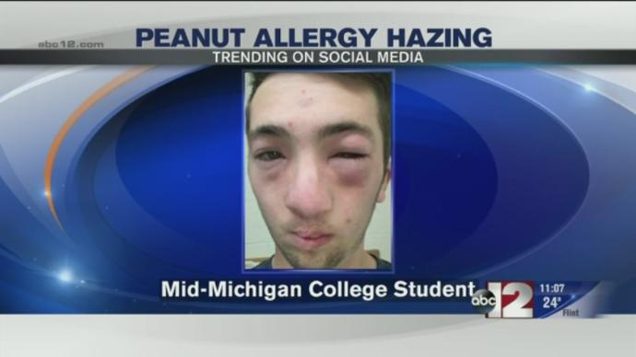
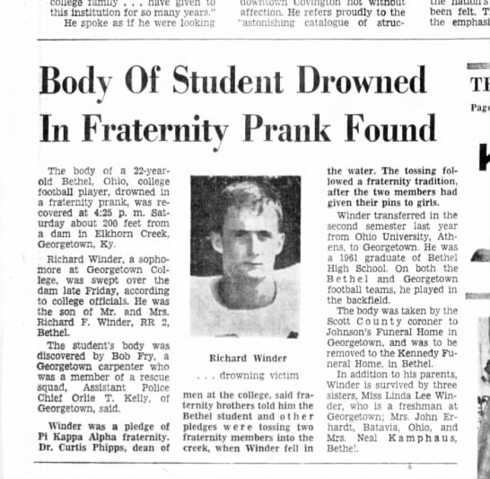
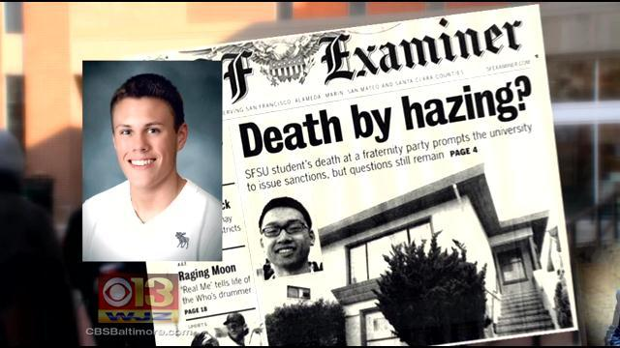
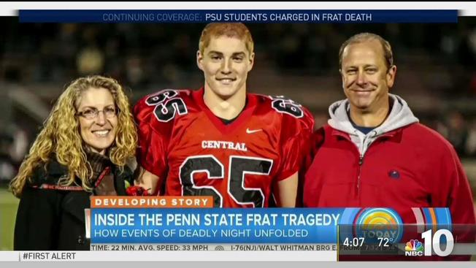
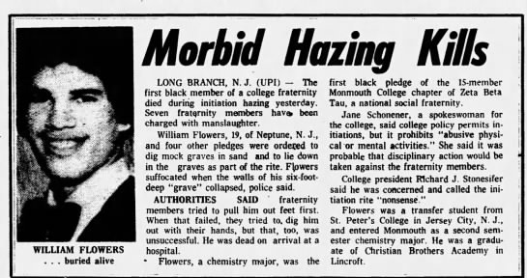
Hazing in the news

Slide 13
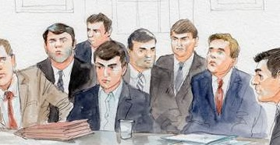
Timothy Piazza Penn State – Beta theta pi
Timothy Piazza, arrived at Hershey Medical Center on February 3rd 2018 with a lacerated spleen, an abdomen full of blood, and multiple traumatic brain injuries. He had fallen down a flight of stairs during a hazing event at his fraternity, Beta Theta Pi, but the members had waited nearly 12 hours before calling 911. Tim underwent surgery shortly after arriving at Hershey, but it was too late. He died early the next morning.
The Piazza case resulted in one of the largest hazing prosecutions in US history. On May 5, 2017, eighteen members of the fraternity were charged in connection with Piazza's death: eight were charged with involuntary manslaughter and the rest with other offenses, including hazing.
Beta Theta Pi fraternity itself was also charged. Its Penn State fraternity branch was closed after its president ordered it banned from campus indefinitely.

Slide 14
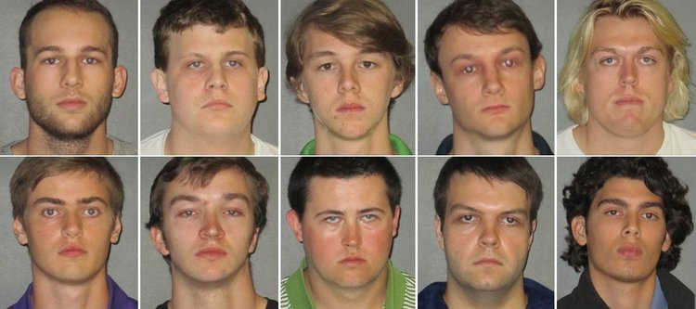
Maxwell Gruver LSU – phi delta theta
Maxwell Gruver was instructed by more senior members of LSU's Phi Delta Theta to repeatedly chug 190-proof Diesel liquor during a Sept 13 hazing ritual called Bible Study, during which pledges are quizzed on fraternity facts.
The incident caused Gruver, a freshman from Roswell, Georgia, to inhale his own vomit and other fluids into his lungs. Gruver's blood-alcohol level was .496, more than six times the state's legal driving limit, when he died on Sept. 14.
The 10 men arrested range in age from 18 to 21 and all face misdemeanor hazing charges. Another man, 19-year-old Matthew Alexander Naquin, faces an additional felony charge of negligent homicide.

Slide 16
What should you do?
After calling 911 for emergency medical help, there are other steps to take to help a person who is experiencing alcohol poisoning. These include:
Keep the person awake if possible.
Keep the person informed. Let the person know if you are going to touch them or perform any action on them, as some individuals may become aggressive.
Keep the person sitting.
If the person is conscious and able to swallow, try to get them to slowly drink water.
If the person is unconscious and lying down, carefully roll them onto their side with their arms over their head so they will not choke on their own vomit.
Get a warm blanket for the person, as alcohol poisoning will likely make them feel cold.

Slide 17
Hazing is okay as long as it is not physically dangerous.

Slide 18
Signs of Hazing
Required to carry certain items.
Cutting, branding, labeling, or shaving of parts of the body.
Required "greeting" of members in a specific manner when seen on campus.
Required walking in groups to class, food service, etc.
Performing of special tasks for the members or others.
Appearance of sadness or expressions of inferiority.
Withdrawal from normal activities or friends.

Slide 19
HAZING AND ITS CONSEQUENCES
IMPACT ON PERSON BEING HAZED
IMPACT ON THOSE WHO HAZE
Physical, emotional, and/or mental instability
Sleep deprivation
Loss of sense of control and empowerment
Decline in grades and coursework
Relationships with friends, significant others, and family suffer
Post-traumatic stress syndrome
Loss of respect for and interest in being part of the organization
Erosion of trust within the group members
Illness or hospitalization with additional effects on family and friends
Decline in grades and coursework
Relationships with friends, significant others, and family suffer
Loss of connection to alums through the organization
Media scrutiny
Damage to one’s personal reputation
Warped sense of leadership
Feelings of shame and guilt

Slide 20
HAZING AND ITS CONSEQUENCES
IMPACT ON THE ORGANIZATION
Loss of reputation within the campus community, local area and nationally
Loss of recognition for the organization, team or club and/or other privileges revoked
Civil damages may be levied against the organization
Organization’s officers may be held responsible
A gradual erosion of the true meaning and values of the organization

Slide 21
Consent
“Consent is not defense. It is not a defense to prosecution of an offense that the person against whom the hazing was directed consented to or acquiesced in the hazing activity.”
- University of Louisiana System Hazing Policy
August 23rd, 2018

Slide 23
How to report hazing?
You can submit a report through ULM Police as a “Silent Witness” or through the ULM “Incident Reporting Form.”
ULM’s ability to investigate reported incidents, enforce the university’s expectations, and protect future students depends on the accuracy and specificity of the information provided.
You are encouraged to provide as much specific detail as possible so that appropriate action can be taken to address the reported behavior. You have the option to submit a report anonymously, though campus officials may find it difficult to complete their investigation without knowing the source of the report.
https://cm.maxient.com/reportingform.php?UnivofLouisianaMonroe&layout_id=50

Slide 24
How to report hazing? Cont.
If you need IMMEDIATE ASSISTANCE, call Campus Police at (318) 342-5350.
In a non-emergency situation, you can discuss hazing-related concerns with any member of the faculty or staff. If you’re unsure who to speak with, you may contact:
Pamela Jackson, Dean of Students: 318-342-5230 or pjackson@ulm.edu
Karen Foster, Director of the Counseling Center: 318-342-5220 or kfoster@ulm.edu
Emily Essex, Director of Student Life and Leadership: 318-342-5286 or essex@ulm.edu
Allison Crotwell, Coordinator of Student Development: 318-342-5289 or crotwell@ulm.edu
Other University Faculty/Staff That You Trust.

Slide 25
LEGAL AND DISCIPLINARY CONSEQUENCES OF HAZING
Such action may include, but is not limited to the following:
Legal actions up to and including jail time and fines
College discipline (suspension or expulsion)
Membership and organizational sanctions

Slide 26
Questions you should ask yourself to determine if you or someone you know might be getting hazed.
Is there secrecy around the activity?
Is there pressure to participate?
Is a specific group or individual singled out?
Do members justify it as being a "tradition?"
Take the perspective of your parents - would they be proud? Your Coach? Athletic or Recreation Director? The college President?
Would you be willing to defend the merit of this activity in the court of law?
Does this activity meet the spirit of it's intent, the ideals and values of the team and the college?

Slide 27
Steps we can take towards preventing hazing
Reduce the Power Differential Between Members and Initiates
Give Members Time to Reflect Their Actions
Encourage Members to Voice Concern With the New Member Education Program
Be Willing to Amend Traditions
Develop a Chapter Anti-Hazing Policy
Share Ideas With Other Organizations
Take Advantage of Campus Resources

Slide 28
In-House Training for your Organization Members
YOU are responsible as organization leaders who attended our training session for training ALL organization members in-house.
An in-house training packet will be distributed to you with detailed instructions on presenting this training to your members.
You will be required to submit a report detailing the in-house training you administered to your members.
New members are required to be educated on this training each semester as they are inducted to your organization.
Failure to comply by the completion dates set forth will result in suspension of your organization for one academic year.

Slide 29
Online Training Module
?

Slide 30
sources
https://deanofstudents.umich.edu/article/what-hazing
http://www.babson.edu/student-life/community-standards/hazing/Pages/hazing-facts-and-myths.aspx
Allan & Madden, 2008, hazingstudy.org
https://en.wikipedia.org/wiki/Death_of_Tim_Piazza
https://www.usatoday.com/story/news/nation-now/2017/10/12/10-charged-lsu-students-hazing-death/757063001/
https://americanaddictioncenters.org/alcoholism-treatment/overdose/
https://hazingprevention.org/home/hazing/hazing-and-its-consequences/
https://www.csbsju.edu/hazing/signs-of-hazing-and-what-to-do
https://www.rochester.edu/college/fsa/hazing/stop.html
https://cm.maxient.com/reportingform.php?UnivofLouisianaMonroe&layout_id=50

