Slide 1



Personal Financial Planning
The Good Life

Slide 2



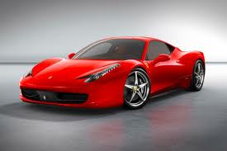




What is the Good Life?

Slide 3
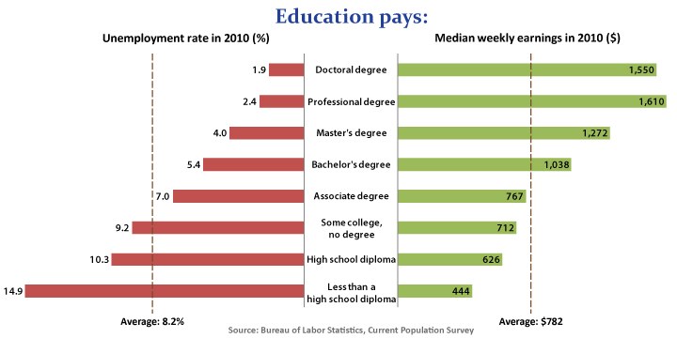
Factors that affect your ability to live the good life.

Slide 4
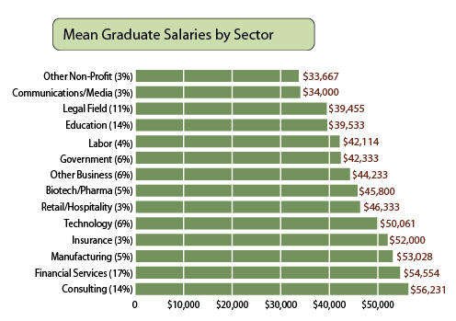
Factors that affect your ability to live the good life.

Slide 5
Factors that affect your ability to live the good life.
Your level of education
Your skills
Your gender
Where you live
BUT MOST IMPORTANTLY…
The decisions that you make with the money you earn!!!

Slide 6


Slide 7
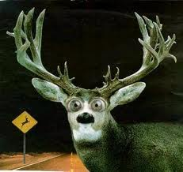
ME? PLANNING???!!!

Slide 8
How do I make good financial decisions?
Prioritize
Figure out the following:
WHAT YOU NEED
vs
WHAT YOU WANT

Slide 9
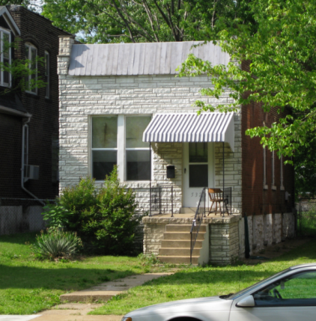

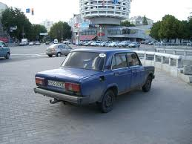
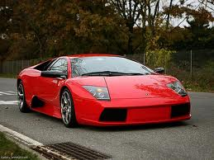
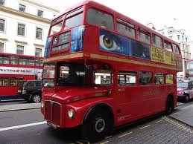


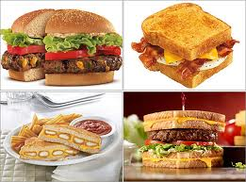

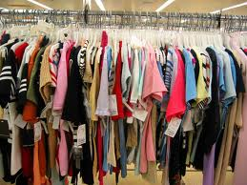

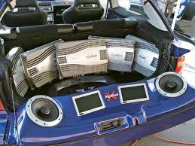
WHAT YOU NEED VS WHAT YOU WANT
Shelter?
Transportation?
Food or clothing
VS Toys?

Slide 10
How do I make good financial decisions?
Prioritize
Figure out the following:
SHORT TERM NEEDS
vs
LONG TERM NEEDS

Slide 11
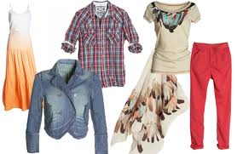


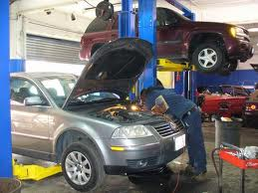
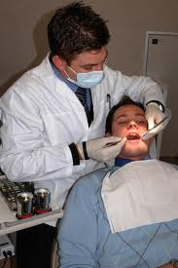





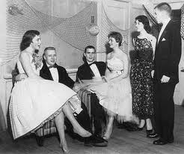
SHORT TERM VS LONG TERM

Slide 12
Planning and Prioritizing
Short-Term planning: Goals that will be fulfilled within 12 months or less
Goal | Priority | Target Date | Cost
Buy new tires and brakes for car | High | 1/15/2012 | 600
Buy clothes for school | Medium | 1/7/2012 | 250
Get new car stereo with MP3 input | Low | 3/15/2012 | 200
Prom dress and jewelry | Medium | 2/28/2012 | 200

Slide 13
Planning and Prioritizing
Medium-Term planning: Goals that will be fulfilled within 2 to 5 years
Goal | Priority | Target Date | Cost
Save money for college | High | 7/15/2014 | 10,000
New laptop computer for college | High | 7/15/2014 | 1,500
Down payment for a better car | Medium | 6/1/2014 | 3,000
High-School graduation trip | Medium | 5/25/2014 | 4,000
Start an emergency savings fund | High | 8/1/2014 | 5000

Slide 14
Planning and Prioritizing
Long-Term planning: Goals that will be fulfilled in 6 or more years
Goal | Priority | Target Date | Cost
Graduate from college and find a job | High | 5/15/2018 | 800
Professional attire for career after college | High | 4/1/2018 | 1,000
Down payment for a new car | Medium | 8/1/2018 | 7,000
College graduation trip | Low | 5/15/2018 | 5,000
Marry high-school (maybe college) sweetheart | High | 5/29/2020 | 6,000
Down payment for a home | Medium | 2025 | 50,000
Increase emergency savings fund | High | 2025 | 15,000

Slide 15


Savings? Me? Why?
A savings account allows people to have money available whenever it is needed, such as in the case of an emergency.
Additionally, by using available cash, people do not have to rely on borrowing, (credit cards), to take care of emergency situations.

Slide 16


Slide 17


Your ability to live the good life is also based upon:
Your average propensity to consume
Your average propensity to consume is the percentage of each dollar of income, on average, that a person spends for short term needs rather than savings.
In other words, if you spend most of your money on surviving, you will not have enough left over to enjoy the good life!!!

Slide 18
Questions?

