Slide 1


Planning for Retirement
Living the Good Life During Retirement

Slide 2





What Does Retirement Look Like?
Is this what retirement looks like? Do you just decide to retire whenever you get old?
Retirement is not about how old you are!!!

Slide 3
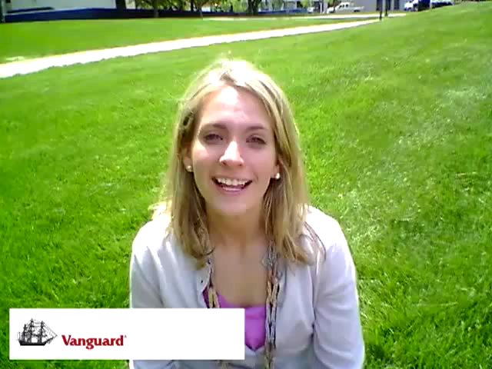

Slide 4

Retirement is About Money
Having enough money to retire requires careful planning
The consequences of not saving enough for retirement can have a negative impact on your ability to live the good life.
You want to have enough funds to take care of all of your needs when you retire. So, you may want to have already gotten rid of all of your debt, so that your income is not spent mostly on paying old debts such as a mortgage or a car loan.
Additionally, you want to make sure that you have enough money saved so that you do not run out while in retirement. If you do run out of money during retirement, you may have to go back into the workforce.
Do not count on social security to be there when you retire. As it stands today, social security is expected to run out of funds by the year 2042.

Slide 5
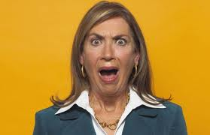

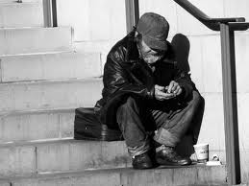
Consequences of not Planning for Retirement
Having to live with your children in your children’s home.
Having to go back to work because you cannot afford to retire.
A decline in your standard of living.
1 in 6 (17%) of elderly Americans currently live in poverty

Slide 6

Pitfalls to Retirement Planning
Starting too late
Putting away too little
Investing too conservatively
Not taking advantage of employee retirement benefits

Slide 7

How Does Saving for Retirement Work?
Saving for retirement is like rolling a snowball down a hillside
We call this “snowball” effect COMPOUNDING
The longer the snowball rolls, the bigger it will get
If you start with a big snowball, it will get bigger at the end of the run
If you add more snow to your snowball as it rolls down, your snowball will be bigger at the end of the run
If you watch your snowball periodically, it will not run off course
The earlier you start saving for retirement, the more you will have at the end
If you already have additional savings, put them in a retirement account
Contribute to your retirement account periodically
Track and monitor your account periodically to make sure your retirement is on track

Slide 8
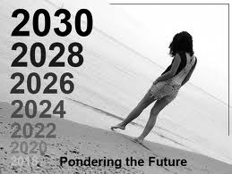
How Much Do I Need to Retire Comfortably?
To answer this question, you need to consider the following:
What will be my expenses when I retire?
How long am I going to live after I retire?
What do I want to do when I retire?
Will I be the only one depending on my retirement income?
Will I have other sources of income while in retirement?
How much do I need to put away to reach my goal?
Inflation

Slide 9
How Much Do I Need to Retire?
Meeting with a qualified financial adviser is an important step to take
Additionally, the internet has a lot of different resources that can help you start your plan towards retirement. One of such resources is included here:
http://www.bankrate.com/calculators/retirement/retirement-plan-calculator.aspx

Slide 10

What About Risk?
Investment risk is important to consider.
Risk goes hand in hand with return
If you do not like risk, the return on your investment will not be high
The following is a good rule to follow regarding risk and age:
  Take on riskier investments when you are young
  Take on less risky investments as you near retirement age
Consult a financial advisor when considering your investment options

Slide 11
Questions?

