Slide 1

Cash Handling
Cash Handling Policies and Procedures

Slide 2
Cash
Currency
Coin
Checks
Money Orders
Travelers Checks
Credit Cards/Debit Cards

Slide 3
Cash Handling
Processes involving cash that may include any of the following:
  Accepting Cash Payments
  Endorsing Checks
  Issuing Receipts
  Having Access to Cash
  Preparing the Departmental Deposit Ticket
  Reconciling Receipts to the Departmental Deposit Ticket
  Reviewing the Department Deposit Ticket
  Making the Cash Deposit
  Comparing the Departmental Deposit Ticket to the Amount in Banner

Slide 4
Cash Collection Center
University department responsible for handling cash
Only official cash collection centers are permitted to handle cash
A department is not considered a cash collection center without the prior approval of the Controller or Vice President for Business Affairs

Slide 5
Cash Handling Policy
Cash must be properly safeguarded and deposited timely
Only University employees (full, part-time, or student) are permitted to handle cash
The full amount of cash collected, including cash collected by departments, must be deposited with La Capitol Federal Credit Union (LaCap)
Cash collected is not to be used to make disbursements or refunds, and deductions may not be made to pay expenses
If a department requires a petty cash fund to provide change to customers or to make small purchases, a request for a Permanent or Temporary Petty Cash may be requested from the Controller

Slide 6
Cash Handling Policy (cont’d)
Access to cash should be restricted
  All cash, including cash collected by individual departments, must be safeguarded from fire and theft and stored in a locked safe, cabinet or drawer depending on the amount of cash
When possible, departments should encourage the use of check payments instead of currency
An individual should not accept payments by cash without prior approval of the Controller’s Office
All checks should be made payable to “The University of Louisiana Monroe” or “ULM”
  Checks payable to The University of Louisiana Monroe cannot be deposited with the ULM Foundation and checks payable to the University Foundation cannot be deposited with ULM

Slide 7
Cash Handling Policy (cont’d)
All bank accounts for the University must be set up by the Controller’s Office
No employee may establish a University bank account or deposit University funds into an unauthorized bank account
Only the President, Vice President for Business Affairs, and the Controller can establish a University bank account
  If anyone else establishes a bank account using the University’s name or Tax ID number, the account will be considered an unauthorized bank account

Slide 8
Departmental Procedures
Currency/checks received should be immediately receipted in triplicate
  Original for the customer
  One copy for the department
  One copy to be sent to LaCap Federal Credit Union with the deposit
Checks received by the department must be recorded on a check receipt log
  The log must, at minimum include the following:
    The payer of the check
    The check number
    The check date
    The amount of the check
    The date the check was received by the department
All checks and money orders should also immediately be restrictively endorsed
  An endorsement stamp may be ordered if you do not have one
  All new endorsement stamps should contain “For Deposit Only University of Louisiana Monroe” as the first line and “Department Name” as the second line

Slide 9
Departmental Procedures (cont’d)
All cash received by the department and submitted to LaCap requires a completed departmental deposit ticket
The department must maintain a record of all deposit tickets
The department must complete:
  The name of department
  Date
  Name of person preparing the deposit
  The department telephone number located at the top of the deposit ticket
To ensure proper credit, the departmental deposit ticket should include the correct University Banner fund, organization, program, and account (or index and account), along with a brief description of the transaction
Any questions concerning the completion of the form should be addressed to the Controller’s Office at (318) 342-5100

Slide 10
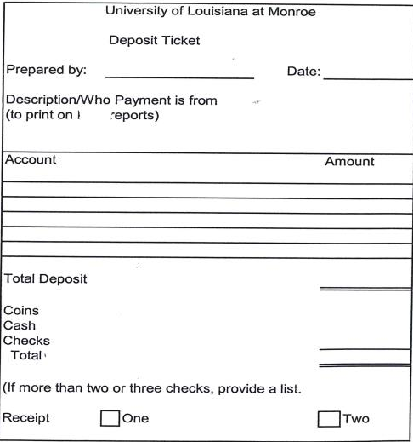

Slide 11
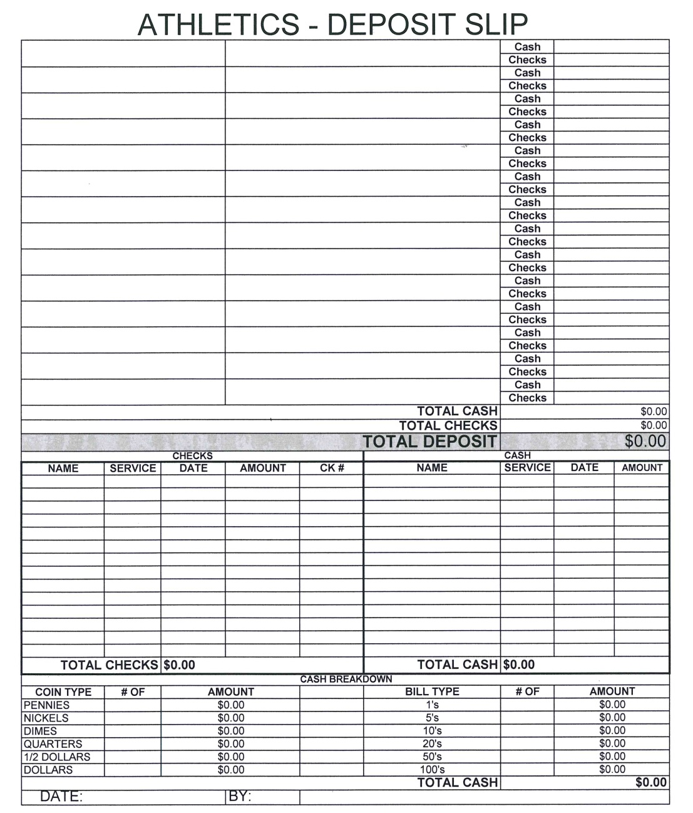

Slide 12
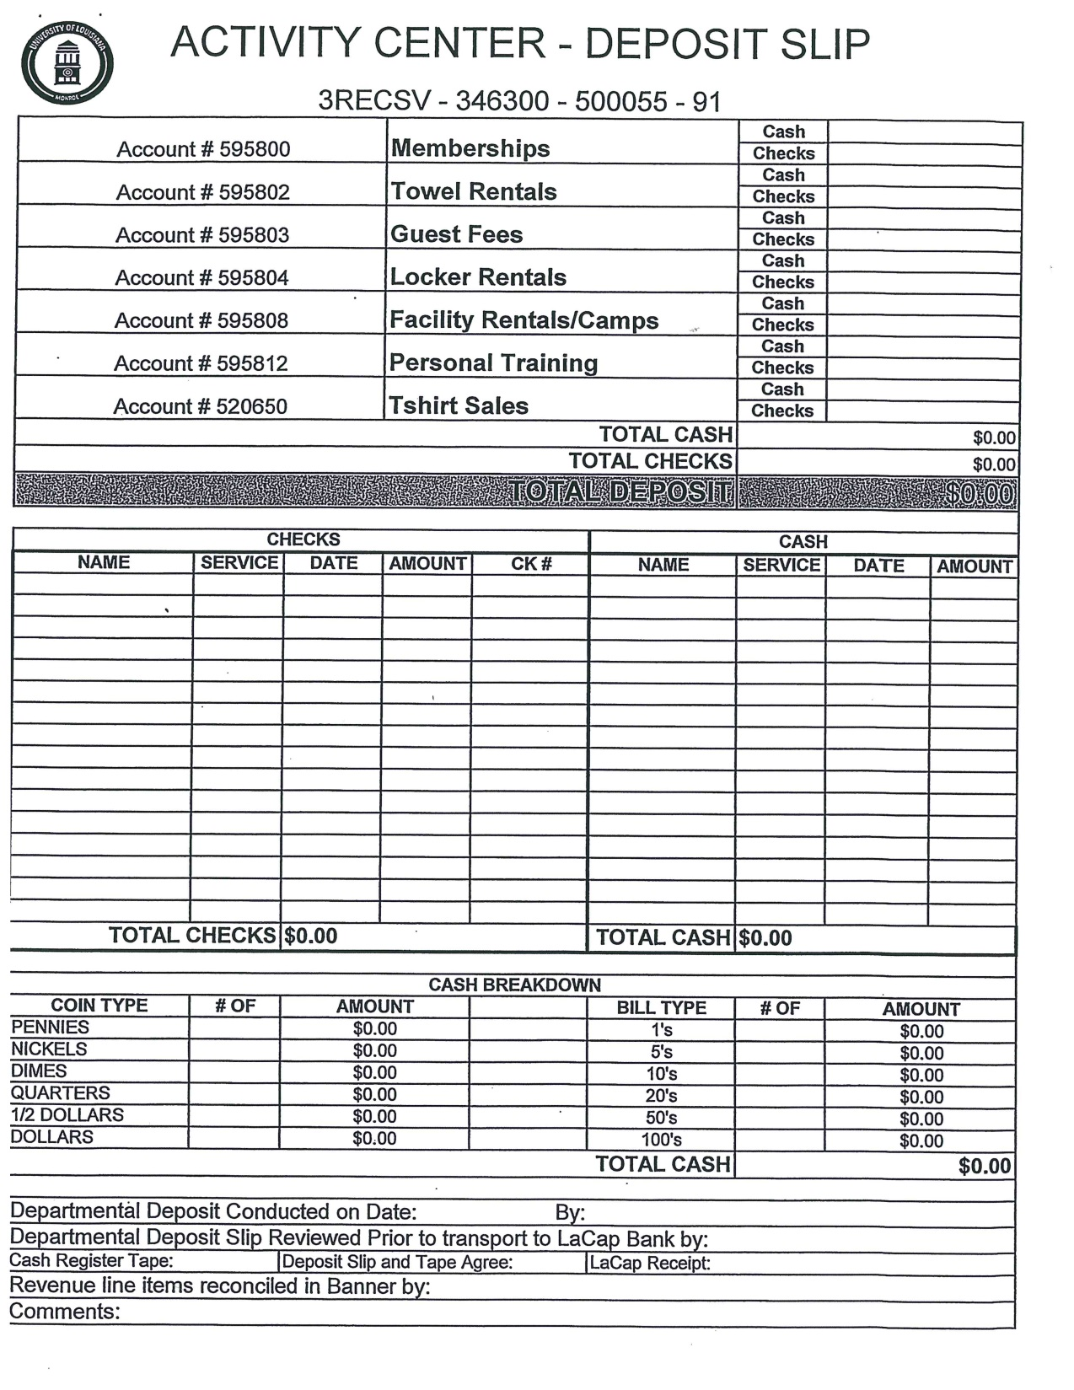

Slide 13
Departmental Procedures (cont’d)
The Cashier will verify that the deposit ticket total agrees with the cash received and stamp all copies of the ticket. One copy will be returned to the department and the Cashier will retain the original.
All cash received by departments must be supported by appropriate documentation as listed below:
  All deposits must be accompanied by departmental deposits
  Credit card transactions must be supported by the individual credit card sales receipts
  Any other documents which will help to ensure the proper documentation and coding of the funds should be included with the deposit
    This supporting documentation may include a copy of the check, computer printout, supporting spreadsheet or itemized list, reconciliation, internal memorandum, or letter from the payer
  The department must retain copies of supporting documentation, including any receipts issued to students or other customers

Slide 14
Departmental Procedures (cont’d)
When departments find discrepancies or have questions about their deposits, they should contact LaCap at (318) 342-5130 (if found the same day the deposit was made) or the Controller’s Office (if found after the date the deposit was made)
A department should immediately contact the appropriate Dean or Division Head if monies are found to be missing, or if there is suspicion of theft or diversion of funds
The Controller, University Police, and the Office of Internal Audit should be notified once the Dean or Division Head is aware

Slide 15
Cash Handling – Segregation of Duties
Departments handling cash should separate, to the extent possible, all duties relating to cash handling
A system of checks and balances should be established in which tasks are performed by different individuals to assure adequate controls
  For example: One person should prepare the deposits and a second person should review the department’s monthly ledger verifying the deposits
It is the department head’s responsibility to ensure that any amount deposited with LaCap includes all monies received
The department head or his designee should review the department’s account on a regular basis, but not less than monthly
The department head may access the departmental accounts and transactions online

Slide 16
Roles in the Cash Handling Process
Handling Cash – Individual who accepts cash payments, endorses checks, and issues a receipt
  This individual has access to cash
Preparing the Deposit – Individual counting the cash and preparing the departmental deposit form or the bank deposit form
  This individual has access to cash
Reconciling Receipts to Deposit – Individual comparing amount of cash collected based on register tape totals, manual receipt book total, or listing of cash receipts
Reviewing Departmental Deposit Form – Individual approving the departmental deposit form to ensure the individual preparing the deposit is different from the individual handling cash; this individual may not handle or have access to cash
Making Cash Deposit – Individuals making cash deposit at LaCap
  This individual has access to cash
Verifying Deposit in Banner – Individual comparing the departmental deposit form to the amount recorded in Banner

Slide 17
Examples of Segregation of Duties
3 Employees
 | Handling Cash | Preparing Deposit | Reconciling Receipts to Deposit | Reviewing Departmental Deposit Form | Making Cash Deposit | Verifying Deposit in Banner
Individual #1 | X |  |  |  | X
Individual #2 |  | X
Individual #3 |  |  | X | X |  | X
2 Employees
 | Handling Cash | Preparing Deposit | Reconciling Receipts to Deposit | Reviewing Departmental Deposit Form | Making Cash Deposit | Verifying Deposit in Banner
Individual #1 | X | X |  |  | X
Individual #2 |  |  | X | X |  | X

Slide 18
Returned Checks
Checks returned by the depository bank for non-sufficient funds (NSF), stop payments, or closed accounts result in additional service fees to the University
Students or staff whose checks are returned to the Controller’s Office for any of these reasons will be assessed a returned check fee has set by the Controller’s Office
Students or staff who have several returned checks may permanently lose their check writing privileges at the University
Each department is responsible, when appropriate, for collecting funds owed when checks they accepted are returned by the depository bank

Slide 19
Cash Handling Training
All employees, including student workers, who handle cash are required to complete cash handling training periodically
The departments designated as “cash collection centers” are responsible for notifying the Controller’s Office of any employees, including student workers, involved in the cash handling process
It is the responsibility of the cash collection centers to ensure that all employees involved in the cash handling process receive training

Slide 20
Controller’s Office Contact Information
Associate Controller – Keisha Chambless
kchambless@ulm.edu
#5104
Accounting & Reporting Analyst – Susan Clow
sclow@ulm.edu
#5122

