Slide 1

Accessibility in Documents​
(Overview and Best Practices)​

Slide 2

Intro and Background
Digital accessibility means making sure our websites, apps, and online content work for everyone, including people with disabilities.
June 9, 2025 – PPM 74 was revised based on the final rule issued by U.S. Department of Justice (DOJ), which establishes technical standards for web and mobile app accessibility under Title II of the Americans with Disabilities Act (ADA).
  PPM 74 refers to the Policy and Procedure Memorandum created to ensure people with disabilities can access online government services.
  Title II of the Americans with Disabilities Act (ADA) prohibits discrimination based on disability by state and local governments in all their services, programs, and activities.

Slide 3






Accessibility Standards
The Web Content Accessibility Guidelines (WCAG) 2.1 provide standards to define how to make web content more accessible to people with disabilities.
Accessibility involves a wide range of disabilities, including:
Vision
Hearing
Mobility
Speech
Cognitive
Neurological
Cataracts
Sun glare
Color Blind
Low vision
Blind
Noise
Ear Infection
Hard of Hearing
Deaf
Hands full
Broken arm
Spinal cord injury
Amelia
Ambient noise
Speech impediment
Unable to speak
Sleepy
Distraction
Migraine
Learning disabilities
Autism
Depression
PTSD
Bipolar
Anxiety

Slide 4
Why Accessibility Matters
Ensures equal access for people with disabilities
Impacts 28% of your residents​
It is a legal & ethical best practice
Benefits all users
  Clearer Structure, Better Navigation, Mobile-Friendly

Slide 5
Four Principles
WCAG 2.1 is built around four key principles that which lay the foundation necessary for anyone to access and use web content
  Perceivable – Information must be presented in ways users can perceive ​
  Operable – Users must be able to navigate and interact with content ​
  Understandable – Information and operation of the document must be clear and predictable​
  Robust – Content must be compatible with current and future assistive technologies​
If a document fails any one of these principles, it is not fully accessible.​

Slide 6
Perceivable
Text Alternatives: Alt text for all images, mark decorative ones​
Adaptable: Use semantic structure (headings, lists, tables, bookmarks)​
Use of Color: Don’t rely on color alone to convey meaning​
Contrast: Normal text 4.5:1, large text 3:1​
Reflow & Resize: Content reflows, text readable at 200% zoom​
Non-Text Contrast: Icons and graphics must meet contrast requirements​
Text Spacing: Document remains readable with adjusted spacing​

Slide 7
Operable
Keyboard Accessible: Navigation works with keyboard only​
No Keyboard Trap: Users can move focus freely (A text box in a form should let users tab out to the next field)​
Navigable: Use page titles, descriptive links, bookmarks​
Focus Visible: Ensure forms/buttons show visible focus​

Slide 8
Understandable
Language: Set document language in properties​
Readable: Use clear, plain language​
Predictable: Navigation consistent (TOC matches headings)​
Input Assistance: Label form fields, identify errors clearly​

Slide 9
Robust
Compatible: Use proper tagging and document standards​
Parsing: Ensure no broken/corrupted tags​
Metadata: Title, author, and subject fields filled​
OCR: Image-only PDFs converted with OCR (Optical Character Recognition)​

Slide 10
How Headings, Bookmarks, and Tags Work
Headers​
  Create the outline of a document (H1, H2, H3).​
  Screen readers let users “jump” by heading.​
  Example: Heading 1 = Title of Section; Heading 2 = Subtopic.​
Bookmarks​
  Digital navigation markers.​
  Act like a clickable Table of Contents.​
  Example: Bookmark → Introduction, Methods, Results, Conclusion.​
Tags​
  Invisible labels that define structure (heading, paragraph, list, table, image).​
  Establish the reading order and preserve relationships.​
  Examples:​
    <H1> = Heading 1​
    <P> = Paragraph​
    <L> = List​
    <Figure> = Image (with alt text)​
    <Table> = Table with headers​
Together, these elements are the blueprint for an accessible document. They give it structure, navigation, and meaning.​

Slide 11
Headers, Bookmarks, and Tags
Word​
  Uses built-in styles (Heading 1, Heading 2, Lists, Tables).​
  These become tags when exported to PDF.​
  Bookmarks can be added for navigation.​
PowerPoint​
  Relies on slide titles as headings.​
  Reading order pane controls tag order.​
  Tags and bookmarks are created on export to PDF.​
Excel​
  Uses header rows, column titles, and sheet names as structure.​
  If exported to PDF, these map into tags.​
PDFs​
  Contain a full tag tree (headings, paragraphs, lists, tables, images).​
  Bookmarks act as a clickable table of contents.​
  Without tags or OCR, PDFs are unreadable to screen readers.​
Each format handles accessibility differently, but the goal is the same: clear structure, logical navigation, and usable reading order.​

Slide 12
Descriptive Links
What they are​
  Links should clearly describe the destination or action.​
  Screen readers can pull up a list of all links in a document, so context must be clear without surrounding text.​
    “Click here“ or "Read more" are meaningless out of context​
Best Practices​
  Make link text descriptive and specific.​
  Avoid vague phrases.​
  Ensure links are underlined or otherwise visually distinct (not just color).​
  Accessibility checkers often do not check for descriptive links so check your work carefully!​
Examples:​
  Non-descriptive link: https://www.uno.edu/cti/teaching-learning/accessibility​
  Non-descriptive link: Looking for UNO’s faculty accessibility website? Click here!​
  Descriptive link: Check out UNO’s faculty accessibility website.​

Slide 13
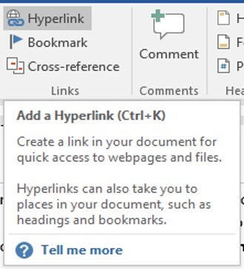
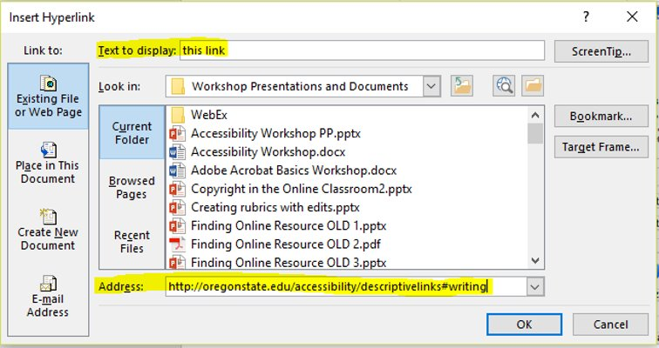
How to add Descriptive Links

Slide 14
Alt Text
What is it​
  Alternative text (“alt text”) is a short description that conveys the meaning of an image to users who cannot see it.​
  Screen readers read this description aloud in place of the image.​
Best Practices​
  Be concise but descriptive: explain the purpose, not every detail.​
    Example: “Bar chart showing enrollment rising from 2020 to 2025.”​
  Avoid redundancy: don’t say “Image of” or “Picture of.”​
  Mark decorative images as decorative (null alt text).​
  For complex images (charts, diagrams), include a longer text explanation in the body or appendix.​

Slide 15
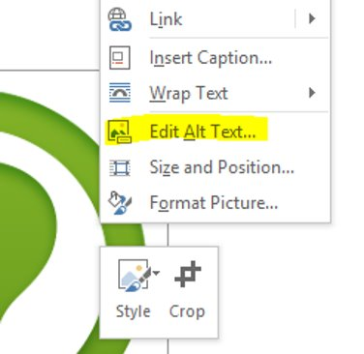
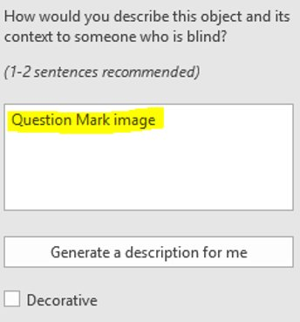
How to add Alt Text

Slide 16
Do tables need Alt text?
Simple Tables​
  Tables usually don’t need alt text if they are properly tagged and interactive.​
  Screen readers announce the structure: “Table with 3 columns and 4 rows … Column 1 header … Row 2 …”​
  The most important thing is to define header rows/columns correctly.​
Complex Tables​
  If a table conveys complex information (e.g., multi-level headers, nested rows), provide a summary or description in the surrounding text.​
  Example: “This table shows student enrollment trends by year and program.”​
Images of Tables​
  If a table is included as an image, then it needs alt text or a text version provided elsewhere in the document.​

Slide 17
Color Contrast
What it is​
  The difference in brightness between text (or graphics) and its background.​
  Ensures readability for people with low vision or color blindness.​
WCAG 2.1 AA Requirements​
  Normal text: 4.5:1 contrast ratio.​
  Large text (18pt+, or 14pt bold): 3:1 ratio.​
  Non-text elements (icons, controls): must also meet contrast requirements.​
Best Practices​
  Don’t use color alone to show meaning (e.g., “items in red are required”).​
  Test with free tools: WebAIM Contrast Checker, Color Contrast Analyzer (CCA).​
  Use high-contrast color combinations (e.g., dark text on light background).​

Slide 18
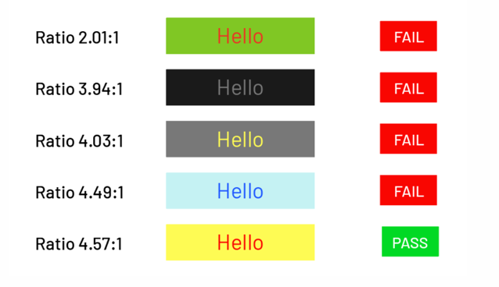
Examples of Color Contrast

Slide 19
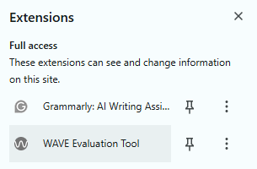
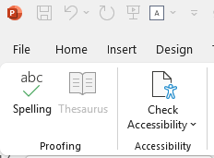
Free tools for testing Accessibility
Free Screen Readers:​
  NVDA (Windows) – nvaccess.org​
  VoiceOver (built into macOS/iOS)​
  Narrator (built into Windows)​
Free Accessibility Checkers:​
  Microsoft Office Accessibility Checkers​
  WAVE (for online docs) ​
  PDF Accessibility Checker – PAC (Windows only)​

Slide 20
WCAG 2.1 AA Document Accessibility Checklist​
✓ Headings: Built-in H1, H2, H3 styles​
✓ Alt Text: All images, charts, figures​
✓ Links: Descriptive (not 'click here')​
✓ Lists: Properly tagged​
✓ Tables: Tagged headers, simple layout​
✓ Bookmarks/TOC: For navigation​
✓ Color Contrast: Meets 4.5:1 or 3:1​
✓ Language: Declared in properties​
✓ Metadata: Title, author, subject set​
✓ Forms: Labels and instructions clear​
✓ OCR: No image-only PDFs​
✓ Accessibility Check: Microsoft/Adobe/WAVE​

Slide 21
ADA Resources
Accessibility Checker​
WebAIM Color Contrast Checker​
Free AI Image Alt Text Generator​
Office of Technology Service Guide to Accessible Web Services​
Pelican: Louisiana’s Design System

Slide 22
University of Louisiana System

Slide 23
Questions?
Contact:
Alyssa Coats
UL System, Web Accessibility Coordinator
alyssa.coats@ulsystem.edu

