Slide 1

Accessible Media​
(Overview and Best Practices)​

Slide 2

Today’s Session Overview
What we mean by “Media”
ADA and WCAG guidelines for multimedia
Four key Principles
Best practices for:
Color contrast and visual design for readability
Images and alt text for visual content
Captions, transcripts, and audio descriptions

Slide 3
What we mean by “Media”
While document accessibility ensures text-based content can be understood by assistive technology, media accessibility ensures audio-visual content can also be perceived, heard/seen, and operated in an equivalent way.
Media:
Is time-based and/or sensory-dependent
May have motion, so timing matters
May have sound, so text equivalents are required
May show visual meaning, so descriptions may be needed
May use controls, so players must be keyboard-operable

Slide 4
Media Includes:
Images
Static images, GIFs, and animated images
Images in LMS pages
Video lectures, recorded classes, lab demonstration videos, or teaching materials
Screencasts, tutorials, narrated PowerPoints, Panopto, Zoom/Teams recordings
Podcasts, audio assignments, interviews
Movies, documentaries or YouTube/Vimeo clips
Interactive objects
H5P or Storyline interactive objects
VR/AR experiences
Simulations and multimedia quizzes
If the student must watch, listen, or control playback, it is treated as media for WCAG and ADA compliance.

Slide 5
Accessibility Standards
ADA Title II: Requires equal access to digital communication
Section 508: Applies to federally funded entities and digital systems
WCAG 2.1 Guidelines: Industry standard for digital accessibility
Perceivable – Information must be presented in ways users can perceive ​
Operable – Users must be able to navigate and interact with content ​
Understandable – Information and operation of the document must be clear and predictable​
Robust – Content must be compatible with current and future assistive technologies​

Slide 6
Perceivable
Everyone can access the information in the media, even if they cannot hear it or see it.
Describe Visuals: Using alternate text for images and audio descriptions for videos​
Text to Read: Alt text, captions, and transcripts​
Use of Color: Don’t rely on color alone to convey meaning​
Contrast: Ensure sufficient contrast for images, charts, and visuals​
Spacing: Media and images leave enough space on the page for easy recognition​

Slide 7
Operable
Users can control the media using different input methods, not just a mouse.
Keyboard Accessible: All media player controls must be keyboard accessible with no keyboard traps
No Autoplay with Audio: Autoplay can interfere with screen readers
Focus Indicators: Users must be able to see where they are on the player when tabbing

Slide 8
Understandable
Users can easily follow the content and know how to interact with the media.
Identifiable: Captions must identify speakers
Synchronized: Captions must be synchronized
Accurate: Captions must be accurate​
Logical: Transcripts and visuals must follow logical order ​
Clear Controls: Media player controls must be clearly labeled (e.g., “Play,” not a vague unlabeled icon)

Slide 9
Robust
Assistive technologies can interpret the media consistently.
Compatible: Use machine-readable text for captions and transcripts so they can be detected by screen readers ​
Standard players and formats: Use standard formats that work with assistive technology
Readable: Avoid text baked into images, as screen readers will not detect them

Slide 10
Color and Contrast in Images
Text on Images
If you place text on a photo or video, you must ensure the text stands out.
If text is baked-into the image or video, you will need alt-text or an audio description for this text, as well.
Charts and Graphs
Never rely on color alone to differentiate data.
Pair color with patterns, labels, or line styles.
Ensure each line/bar/segment meets 3:1 contrast against the background.
Icons and Buttons
Playback buttons, pause icons, or CC toggles must be visible against backgrounds.
Media players must meet non-text contrast requirements.

Slide 11
Why Color Contrast Matters
Good contrast ensures that:
People with low vision can read and interpret information
Users with colorblindness can differentiate elements
Mobile users in bright lighting can still see the content
Charts, diagrams, and images remain understandable to everyone
Poor contrast is one of the most common accessibility failures in documents, LMS pages, videos, and lecture slides.

Slide 12
Alternative Text for Images
Alt text: Short, written description that conveys the purpose and meaning of an image to users who cannot see it.
Alt text is required for all informative or functional images in accessible media and digital content.
A screen reader reads the alt text aloud, allowing users to understand what the image communicates.
Images that do not communicate meaning can be marked as decorative.
This applies to images in:
LMS pages
Documents (slides, Word, Excel, .pdfs)
Websites
Infographics
Embedded images in video or media players (when relevant)

Slide 13
Why Alt Text Matters
Alt text ensures that:
Blind and low-vision users receive the same information as sighted users
Screen reader users can navigate content efficiently
Images used in instruction, assessment, or navigation are accessible
Users with slow internet or blocked images can still understand the content
Without alt text, images become “invisible” to assistive technology.

Slide 14
Captions
Captions: Synchronized on-screen text that represents all meaningful audio content in a video.
This includes:
Spoken dialogue
Speaker identification (when needed)
Meaningful sound effects (e.g., [laughter], [door slams])
Important background audio cues (e.g., [dramatic music])
Captions are designed to be read while the video plays and must be timed to match the audio.

Slide 15
Why Captions Matter
Captions ensure equal access for:
Deaf and hard-of-hearing users
English language learners
Learners in noisy or silent environments
Anyone who benefits from reading along
When are captions required?
Captions are not optional for accessible video content.
Required for all prerecorded video with sound
Required for live media

Slide 16
Transcripts
Transcript: Text document that includes all spoken words and meaningful sounds from audio or video.
It may also include brief visual descriptions when needed.
Unlike captions, a transcript is not synchronized with the media.

Slide 17
Why Transcripts Matter
Transcripts provide access for:
Deaf, hard-of-hearing, and deafblind users
Screen reader users
Learners who want to search, highlight, or annotate
Users with low bandwidth or no audio/video playback
Students who prefer to read instead of watch
When are transcripts required?
Pre-recorded audio-only
Strongly recommended for all video, even though captions cover synchronizing needs

Slide 18
Audio Descriptions
Audio descriptions (sometimes called video descriptions or AD): Narrated descriptions of key visual information in a video.
Audio descriptions communicate things like:
Actions, movements, and gestures
On-screen text and titles
Scene changes, settings, and visual context
Facial expressions or visual tone
Diagrams, charts, or visual demonstrations
If a sighted viewer needs the visual information to understand the content, an audio description provides that same access non-visually.

Slide 19
Why Audio Descriptions Matter
Without audio descriptions, these learners miss content that sighted viewers take for granted.
Audio descriptions ensure full access for:
Blind and low-vision learners
Deafblind users (when paired with transcripts)
Screen-reader users viewing videos
Anyone listening without the screen visible
When are audio descriptions required?
In videos when visuals are essential to meaning
If visual information is teaching something, showing steps, or conveying data, audio description is required.

Slide 20
Free tools for testing Accessibility
Free Color and Contrast Checkers:​
WebAIM Contrast Checker
Adobe Color Contrast Tool
TPGi Colour Contrast Analyzer
Free Accessibility Checkers
Microsoft Office Accessibility Checkers​
WAVE (for online docs and media players) ​
PDF Accessibility Checker – PAC (Windows only)
LMS accessibility checkers

Slide 21
WCAG 2.1 AA Media Accessibility Checklist​
✓ Color Contrast: Text meets 4.5:1 (normal) or 3:1 (large) contrast
✓ Non-Text Contrast: Icons, controls, and key visuals meet 3:1 contrast
✓ No Color-Only Meaning: Charts, diagrams, and states use labels, shapes, or patterns—not just color
✓ Clear On-Screen Text: Avoid text baked into images without alternatives
✓ Alt Text: Provided for meaningful images, diagrams, and screenshots
✓ Decorative Images: Mark with empty alt text (alt=””) or ignore in player ✓ Complex Visuals: Provide text summaries for charts, graphs, or infographics
✓ Captions (Prerecorded): Accurate, synchronized dialogue + meaningful sounds ✓ Captions (Live): Real-time captions for livestreamed events
✓ Transcripts: Full text alternative for all audio-only content
✓ Transcript Recommended for Video: Supports search, study, and deafblind access
✓ Audio Descriptions: Narrate essential visual info (actions, text, data, demos) when visuals convey meaning ✓ Accessible Media Player: Keyboard operable, labeled controls, visible focus
✓ No Autoplay with Sound: Avoid auto-start; it interferes with screen readers
✓ Test with Assistive Tech: Check with keyboard only, captions on/off, and a screen reader

Slide 22
Images, Color, and Design Rules​
(Overview and Best Practices)​

Slide 23
Use of Color
Color blindness
1 in 12 men (8%)
1 in 200 women (0.5%)
Most common type: red-green
Can confuse any colors that have red or green in them, so colors such as purple and blue can be difficult to distinguish

Slide 24
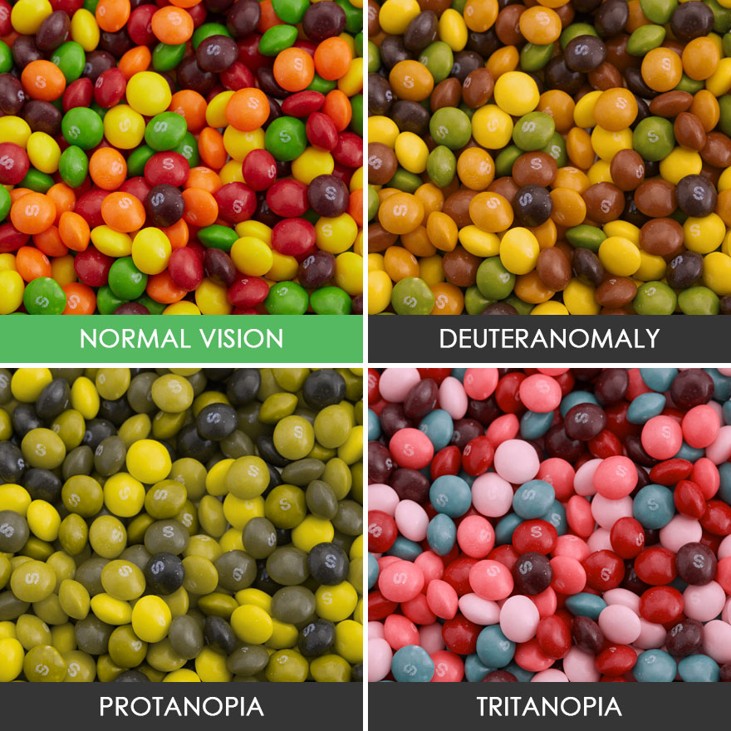
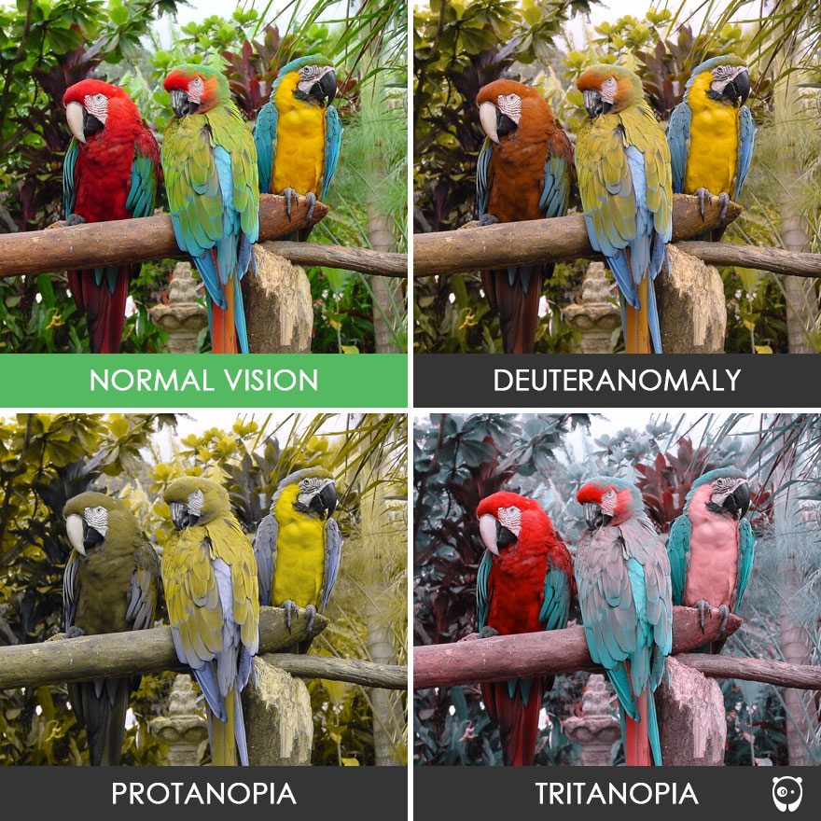
Types of Color Blindness

Slide 25
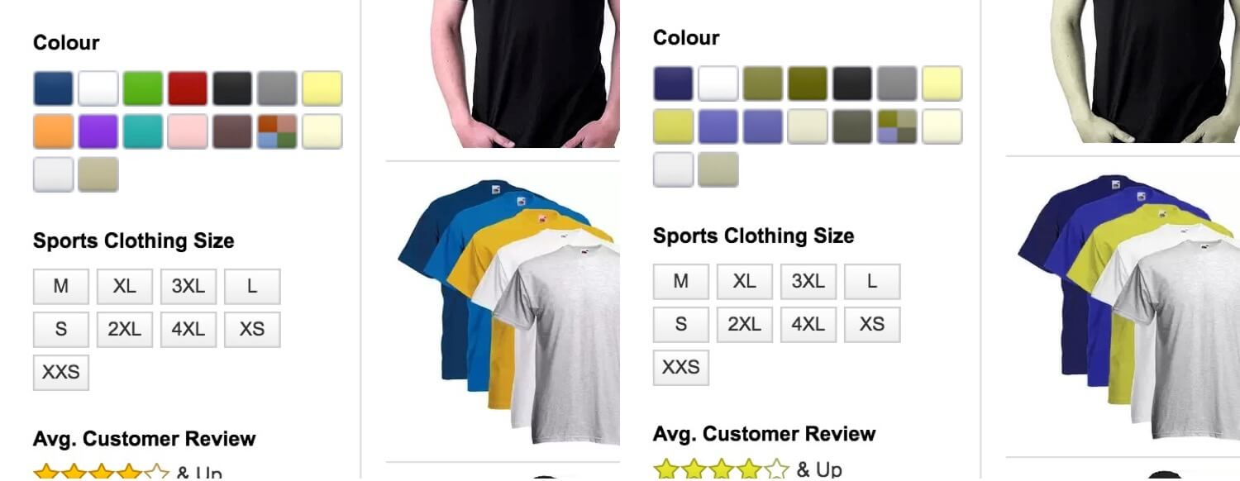
Types of Color Blindness
An Amazon listing using a filter simulating Protanopia (red-green color blindness)

Slide 26

Color Combinations to Avoid
Avoid high value complimentary colors. (green/red, green/brown, blue/purple, green/yellow, etc)
Green/Red
Green/Brown
Blue/Purple
Green/Yellow
On the right, how those may appear to individuals with color blindness.

Slide 27
Color Contrast Standards
Contrast ratio: measure of difference in brightness
1:1 = same color; 21:1 highest possible
Most text and images: Contrast ratio of 4.5: 1
Large scale (min 18 pt or 14 pt bold) text: Contrast ratio minimum 3:1
Graphs and charts: 3:1
Accessibility checker will flag
Contrast checker:
WebAIM

Slide 28
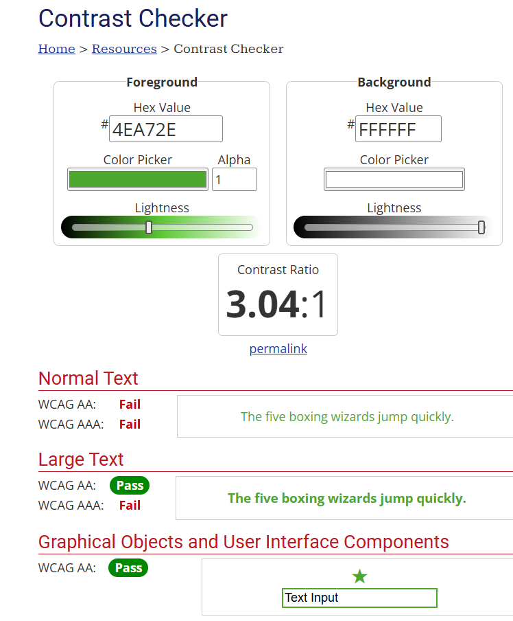
WebAim Color Contrast Checker
WCAG: Minimum 4.5:1 for regular text and 3:1 for large text

Slide 29
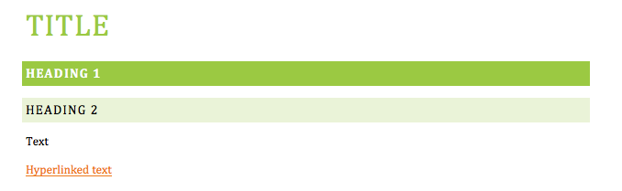
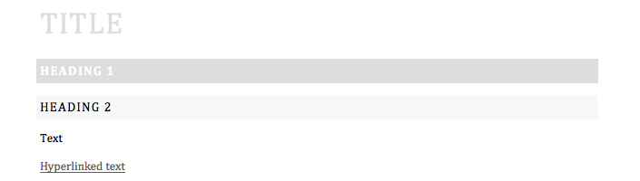
Contrast Examples

Slide 30


Graphics with Low Contrast
Content difficult to distinguish from background

Slide 31


Avoid Busy Backgrounds behind Text

Slide 32
Color Alone to Denote Meaning
Example: Group one in red; group two in green
DON’T:
Emily
Jarrod
Stephanie
Danielle
Brian
Melanie
BETTER:
Group 1
Emily
Stephanie
Brian
Group 2
Jarrod
Danielle
Melanie
Emily (Group 1)
Jarrod (Group 2)
Stephanie (Group 1)
Danielle (Group 2)
Brian (Group 1)
Melanie (Group 2)

Slide 33
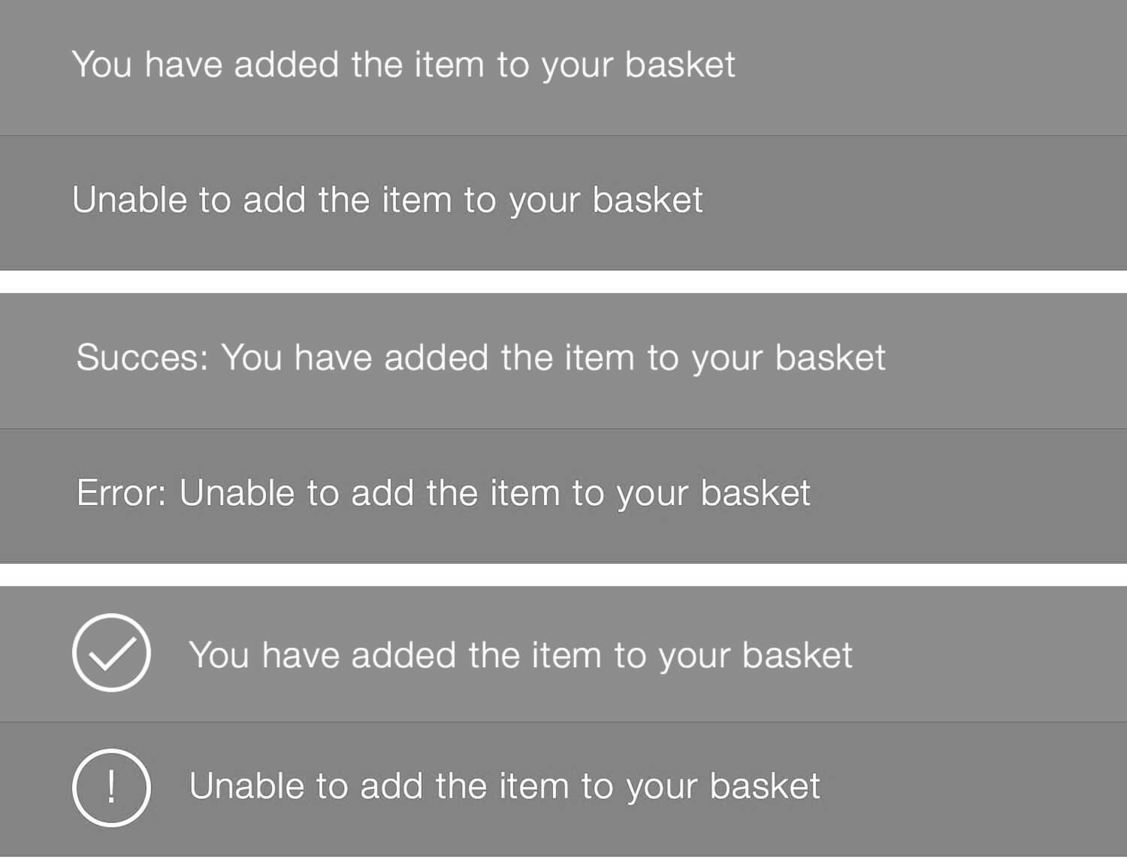
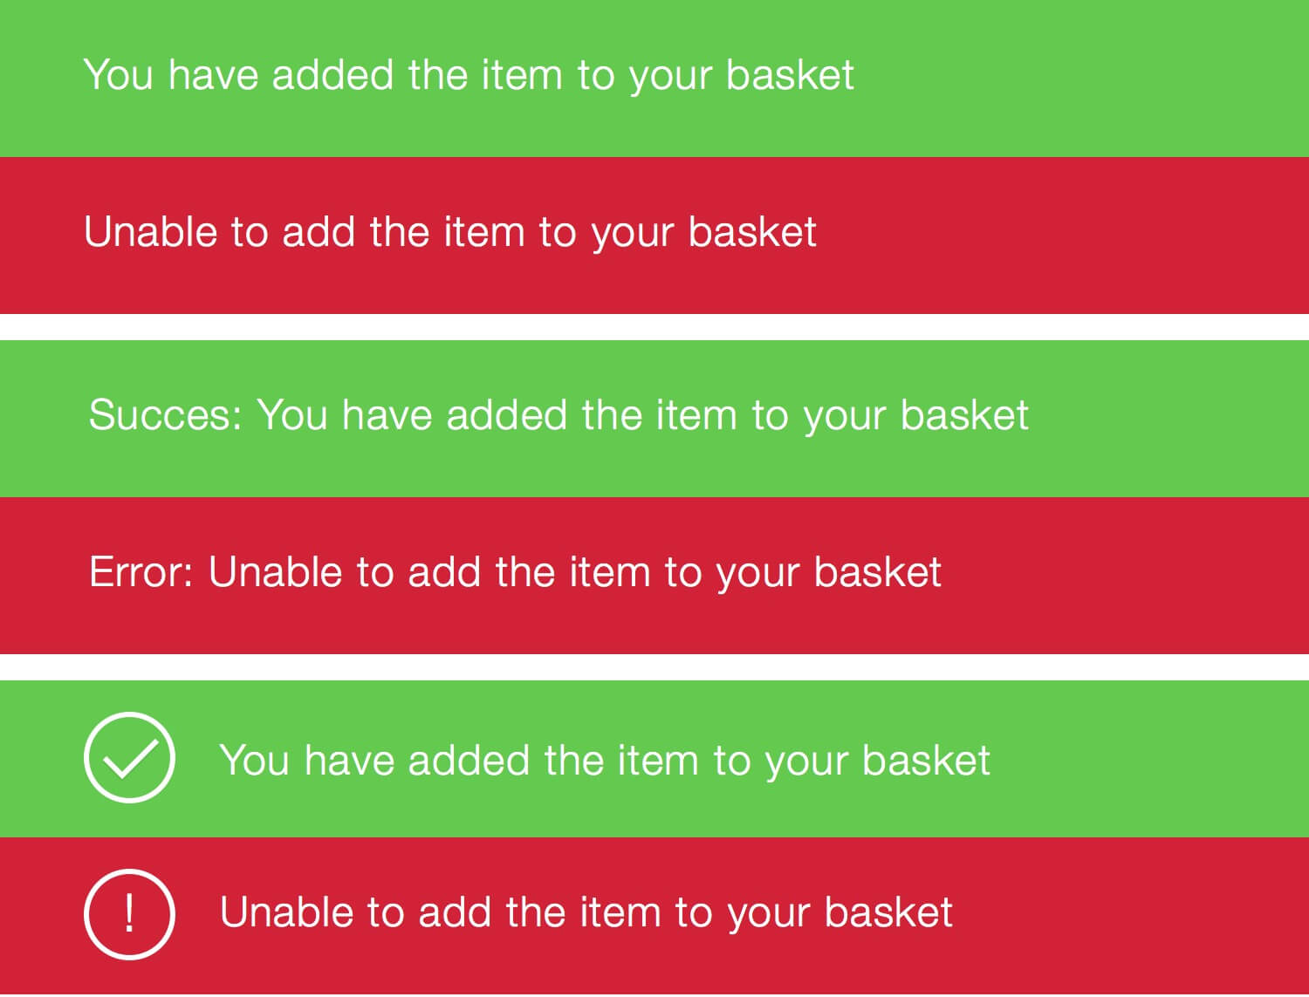
Add Descriptions if Using Color
Include a brief description along with color differentiation.

Slide 34
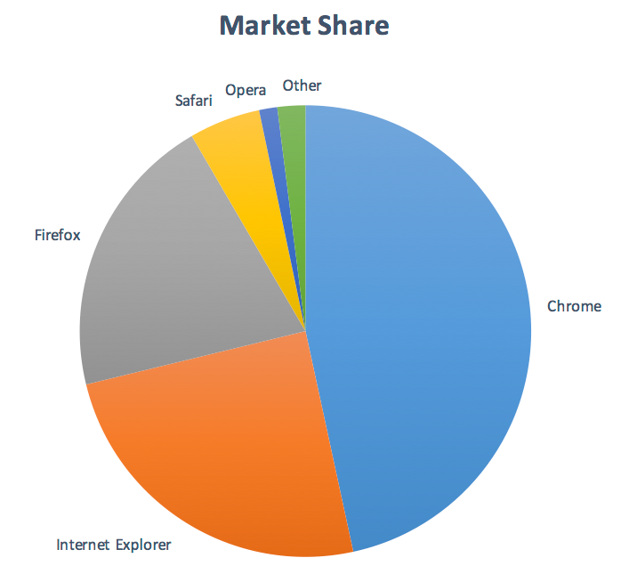
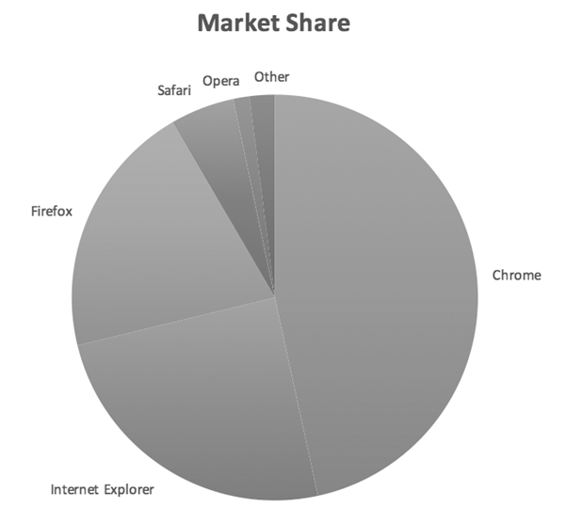
Contrast (Chart)
Make sure colors within a graphic have adequate contrast.
Example of contrast too low; difficult to see edges

Slide 35
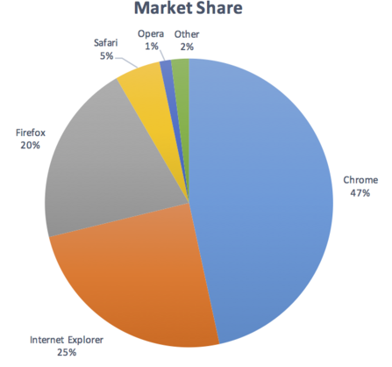
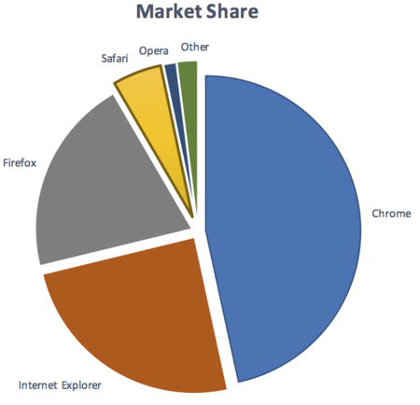
Contrast (Chart) Add Labels
Add callouts or labels to the chart.
Adding callouts with labels and percentages makes this chart more understandable
On the right- Adding more contrast between the sections can also help show the differences.

Slide 36
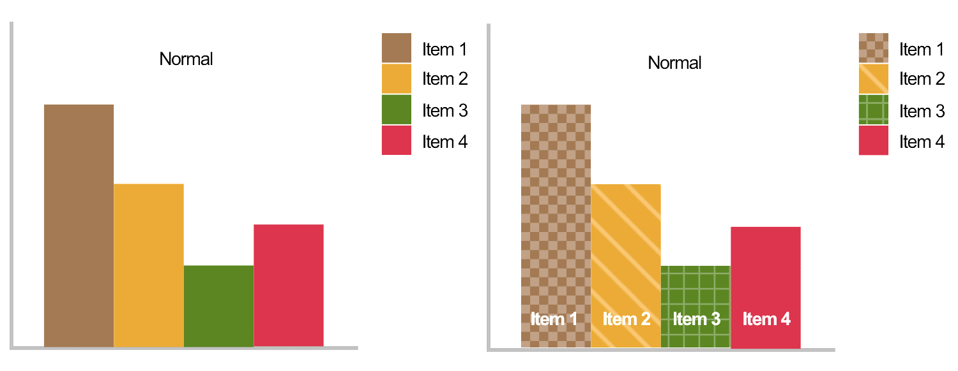
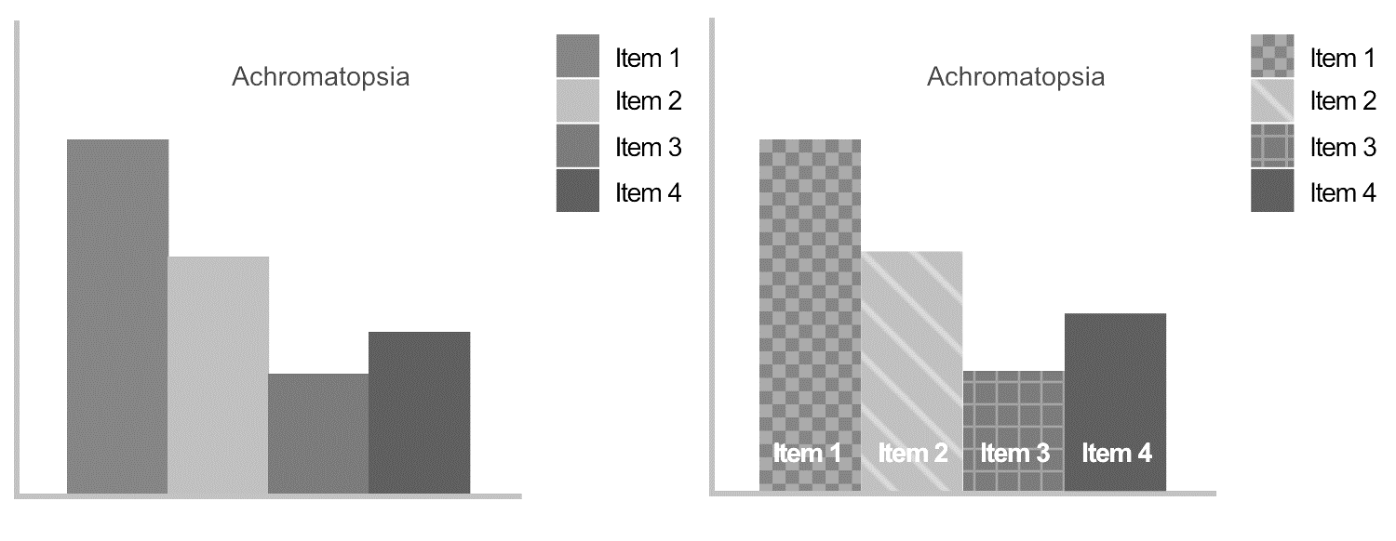
Graphs
Label items
Use shapes and patterns when possible

Slide 37
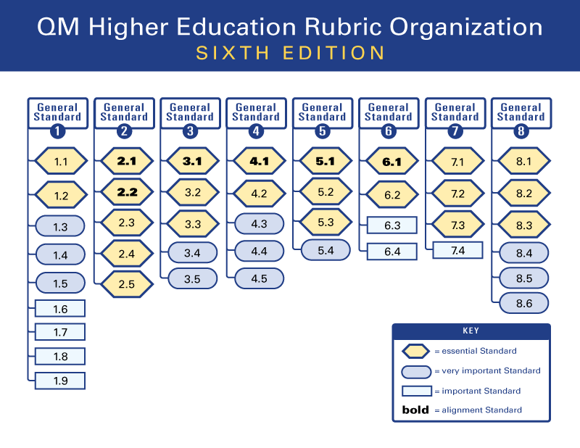
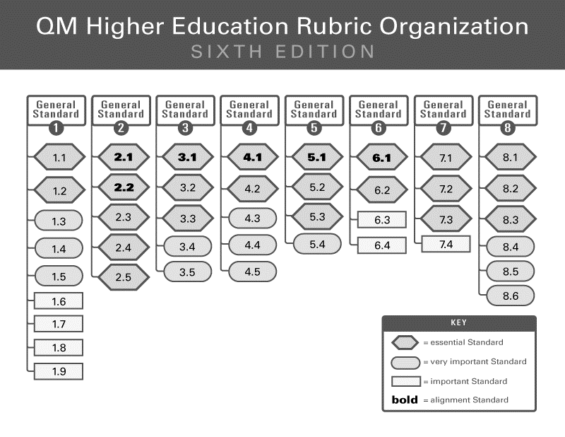
Example

Slide 38
Color & Design Rules Resources
Tools to help you design with colorblindness in mind:
A great explanation of color font ratios.
WebAim’s color contrast checker: provide two colors to see if they pass accessibility guidelines.
Color Oracle: a color blindness simulator for Windows, Mac and Linux, showing you what people with common color vision impairments will see.

Slide 39
Alt Text​
(Overview and Best Practices)​

Slide 40
What Is Alt Text?
Alt text is a written substitute for meaningful image content.
Read aloud by screen readers for blind/low-vision users
Required by WCAG 1.1.1 Non-Text Content
Goal: provide the same meaning, not the same visual detail

Slide 41
When Do You Use Alt Text?
Use alt text when an image:
Conveys information (charts, diagrams, screenshots, labels)
Supports instruction or is referenced in the content
Identifies a person, place, or object
Functions as a link or button
Example: alt="Download syllabus“
If you remove the image, does the user lose meaning? If yes, alt text is required.

Slide 42
How to Write Good Alt Text
Be concise and specific (aim for ≤ 125 characters or one/two sentences.)
Focus on purpose, not appearance
Don’t start with “Image of…” or “Picture of…”
Describe meaning, not style

Slide 43
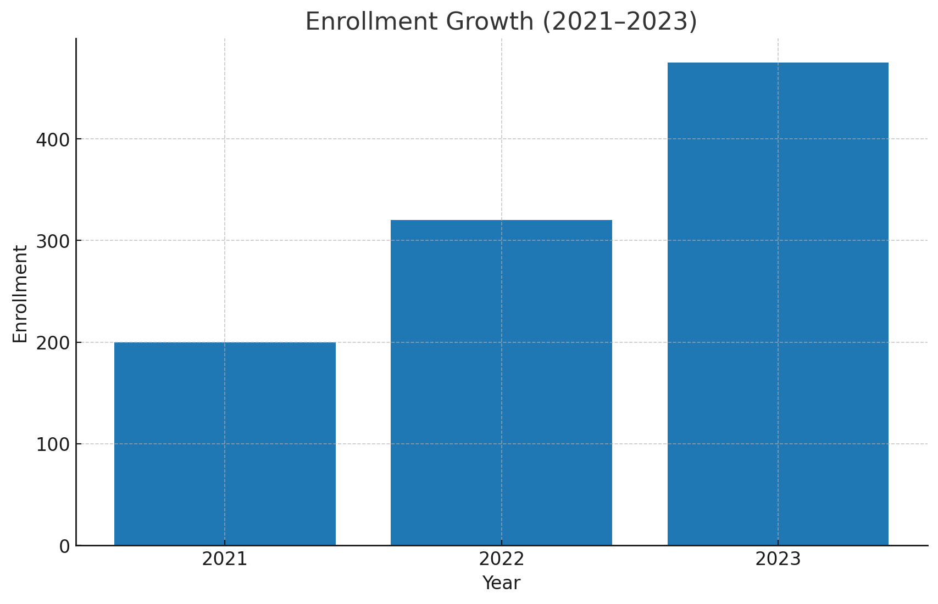
Alt Text – Chart Example
The image of a blue bar chart with three tall bars.

Slide 44
Alt Text – Chart Example
The image of a blue bar chart with three tall bars.
Bar chart showing enrollment rising from 200 to 475 from 2021 to 2023.

Slide 45

Alt Text – Image Example
A lake with mountains and trees

Slide 46
Alt Text – Image Example
A lake with mountains and trees
Snowy mountains glow at sunrise above a still lake and dark evergreens as pink clouds drift across a clear, peaceful sky.

Slide 47
When Alt Text Isn’t Enough (Long Descriptions)
For complex visuals (e.g., infographics, maps, detailed charts):
Give a short alt text and long description elsewhere
Long descriptions can go:
In surrounding text
In a figure caption
On a separate linked page/accordion
Rule:
Alt text = summary of meaning
Long description = details and data

Slide 48
Context Matters
Alt text should answer “What does a sighted user gain from this image right here that a non-sighted user also needs?”
Questions that shape how you write alt text contextually:
Why is the image here?
What information does it add?
What should the viewer learn or notice from it?
If the purpose changes, the alt text must change too, even if the image stays the same.

Slide 49

Context Matters – Example
Biology Lesson
A Brown Pelican perched on a piling, showing its long bill.
Marketing Poster
A pelican perched on a piling at sunset along the calm, Louisiana coast.

Slide 50
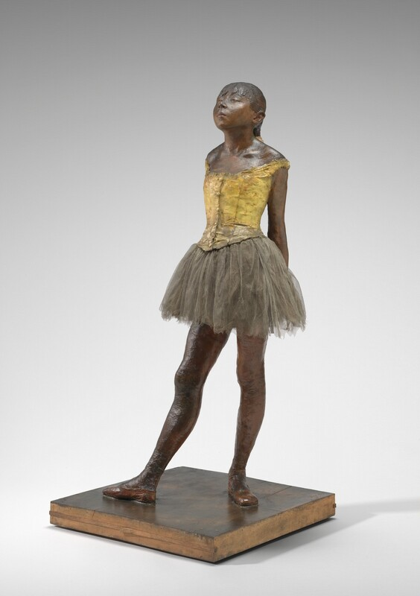
Context Matters – Example
Dance Textbook
Degas’ 1881 sculpture Little Dancer Aged Fourteen
Art History Quiz
A bronze statue of a girl in a tutu, hands behind her back, face upturned.

Slide 51
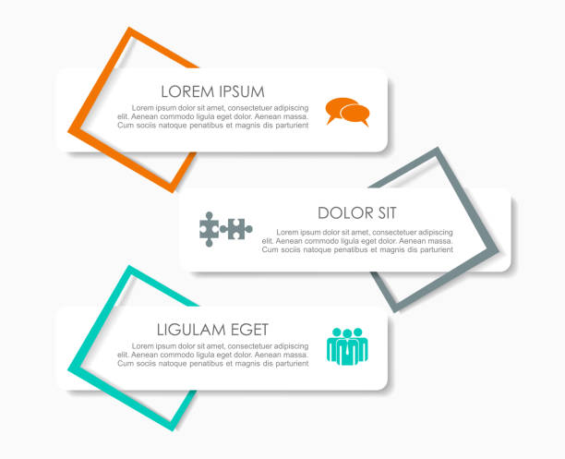
Decorative Images
Decorative images add visual interest but do not convey meaning.
Decorative images use empty alt text (alt=""). Many programs achieve this by allowing you to “mark as decorative.”
Examples
Background images or textures
Stock photos used only for “mood”
Clip art or icons used only for decoration
Campus/scenery photos not discussed in content
Logos used only for branding
Divider images or decorative bullets

Slide 52


Special Cases
Icons: describe function
(e.g., “More information”)
Screenshots: Explain what matters, not every pixel
Logos: Identify organization or logo
(e.g., “University of New Orleans logo”)
Text in images: Repeat the visible text in the alt text

Slide 53
Automated Alt Text
Many platforms (Microsoft, Google) can use AI to guess a short description for an image.
It’s a starting point, not a finish line. Always check auto-generated alt-text!
When auto-alt sometimes gets it right:
Simple, literal photos used for light illustration.
Non-critical visuals where a small error won’t affect learning.
Decorative images you’ll immediately mark as decorative.
When auto-alt is not enough:
Instructional images tied to outcomes (“identify beam stress points”).
Charts/graphs/infographics (require a main takeaway + often a long description or data summary).
Screenshots with text/UI (repeat the key text/action; don’t describe pixels).
Functional icons/links (must describe action: e.g., “Download syllabus”).

Slide 54
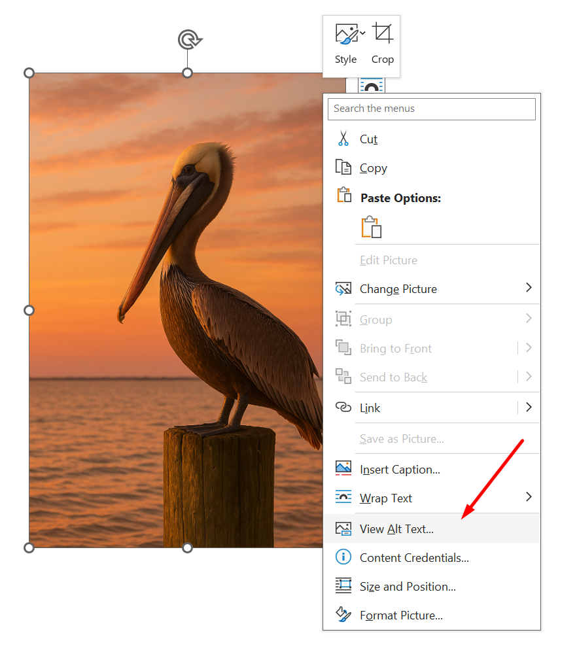
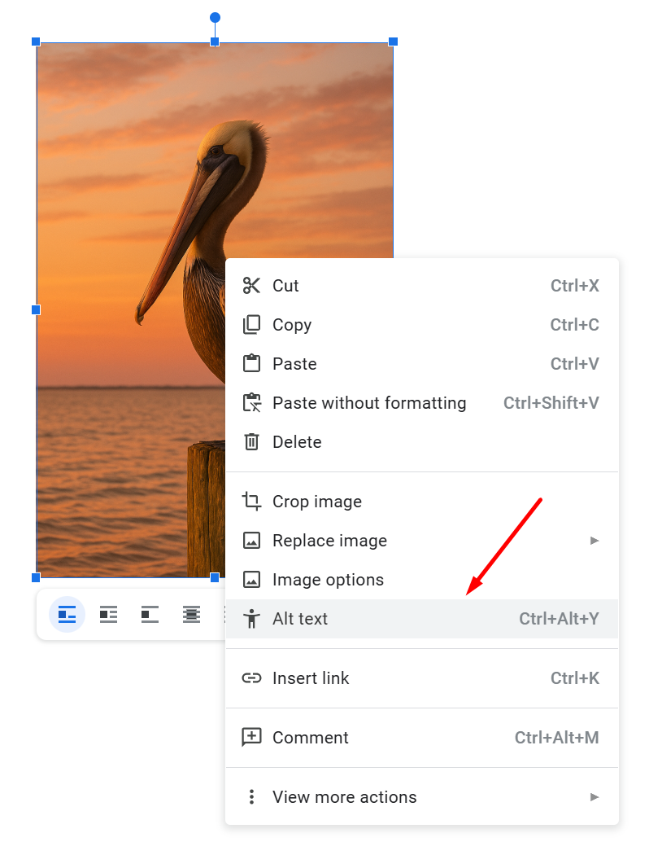
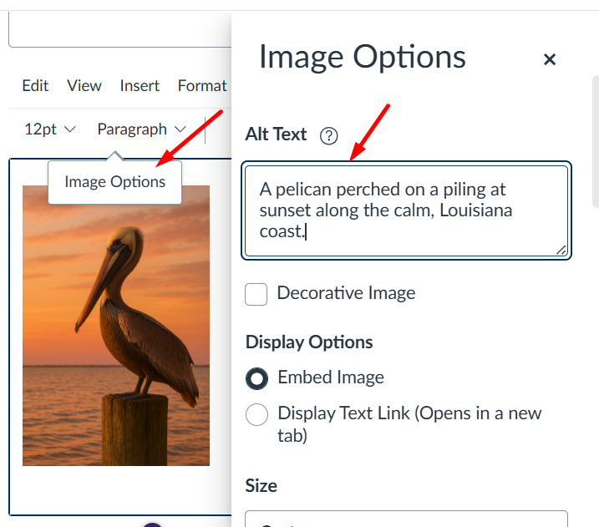
How Do I Add Alt Text
Click or right click/ctrl click/cmd click on images in nearly any software to find the alt text option!
Right-click image in Word
Right-click image in Google Docs
Click image (“Image options”) in Canvas

Slide 55
Key Takeaways
If it has meaning, describe it.
If it's decorative, hide it.
Context matters.
Keep alt text short and purpose-focused.
Use long descriptions for complex images.

Slide 56
Captions
(Overview and Best Practices)​

Slide 57
What Are Captions?
On-screen, synchronized text of speech and meaningful sounds
Enables real-time comprehension while watching
Includes:
Dialogue
Speaker identification (when unclear)
Meaningful sound effects ([laughter], [door slams])
Required for both pre-recorded and live videos.
Required even if you did not create the video.
Key Idea: Captions = equivalent viewing experience

Slide 58
What Are Transcripts?
Text alternative for media content
Contains all spoken words and sound cues
Not synchronized; can be read independently
Required for pre-recorded audio-only or video-only
Supports:
Screen readers
Deafblind access
Low bandwidth situations
Study, search, and note-taking
Key Idea: Transcripts = flexible, study-friendly access

Slide 59
Captions vs. Transcripts
Feature | Captions | Transcript
Format | On-screen text | Stand-alone text
Sync w/ Audio | ✅ | ❌
Best For | Watching | Reviewing
Rule of Thumb:
Captions = during playback for video with synced audio
Transcripts = before/after playback or during playback with audio that does not have video

Slide 60
When To Use Captions vs. Transcripts
Media Type | Captions | Transcript
Audio-only (podcast) | ❌ | ✅
Video with speech | ✅ | Recommended
Video-only (silent) | ❌ | ✅
Live stream | ✅ (live captions) | Post-transcript recommended
Instructional video | ✅ | Recommended

Slide 61
Auto-Captioning & Auto-Transcripts
Auto tools (YouTube, Panopto, Zoom, Teams, Google, etc.)
Pros:
Fast first draft
Increases baseline accessibility
Limitations:
Inaccurate with:
Accents
Names/technical terms
Multiple speakers
Missing or incorrect punctuation
Often fails to identify speakers
Does NOT meet WCAG unless edited for accuracy
Auto-captions are a starting point. They must be edited for compliance.

Slide 62
Expectations
Captions and transcripts should be:
Accurate
Synchronized (Captions)
Complete
Speaker-clear
Include meaningful sounds
Accuracy Checklist:
Names
Homophones
Technical terms
Speaker labels
Punctuation and capitalization

Slide 63
Best Practices
Captions
Break into short readable chunks
Use sentence case, not ALL CAPS
Minimum 1 second per caption, max 2 lines
Include sound cues only when meaningful
Transcripts
Match spoken order
Include sound cues only when meaningful
Technical terms
Identify speakers when helpful
Add visual descriptions for video-only action or scenes

Slide 64
Tools for Captioning & Transcription
YouTube Studio (upload captions; automated captions; edit captions)
Google Drive (upload captions; automated captions; edit captions)
Zoom (live auto-captioning; recorded captions and transcripts; edit transcript/captions)
Teams/Clipchamp (live auto-captioning; recorded captions and transcripts; editing)
Panopto (if licensed – upload captions; automated captions; edit captions)
Yuja (if licensed – upload captions; automated captions; edit captions)
Canvas Rich Content Editor (upload captions)
Moodle (upload captions – directions may vary depending on Moodle version)
Otter.ai (create transcripts and caption files)
Turboscribe.ai (create transcripts and caption files; edit transcripts and caption files)

Slide 65
Key Takeaways
Captions = required for video even if you did not create the video
Transcripts = required for audio-only even if you did not create the audio
Auto-captions/auto-transcripts = edit before publishing
Goal: Equal access to content, not just “text on screen”

Slide 66
Audio Descriptions Made Easy October 22, 2025

Slide 67
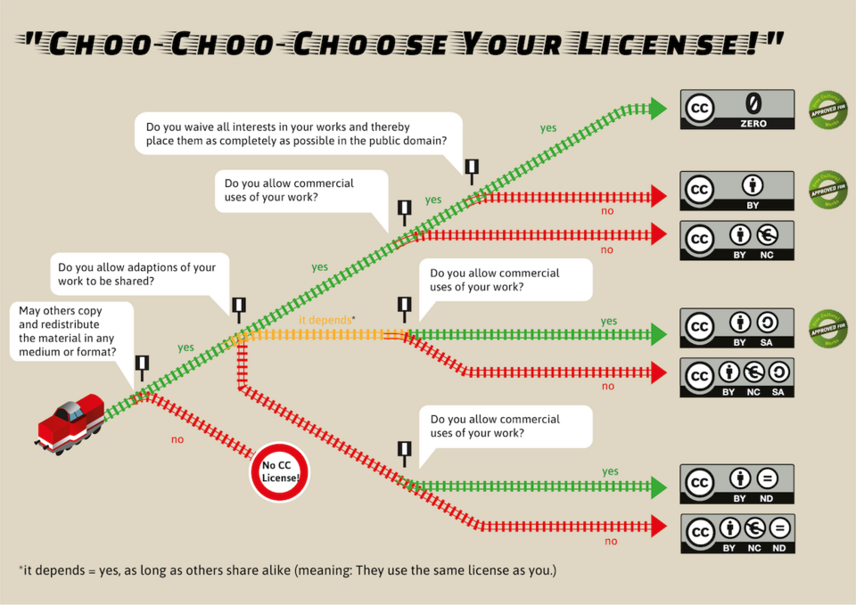
Choo-Choo Choose Your license!”

Slide 68
WCAG 2.1 SC 1.2.5 (Level AA)
Audio description is provided for all prerecorded video content in synchronized media.
Goal: Videos can be played with audio descriptions.
What to do: Provide a synchronized spoken description of the visual content in videos.
Why it's important: People who cannot see or understand the visual content can hear about it while playing videos.
*Descriptive transcripts are not sufficient to meet this requirement.

Slide 69
Does Your Video Require Audio Descriptions?
Ask Yourself:
If I couldn’t see the screen, what would I miss?
Ask Someone Else:
Listen to it without watching the video. What did they miss?

Slide 70
To Audio Describe or Not to Audio Describe?
Visuals that Require Audio Descriptions:
Charts, Graphs, Diagrams, Demonstrations, Text, Actions and Gestures
Visuals that Do Not Require Audio Descriptions:
Decorative or Repetitive Images

Slide 71
Solutions for Pre-Recorded Media
Option 1: Add an Extended Audio Description
Extended audio description uses a secondary audio track to play verbal descriptions of visual content
Requires a tool such as Panopto, Kaltura, or Yuja Lumina to add and play back the extended audio description
Generate the audio description manually or with AI
Audio description plays during natural or artificial pauses in the video
The description is read aloud, typically by a synthetic voice
Audio descriptions can be enabled or disabled (like closed captions)
Paid services exist to add extended audio descriptions

Slide 72

Video showing audio descriptions

Slide 73
Solutions for Pre-Recorded Media
Option 2: Add a Natural Audio Description
Natural audio description occurs when the main audio track includes descriptions of visual content
Rewrite the narrative script to include descriptions of visual content and re-record the video using the new script
OR edit the existing audio track to splice in audio descriptions using free video editors

Slide 74
Choo choo choose your license!

Slide 75
Solutions for Pre-Recorded Media
Option 3: Replace the Video with Other Accessible Media
Narrated PowerPoint (requires steps similar to Option 2)
Images with Alt Text
Screen-readable Documents (Word, PDF, etc.)

Slide 76
Recording Accessible Videos the First Time
Storyboard visuals and identify where audio descriptions are needed
Integrate descriptions naturally into your narration
Avoid phrases like “as you can see here”
Pause briefly to give listeners time to absorb visuals
Test your video by playing it without watching the screen to test comprehension and confirm all essential visuals are conveyed audibly

Slide 77
Audio Description Resources
WCAG Accessibility Principles
WCAG 2.1 1.2.3 (Level A): Audio Description or Descriptive Transcript
WCAG 2.1 1.2.5 (Level AA): Audio Description (natural description)
WCAG 2.1 1.2.7 (Level AAA): Extended Audio Description (paused description)
Standard Audio Description vs. Extended Audio Description
Panopto - How To Add Audio Descriptions
Sample Video with Audio Description

Slide 78
ADA Resources
Accessibility Checker​
WebAIM Color Contrast Checker​
Free AI Image Alt Text Generator​
Office of Technology Service Guide to Accessible Web Services​
Pelican: Louisiana’s Design System

Slide 79
Questions?
Contact:
Alyssa Coats
UL System, Web Accessibility Coordinator
alyssa.coats@ulsystem.edu

Slide 80
University of Louisiana System

