Slide 1
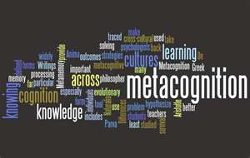
Help Students Develop Metacognitive
Strategies to Successfully Negotiate the College Transitional Year and Beyond
Saundra Y. McGuire, Ph.D.
Ret. Assistant Vice Chancellor & Professor of Chemistry
Director Emerita, Center for Academic Success
Louisiana State University
Fellow, American Chemical Society & AAAS

Slide 2

Mission Statement
The University of Louisiana at Monroe seeks students who find value in our programs and prepares them to compete, succeed, and contribute in an ever-changing global society through a transformative education.
Vison Statement
The University of Louisiana at Monroe will be recognized among the best-performing regional universities in the South.

Slide 3
Metacognition
The ability to:
think about your own thinking
be consciously aware of yourself as a problem solver
monitor, plan, and control your mental processing (e.g. “Am I understanding this material, or just memorizing it?”)
accurately judge your level of learning
know what you know and what you don’t know
Flavell, J. H. (1976). Metacognitive aspects of problem solving. In L. B. Resnick (Ed.), The nature of intelligence (pp.231-236). Hillsdale, NJ: Erlbaum

Slide 4
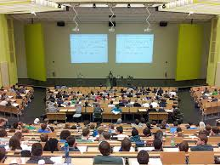
Power of Metacognitive
Learning Strategies
Sydnie’s Story: Intro and emails
First encounter on September 23, 2013
Email on October 14, 2013
Email on January 9, 2014
Email on January 20, 2014
Email on May 7, 2014

Slide 5


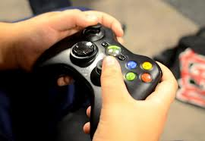
Why haven’t most students developed these skills?
It wasn’t necessary in high school

Slide 6
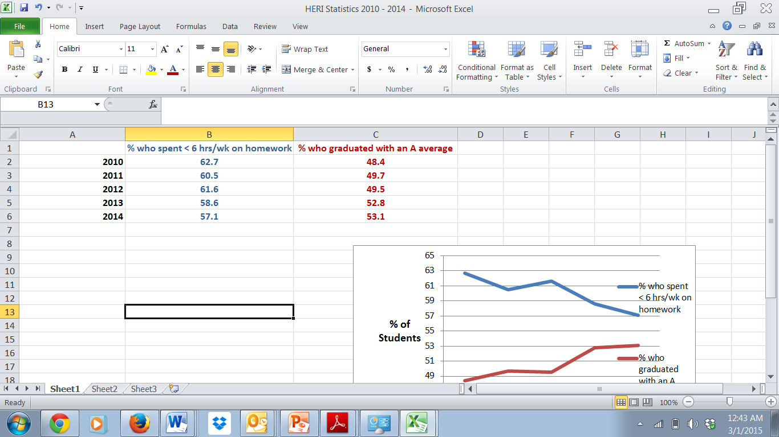
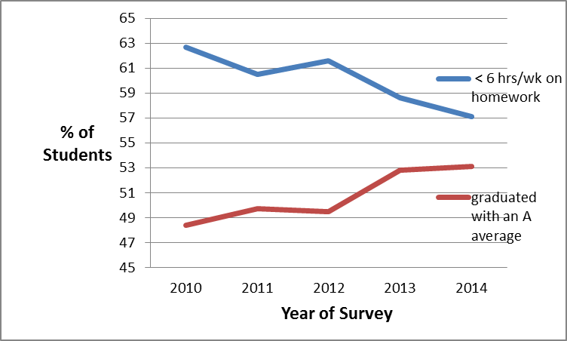
Data from UCLA Higher Education Research Institute (HERI
First Year Student Survey – 2010 - 2014
http://www.heri.ucla.edu/

Slide 7


Slide 8



Slide 9
What did most of your teachers in high school do the day before the test?
How do you think most students would answer the following?
What did they do during this activity?
What grade would you have made on the test if you had gone to class only
on the day before the test?

Slide 10

Faculty Must Help Students
Make the Transition to College
Help students identify and close “the gap”
current behavior current grades
productive behavior desired grades

Slide 11
Reflection Questions
What’s the difference, if any, between studying and learning?
For which task would you work harder?
A. Make an A on the test
B. Teach the material to the class

Slide 12
The Story of Two Students
Travis, junior psychology student
47, 52, 82, 86 B in course
Dana, first year physics student
80, 54, 91, 97, 90 (final) A in course

Slide 13
A Reading Strategy that Works: SQ3R (4R or 5R)
Survey (look at intro, summary, bold print, italicized words, etc.)
Question (devise questions survey that you think the reading will answer)
Read (one paragraph at a time)
Recite (summarize in your own words)
Record or wRite (annotate in margins)
Review (summarize the information in your words)
Reflect (other views, remaining questions)

Slide 14
Travis, junior psychology student
47, 52, 82, 86
Problem: Reading Comprehension
Solution: Preview text before reading*
Develop questions*
Read one paragraph at a time
and paraphrase information
* Developing an anticipatory set

Slide 15
First Voyage of Christopher Columbus
WITH HOCKED GEMS FINANCING HIM/ OUR HERO BRAVELY DEFIED ALL SCORNFUL LAUGHTER/ THAT TRIED TO PREVENT HIS SCHEME/ YOUR EYES DECEIVE/ HE HAD SAID/ AN EGG/ NOT A TABLE/ CORRECTLY TYPIFIES THIS UNEXPLORED PLANET/ NOW THREE STURDY SISTERS SOUGHT PROOF/ FORGING ALONG SOMETIMES THROUGH CALM VASTNESS/ YET MORE OFTEN OVER TURBULENT PEAKS AND VALLEYS/ DAYS BECAME WEEKS/ AS MANY DOUBTERS SPREAD FEARFUL RUMORS ABOUT THE EDGE/ AT LAST/ FROM NOWHERE/ WELCOME WINGED CREATURES APPEARED/ SIGNIFYING MOMENTOUS SUCCESS
Dooling, J.D. and Lachman, R. Effects of Comprehension on Retention of Prose, Journal of Experimental Psychology, (1971), Vol. 88, No. 2, 216-222

Slide 16

Anticipatory set CAN interfere!
Let’s look at the car on the next slide…

Slide 17
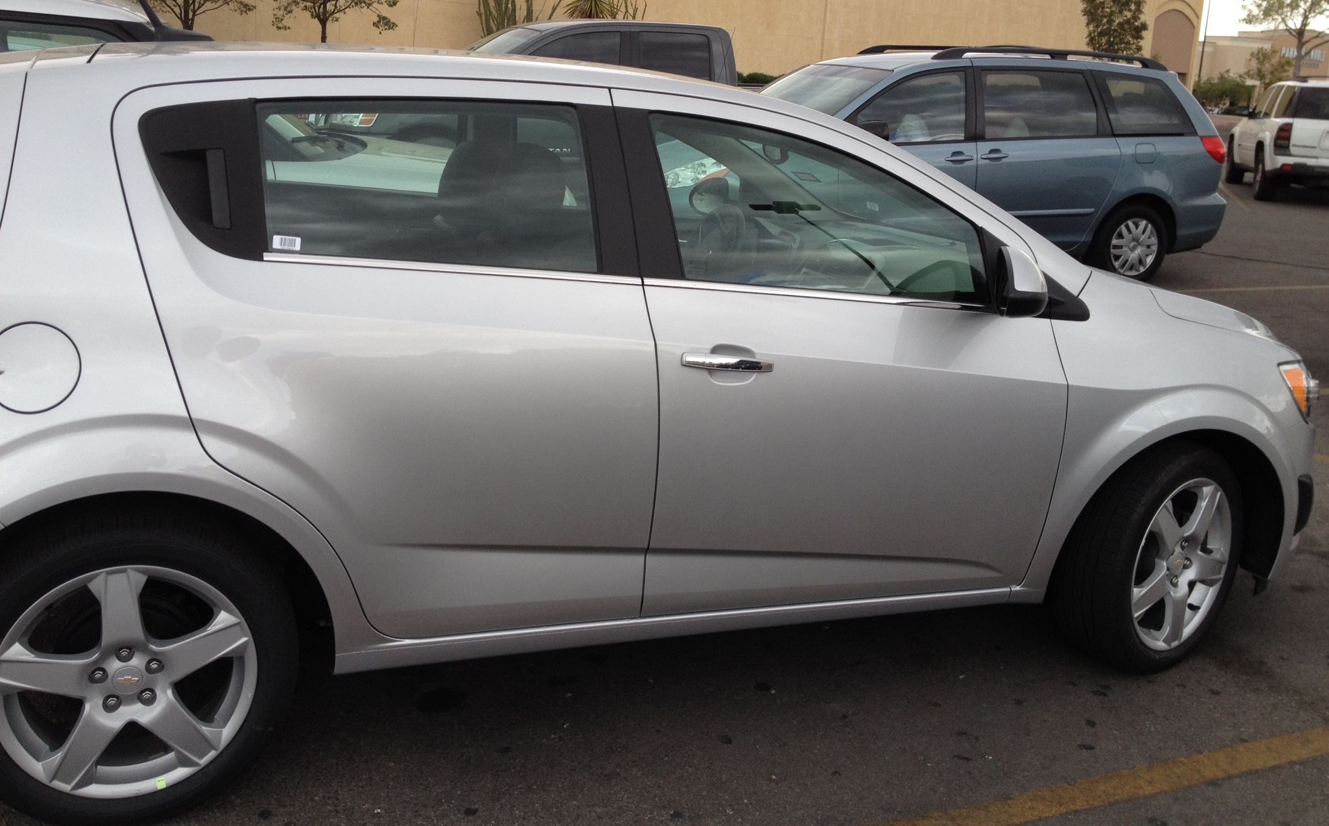
Is this a 2-door or 4-door car?

Slide 18
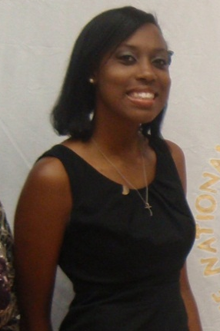
Dana, first year physics student
80, 54, 91, 97, 90 (final)
Problem: Memorizing formulas and using on-line solutions help for problems
Solution: Solve problems with no external aids and test mastery of concepts

Slide 19
Problem Solving is Essential to Student Success!
Homework system that can be taught
Study material first, before looking at the problems/questions
Work example problems (without looking at the solutions) until you get to the answer
Check to see if answer is correct
If answer is not correct, figure out where mistake was made, without consulting solution
Work homework problems/answer questions as if taking a test

Slide 20



Why the Fast and Dramatic Increase?
It’s all about the strategies, and getting them to engage their brains!

Slide 21
Counting Vowels in 45 seconds
How accurate are you?
Count all the vowels
in the words on the next slide.

Slide 22
Dollar Bill
Dice
Tricycle
Four-leaf Clover
Hand
Six-Pack
Seven-Up
Octopus
Cat Lives
Bowling Pins
Football Team
Dozen Eggs
Unlucky Friday
Valentine’s Day
Quarter Hour

Slide 23
How many words or phrases do you remember?

Slide 24
Let’s look at the words again…
What are they arranged
according to?

Slide 25
Dollar Bill
Dice
Tricycle
Four-leaf Clover
Hand
Six-Pack
Seven-Up
Octopus
Cat Lives
Bowling Pins
Football Team
Dozen Eggs
Unlucky Friday
Valentine’s Day
Quarter Hour

Slide 26
NOW, how many words or phrases do you remember?

Slide 27
2. We knew how the information was organized
What were two major differences
between the two attempts?
1. We knew what the task was

Slide 28

Bransford, J.D., Brown, A.L., Cocking, R.R. (Eds.), 2000. How people learn: Brain, Mind, Experience, and School. Washington, DC: National Academy Press.

Slide 29
What we know about learning
Active learning is more lasting than passive learning
-- Passive learning is an oxymoron*
Thinking about thinking is important
  Metacognition**
The level at which learning occurs is important
  Bloom’s Taxonomy***
  *Cross, Patricia, “Opening Windows on Learning” League for Innovation in the Community College, June 1998, p. 21.
** Flavell, John, “Metacognition and cognitive monitoring: A new area of cognitive–developmental inquiry.” American Psychologist, Vol 34(10), Oct 1979, 906-911.
*** Bloom Benjamin. S. (1956). Taxonomy of Educational Objectives, Handbook I: The Cognitive Domain. New York: David McKay Co Inc.

Slide 30
This pyramid depicts the different levels of thinking we use when learning. Notice how each level builds on the foundation that precedes it. It is required that we learn the lower levels before we can effectively use the skills above.
Bloom’s Taxonomy
Creating
Putting elements together to form a coherent or functional whole; reorganizing elements into a new pattern or structure through generating,
planning, or producing.
Making judgments based on criteria and standards through checking and critiquing.
Evaluating
Breaking material into constituent parts, determining how the parts relate to one another and to an overall structure .
Analyzing
Carrying out or using a procedure through executing, or implementing.
Applying
Constructing meaning from oral, written, and graphic messages through interpreting, exemplifying, classifying, summarizing, inferring, comparing, and explaining.
Understanding
Retrieving, recognizing, and recalling relevant knowledge from
long-term memory.
Remembering
http://www.odu.edu/educ/llschult/blooms_taxonomy.htm

Slide 31

When we teach students about Bloom’s Taxonomy…
They GET it!

Slide 32
How do you think students answered?
At what level of Bloom’s did you have to operate to make A’s or B’s in high school?
Remembering
Understanding
Applying
Analyzing
Evaluating
Creating

Slide 33
How students answered (2008)
At what level of Bloom’s did you have to operate to make A’s or B’s in high school?
Remembering
Understanding
Applying
Analyzing
Evaluating
Creating

Slide 34
At what level of Bloom’s did you have to operate to make A’s or B’s in high school?
How students answered (2013)
Remembering
Understanding
Applying
Analyzing
Evaluating
Creating

Slide 35
At what level of Bloom’s did you have to operate to make A’s and B’s in high school?
How students answered (2014)
Remembering
Understanding
Applying
Analyzing
Evaluating
Creating

Slide 36
How do you think students answered?
At what level of Bloom’s do you think you’ll need to operate to make A’s in college courses?
Remembering
Understanding
Applying
Analyzing
Evaluating
Creating

Slide 37
How students answered (in 2008)
At what level of Bloom’s do you think you’ll need to operate to make an A’s in college?
Remembering
Understanding
Applying
Analyzing
Evaluating
Creating

Slide 38
How students answered (in 2013)
At what level of Bloom’s do you think you’ll need to operate to make A’s in college?
Remembering
Understanding
Applying
Analyzing
Evaluating
Creating

Slide 39
At what level of Bloom’s do you think you’ll need to operate to make A’s in college?
How students answered (in 2014)
Remembering
Understanding
Applying
Analyzing
Evaluating
Creating

Slide 40
How do we teach students to move higher on Bloom’s Taxonomy?
Teach them the Study Cycle*
*adapted from Frank Christ’s PLRS system

Slide 41

The Study Cycle
4
Reflect
3
Review
4
Reflect
Preview
Preview before class – Skim the chapter, note headings and boldface words, review summaries and chapter objectives, and come up with questions you’d like the lecture to answer for you.
Attend
Attend class – GO TO CLASS! Answer and ask questions and take meaningful notes.
Review
Review after class – As soon after class as possible, read notes, fill in gaps and note any questions.
Study
Study – Repetition is the key. Ask questions such as ‘why’, ‘how’, and ‘what if’.
Intense Study Sessions* - 3-5 short study sessions per day
Weekend Review – Read notes and material from the week to make connections
Assess
Assess your Learning – Periodically perform reality checks
Am I using study methods that are effective?
Do I understand the material enough to teach it to others?
Intense Study Sessions
1 | Set a Goal | 1-2 min | Decide what you want to accomplish in your study session
2 | Study with Focus | 30-50 min | Interact with material- organize, concept map, summarize, process, re-read, fill-in notes, reflect, etc.
3 | Reward Yourself | 10-15 min | Take a break– call a friend, play a short game, get a snack
4 | Review | 5 min | Go over what you just studied
Center for Academic Success
B-31 Coates Hall ▪ 225.578.2872 ▪www.cas.lsu.edu

Slide 42

What happens when we teach metacognitive learning strategies, Bloom’s Taxonomy, and the Study Cycle to an entire class, not just individuals?

Slide 43
Performance in Gen Chem I in 2011 Based on One Learning Strategies Session*
Attended Absent
Exam 1 Avg: 71.65% 70.45%
Exam 2 Avg: 77.18% 68.90%
Final course Avg*: 81.60% 70.43%
Final Course Grade: B C
The one 50-min presentation on study and learning strategies was followed by an improvement of one full letter grade
*Cook, E.; Kennedy, E.; McGuire, S. Y. J. Chem. Educ., 2013, 90 (8), 961–967

Slide 44
Performance in Gen Chem 1202 Sp 2013 Based on One Learning Strategies Session
Attended Absent
Exam 1 Avg: 71.33% 69.27%
Homework Total: 169.8 119.1
Final course Avg*: 82.36% 67.71%
Final Course Grade: B D
The 50-min presentation on study and learning strategies was followed by an improvement of two letter grades

Slide 45
Performance in Gen Chem 1202 Sp 2015 Based on One Learning Strategies Session
Attended Absent
Exam 1, 2, 3 Avg: 68.14% 69.67%
Exam 4 Avg: 83.45% 75.91%
Final Exam Avg: 80.98% 75.24%
Final course Avg*: 84.90% 78.83%
Final Course Grade: B C
The 50-min presentation on study and learning strategies
after exam 3 was followed by an improvement of one letter grade

Slide 46
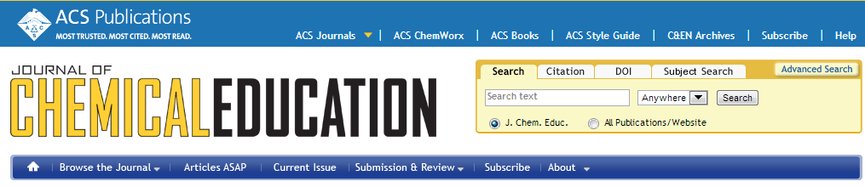
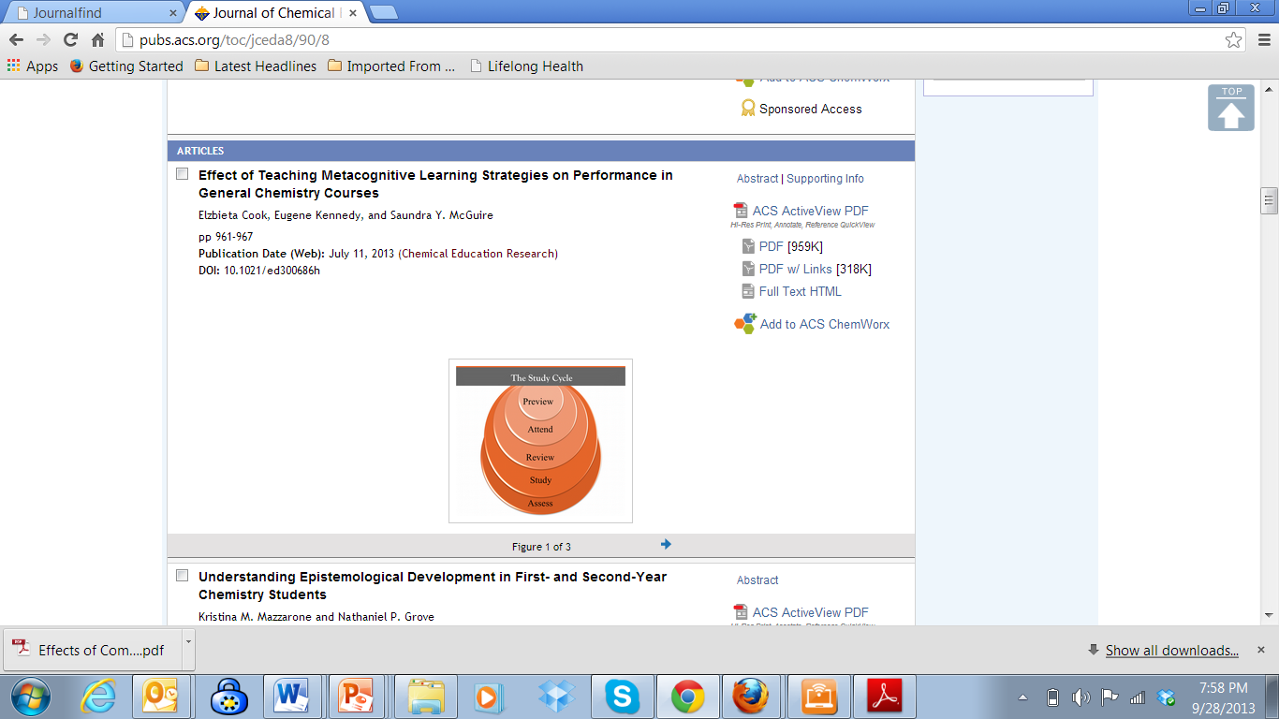
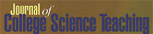
Metacognition: An Effective Tool to Promote Success
in College Science Learning*
Ningfeng Zhao¹, Jeffrey Wardeska¹, Saundra McGuire², Elzbieta Cook²
¹Department of Chemistry, East Tennessee State University
²Department of Chemistry, Louisiana State University
*March/April 2014 issue of JCST, Vol. 43, No. 4, pages 48-54

Slide 47
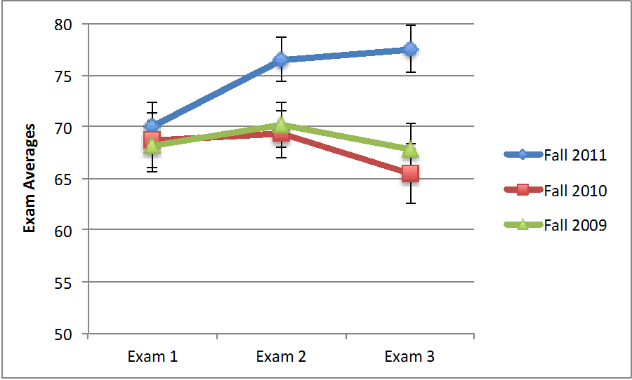
Professor Ningfeng Zhao’s Exam Averages
Intervention:
One fifty minute learning strategies session after Exam 1
Zhao, N., Wardeska, J. G., McGuire, S. Y., & Cook, E. (2014). Metacognition: An effective tool to promote success in college science learning. Journal of College Science Teaching, 43(4), 48–54.

Slide 48
Professor Nina Stein’s Exam Averages
EXAM | AVERAGE | AVERAGE | AVERAGE*
 | Fall 2012 | Fall 2013 | Fall 2014
1 | 69.25 | 70.06 | 77.42
2 | 79.40 | 73.33 | 86.17
3 | 70.35 | 73.38 | 85.12
final | 66.00 | 63.06 | 82.17
 |  |  | *The semester I did the study skills workshop
Intervention: One twenty minute learning strategies session
after Exam 1
Nina Stein, University of Connecticut, personal communication, April 4, 2015

Slide 49

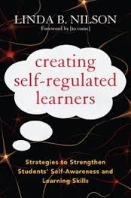
Two Valuable References
Gabriel, Kathleen F. (2008) Teaching Unprepared Students.
Sterling, VA: Stylus Publishing
Nilson, Linda. (2013) Creating Self-regulated Learners
Sterling, VA: Stylus Publishing

Slide 50
Changes Faculty Have Made that Improved Learning and Performance
Provide learning strategies information to students after Test 1, and tell them about mindset
(Psychology Professor at Southern Crescent Technical College, 2013)
Have students determine their learning style and write reflection on how they will use the information (Entomology Professor at LSU, 2009)
Present one 50 minute session on metacognition, Bloom’s Taxonomy, and the Study Cycle (Chemistry Professor at Middle Tennessee State University, 2012)
Present one 20 minute session on Bloom’s Taxonomy and Eight Learning Strategies, (Chemistry Professor at the University of Connecticut, 2014)

Slide 51
LSU Analytical Chemistry Graduate Student’s Cumulative Exam Record
2004 – 2005
9/04 Failed
10/04 Failed
11/04 Failed
12/04 Failed
1/05 Passed
2/05 Failed
3/05 Failed
4/05 Failed
2005 – 2006
10/05 Passed
11/05 Failed
12/05 Passed best in group
1/06 Passed
2/06 Passed
3/06 Failed
4/06 Passed last one!
5/06 N/A
Began work with CAS and the Writing Center in October 2005

Slide 52

Dr. Algernon Kelley, December 2009

Slide 53
From a Xavier University student to Dr. Kelley in Fall 2011
Oct. 17, 2011
Hello Dr. Kelley. … I am struggling at Xavier and I REALLY want to succeed, but everything I've tried seems to end with a "decent" grade. I’m not the type of person that settles for decent. What you preached during the time you were in Dr. Privett's class last week is still ringing in my head. I really want to know how you were able to do really well even despite your circumstances growing up. I was hoping you could mentor me and guide me down the path that will help me realize my true potential while here at Xavier. Honestly I want to do what you did, but I seriously can't find a way how to. Can I please set up a meeting with you as soon as you’re available so I can learn how to get a handle grades and classes?
Oct. 24, 2011
Hey Dr. Kelley, I made an 84 on my chemistry exam (compared to the 56 on my first one) using your method for 2 days (without prior intense studying). Thanks for pointing me in the right direction. I’ll come by your office Friday and talk to you about the test.
Nov 3, 2011
Hey Dr. Kelley! I have increased my Bio exam grade from a 76% to a 91.5% using your system. Ever since I started your study cycle program, my grades have significantly improved. I have honestly gained a sense of hope and confidence here at Xavier. My family and I are really grateful that you have taken time to get me back on track.

Slide 54

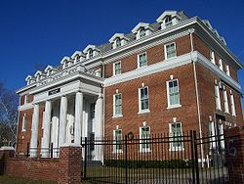
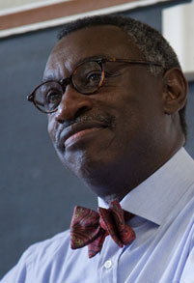
Final Reflection Questions
Who is primarily responsible
for student learning?
a) the student
b) the instructor
c) the institution

Slide 55
Who do you think students say is primarily responsible for student learning?
a) the student
b) the instructor
c) the institution

Slide 56

The reality is that…
when all three of these entities take full responsibility for student learning,
we will experience a significant increase in student learning, retention, and graduation rates!

Slide 57
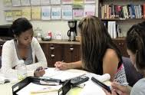
Conclusion
We can significantly increase learning by…
teaching students how to learn
making learning visible
not judging student potential on initial performance
encouraging students to persist in the face of initial failure
encouraging the use of metacognitive tools for deep and integrative learning

Slide 58
Useful Websites
www.cas.lsu.edu
www.howtostudy.org
www.vark-learn.com
www.drearlbloch.com

Slide 59
Additional References
Bruer, John T. , 2000. Schools For Thought: A Science of Learning in the Classroom. MIT Press.
Bransford, J.D., Brown, A.L., Cocking, R.R. (Eds.), 2000. How people learn: Brain, Mind, Experience, and School. Washington, DC: National Academy Press.
Christ, F. L., 1997. Seven Steps to Better Management of Your Study Time. Clearwater, FL: H & H Publishing
Cromley, Jennifer, 2000. Learning to Think, Learning to Learn: What the Science of Thinking and Learning Has to Offer Adult Education. Washington, DC: National Institute for Literacy.
Ellis, David, 2014. Becoming a Master Student*. Boston: Cengage Learning.
Hoffman, Roald and Saundra Y. McGuire. (2010). Learning and Teaching Strategies. American Scientist , vol. 98, pp. 378-382.
Nilson, Linda, 2004. Teaching at Its Best: A Research-Based Resource for College Instructors. Bolton, MA: Anker Publishing Company.
Pierce, William, 2004. Metacognition: Study Strategies, Monitoring, and Motivation.
http://academic.pg.cc.md.us/~wpeirce/MCCCTR/metacognition.htm
*Excellent student reference

Slide 60
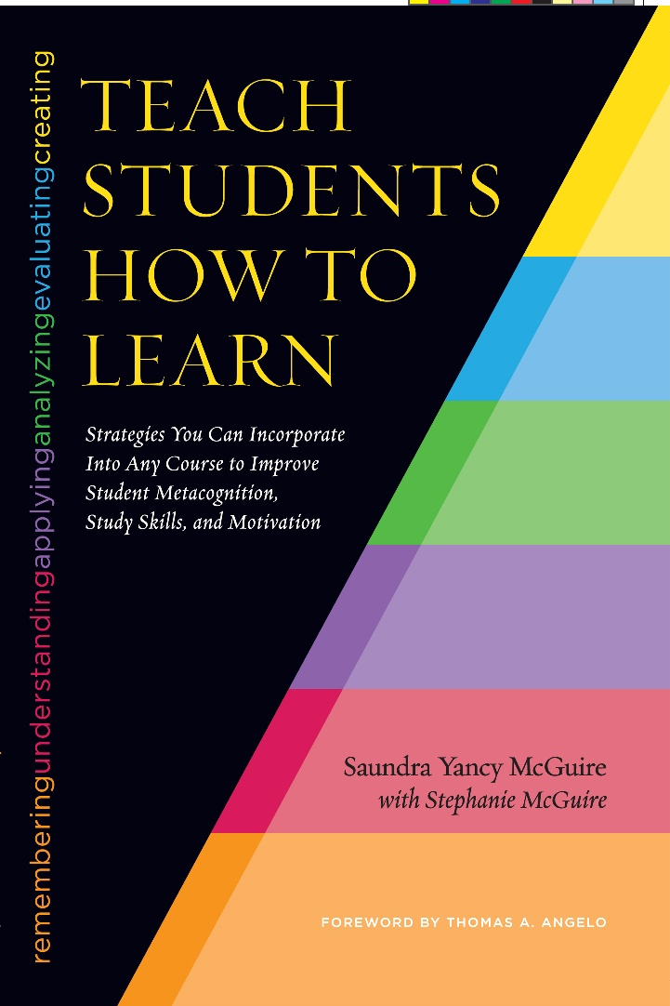
A New Reference
McGuire, S.Y. (2015). Teach Students How to Learn: Strategies You Can Incorporate into Any Course to Improve Student Metacognition, Study Skills, and Motivation. Sterling, VA: Stylus

