Slide 1

Increasing STEM Students’ Motivation: Strategies That Work
Saundra Yancy McGuire, Ph.D.
Distinguished Alumna, Southern Univ Dept of Chemistry
Retired Asst. Vice Chancellor & Prof of Chemistry
Director Emerita, Center for Academic Success
Louisiana State University
Fellow, American Chemical Society & AAAS

Slide 2
Motivation
“Motivation refers to the personal investment an individual has in reaching
a desired state or outcome.
(Ambrose et. al, 68)
“In the academy, the term ‘motivating’ means stimulating interest in a subject and, therefore, the desire to learn it.”
(Nilson, 57)

Slide 3
Why Is It Often Difficult to
Motivate STEM Students?
Characteristics of many STEM students:
Working more hours
More diagnosed ADHD
Interested in obtaining credentials
Feel entitled to an A or B if they consistently attend class
STEM career not personal goal
Few learning skills
Few time management skills

Slide 4
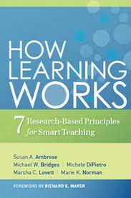
Ambrose, S.A., Bridges, M.W., DiPietro, M., Lovett, M.C., Norman, M.K. (2010) How Learning Works: Seven Research-Based Principles for Smart Teaching. San Francisco, CA: Jossey Bass.

Slide 5
Three Important Levers that Influence Motivation
Value – the importance of a goal (attainment, intrinsic, instrumental)
Supportive Nature of the Environment – the instructor is approachable, support is available from peers and others
Efficacy Expectancies – the belief that one is capable of identifying, organizing, initiating, and executing a course of action that will bring about a desired outcome
Ambrose et al., 80

Slide 6
Motivation Principles
Students’ motivation generates, directs, and sustains what they do to learn
Concepts important to understanding motivation: subjective value of a goal and the expectation for successful attainment of the goal (problem for some STEM students)
Ambrose et al., 69

Slide 7
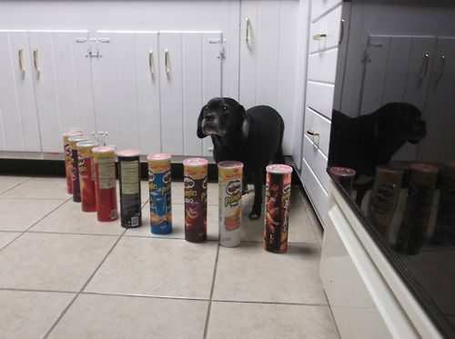
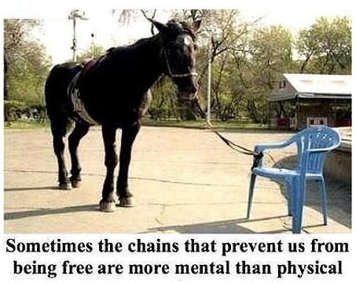
Learned Helplessness*
Based on prior experience, the feeling that no amount of effort will bring success
Destroys motivation to attempt a task
*Martin Seligman and Steven F. Maier

Slide 8
Solving Anagrams http://www.youtube.com/watch?v=MTqBP-x3yR0

Slide 9
Remediation of Learned Helplessness Requires That We:
Understand the causes
Help students understand the distorted beliefs and misperceptions that are causing their current deficits (I must not be a math person)
Provide students the tools to change their behavior and refute their distorted beliefs

Slide 10
The Cure for Learned Helplessness
Understanding your “explanatory style”
To what do you attribute failure or success?
Changing the negative, self-destructive things you say to yourself when you fail
Making the new statements a permanent part of your explanatory style
Recognizing that perception of ability has the most influence on the amount of effort you will expend on a task!

Slide 11
Ways to Create
A Supportive Environment
Introduce engaging, fun activity if possible.
Provide clear grading schemas and rubrics if possible
Show the instructor’s human side – hobbies, past academic struggles, etc
Emphasize the importance of effort, rather than prior experiences, in performance
Demonstrate confidence that every student can succeed!

Slide 12
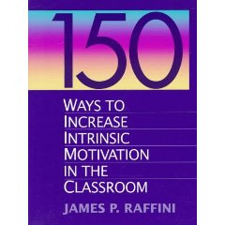
Raffini, James P. (1995) 150 Ways to Improve Intrinsic Motivation in the Classroom. New York, NY: Allyn and Bacon.

Slide 13
Five Bases of
Intrinsic Motivation
Autonomy (Control One’s Own Destiny)
Competence (Do Things that Help One Feel Successful)
Belonging (To Feel Part of a Group Effort)
Self-Esteem (To Feel Good About Who They Are)
Involvement and Enjoyment (To Find Pleasure in What They Do)
James Raffini, Allyn and Bacon, 1995

Slide 14

Strategies for Enhancing
Student Autonomy
Student Choice in Research Papers, Groups, Projects, Discussion Topics
Goal Setting Activity

Slide 15
Strategies for Enhancing Competence
Clearly articulate expectations
Provide Early Success Opportunities
Discuss the way many students explain success and failure – attribution theory
(e.g. success attributed to luck or ability, rather than effort; failure attributed to lack of ability or factors beyond their control, rather than lack of effort)

Slide 16
More Strategies for
Enhancing Competence
Provide Targeted Feedback and Rubrics
Describe Effective Learning Strategies
  - Introduce Metacognition
  and Bloom’s Taxonomy
- Implement Cooperative Learning
- Games (e.g. Jeopardy, Millionaire)

Slide 17
Metacognition
The ability to:
think about one’s own thinking
monitor, plan, and control one’s mental processing (e.g. “Am I understanding this material, or just memorizing it?”)
accurately judge one’s level of learning
Flavell, J. H. (1976). Metacognitive aspects of problem solving. In L. B. Resnick (Ed.), The nature of intelligence (pp.231-236). Hillsdale, NJ: Erlbaum

Slide 18
This pyramid depicts the different levels of thinking we use when learning. Notice how each level builds on the foundation that precedes it. It is required that we learn the lower levels before we can effectively use the skills above.
Bloom’s Taxonomy
Creating
Putting elements together to form a coherent or functional whole; reorganizing elements into a new pattern or structure through generating,
planning, or producing.
Making judgments based on criteria and standards through checking and critiquing.
Evaluating
Breaking material into constituent parts, determining how the parts relate to one another and to an overall structure .
Analyzing
Carrying out or using a procedure through executing, or implementing.
Applying
Constructing meaning from oral, written, and graphic messages through interpreting, exemplifying, classifying, summarizing, inferring, comparing, and explaining.
Understanding
Retrieving, recognizing, and recalling relevant knowledge from
long-term memory.
Remembering
http://www.odu.edu/educ/llschult/blooms_taxonomy.htm

Slide 19

The Study Cycle
4
Reflect
3
Review
4
Reflect
Preview
Preview before class – Skim the chapter, note headings and boldface words, review summaries and chapter objectives, and come up with questions you’d like the lecture to answer for you.
Attend
Attend class – GO TO CLASS! Answer and ask questions and take meaningful notes.
Review
Review after class – As soon after class as possible, read notes, fill in gaps and note any questions.
Study
Study – Repetition is the key. Ask questions such as ‘why’, ‘how’, and ‘what if’.
Intense Study Sessions* - 3-5 short study sessions per day
Weekend Review – Read notes and material from the week to make connections
Assess
Assess your Learning – Periodically perform reality checks
Am I using study methods that are effective?
Do I understand the material enough to teach it to others?
Intense Study Sessions
1 | Set a Goal | 1-2 min | Decide what you want to accomplish in your study session
2 | Study with Focus | 30-50 min | Interact with material- organize, concept map, summarize, process, re-read, fill-in notes, reflect, etc.
3 | Reward Yourself | 10-15 min | Take a break– call a friend, play a short game, get a snack
4 | Review | 5 min | Go over what you just studied
Center for Academic Success
B-31 Coates Hall ▪ 225.578.2872 ▪www.cas.lsu.edu

Slide 20
Sharing Strategies that Have Worked for Others Can Be Very Motivational

Slide 21
Top 5 Reasons Students Did Poorly on Test 1 in General Chemistry
1. Didn’t spend enough time on the material
2. Started the homework too late
3. Didn’t memorize the information I needed to memorize
4. Did not use the book
5. Assumed I understood information that I had read and re-read, but had not applied

Slide 22
Top 5 Reasons Students Made an A on Test 1:
1. Did preview-review for every class
2. Did a little of the homework at a time
3. Used the book and did the suggested problems
4. Made flashcards of the information to be memorized
5. Practiced explaining the information to others

Slide 23
Email from ENG Professor at New Mexico State Univ.
Received on 10/22/2013
At the end of a 60 minute learning strategies presentation by the professor, students were given a survey to determine their self-assessment of whether they were using or not using the strategies. The average scores of the different groups on the first two exams are shown below.
Self-Reported Use of Strategies | Exam 1 | Exam 2
Did not use the strategies | 58 | 54
Used metacognitive strategies | 95 | 80

Slide 24
Comments from Engineering Students about what they changed for Test 3*
I changed my study habits by doing the homework early. I also started reading some of the material before going to the class. The most effective was spending more time on the material.
I started studying for the exam sooner. I also took more time to do the homework. I reviewed/rewrote my notes from class.
I studied for the class as close to everyday as possible
I got together with other classmates and helped them with their weakness and of course they helped me with mine as well.
*class average increased from 65.7% to 80.5%!
(for students who took all three course exams)

Slide 25
Before and After
Robert, freshman chemistry student
42, 100, 100, 100 A in course
Michael, senior pre-med organic student
30, 28, 80, 91 B in course
Miriam, freshman calculus student
37.5, 83, 93 B in course
Ifeanyi, sophomore thermodynamics student
67, 54, 68, 95 B in course
Terrence, junior Bio Engineering student
GPA 1.67 cum, 3.54 (F 03), 3.8 (S 04)
Meaningful Learning Rote Learning

Slide 26
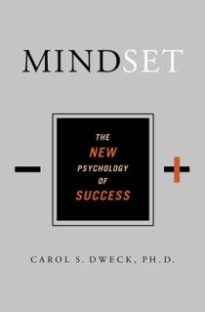

Help Students Develop the Right Mindset
Shenk, David, 2010. The Genius in All of Us: Why Everything You've Been Told About Genetics, Talent, and IQ Is Wrong. New York: Doubleday
Dweck, Carol, 2006.
Mindset: The New Psychology
of Success. New York:
Random House Publishing

Slide 27
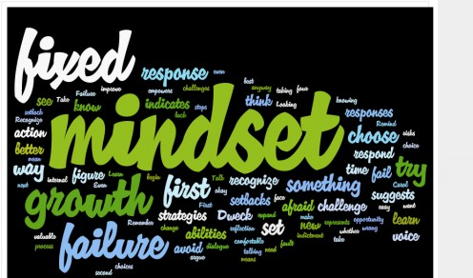
Mindset* is Important!
Fixed Intelligence Mindset
Intelligence is static
You have a certain amount of it
Growth Intelligence Mindset
Intelligence can be developed
You can grow it with actions
Dweck, Carol (2006) Mindset: The New Psychology of Success. New York: Random House Publishing

Slide 28
Responses to Many Situations are Based on Mindset
 | Fixed Intelligence Mindset Response | Growth Intelligence Mindset Response
Challenges | Avoid | Embrace
Obstacles | Give up easily | Persist
Tasks requiring effort | Fruitless to Try | Path to mastery
Criticism | Ignore it | Learn from it
Success of Others | Threatening | Inspirational

Slide 29
Which mindset about intelligence do you think most students have?
Fixed
Growth

Slide 30
Which mindset about student intelligence do you think most faculty have?
Fixed
Growth

Slide 31
Which mindset about student intelligence do you think most STEM faculty have?
Fixed
Growth

Slide 32
Email from a Spring 2011 Chemistry 1201 Student
“…Personally, I am not so good at chemistry and unfortunately, at this point my grade for that class is reflecting exactly that. I am emailing you inquiring about a possibility of you tutoring me.”
April 6, 2011
------------------------------------------------------------------------------------------------------------------------------------
“I made a 68, 50, (50), 87, 87, and a 97 on my final. I ended up earning a 90 (A) in the course, but I started with a 60 (D). I think what I did different was make sidenotes in each chapter and as I progressed onto the next chapter I was able to refer to these notes. I would say that in chemistry everything builds from the previous topic.
May 13, 2011
  Semester GPA: 3.8

Slide 33
Mindset* is Important!
Fixed Intelligence Mindset
Intelligence is static
You have a certain amount of it
Growth Intelligence Mindset
Intelligence can be developed
You can grow it with actions
Dweck, Carol (2006) Mindset: The New Psychology of Success. New York: Random House Publishing

Slide 34
Responses to Many Situations are Based on Mindset
 | Fixed Intelligence Mindset Response | Growth Intelligence Mindset Response
Challenges | Avoid | Embrace
Obstacles | Give up easily | Persist
Tasks requiring effort | Fruitless to Try | Path to mastery
Criticism | Ignore it | Learn from it
Success of Others | Threatening | Inspirational

Slide 35
American, Japanese, and Taiwanese Mothers’
View of Mathematics Achievement*
American mothers rated effort as significantly less important than Asian mothers
American mothers rated ability as significantly more important than Asian mothers
American mothers said it was possible to predict a child’s high school math performance much earlier than Asian mothers said was possible
American parents are satisfied with their children’s mediocre performance, whereas Asian parents express much less satisfaction with their children’s higher achievement.
American parents and children believe that Asian children are more talented in mathematics than American children.
*Uttal, D. H. (1997). Beliefs about genetic influences on mathematics achievement:
A cross-cultural comparison. Genetica, 99, 165–172.

Slide 36

Mr. Lorenzo Foster’s Physics I AP Class Test Scores Strategies, Dedication and Hard Work PAID OFF!
Lorenzo Foster’s Physics I AP Class Test Scores

Slide 37

Physics I AP Students
After Learning Their Test 2 Scores

Slide 38
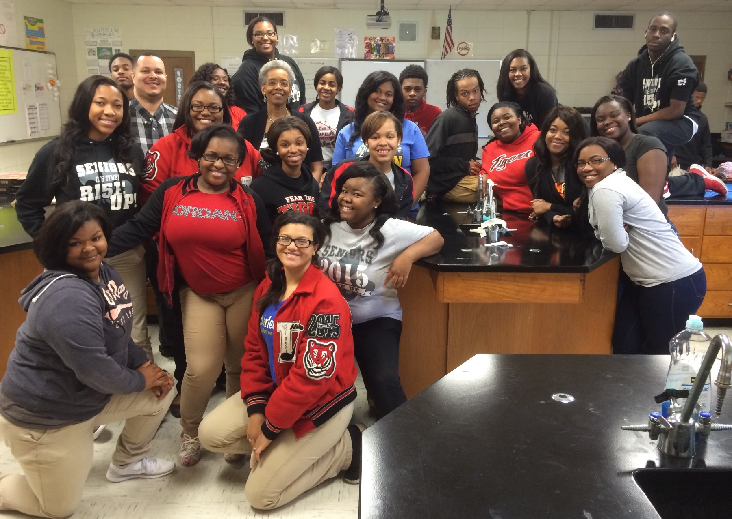
Physics I AP Students
After Learning Their Test 3 Scores

Slide 39
Strategies for Enhancing
Belonging and Relatedness
Create a community of scholars in the classroom where students are accountable to each other
e.g. Team based learning
Provide authentic, real world tasks
e.g. Service-learning, problem based learning,

Slide 40

Strategies for Enhancing Self-Esteem
Have students share answers to:
What is one thing do you do very well? How did you learn to do it well?
How can you relate this to academic success?
Identify an appropriate level of challenge
Provide Early Success Opportunities

Slide 41
Strategies for Enhancing
Involvement and Enjoyment
Introduce Engaging and Fun Activities
Connect to Students’ Interests
Switch Days (Student becomes teacher; teacher becomes student)
Reduce Student Anxiety
Use Strategies from Skip Downing at www.oncourseworkshop.com

Slide 42
Teacher’s Role in Student Motivation
Eric Hobson, Albany College of Pharmacy
Positive Motivation
Teacher’s attitudes 27%
Course structure 22%
Intrinsic 20%
Course content 17%
Performance meas. 10%
Financial 1%
Parents/Others 1%
Negative Motivation
Teacher’s attitudes 32%
Course structure 26%
Learning environ. 13%
Course content 11%
Intrinsic 10%
Parents/Others 1%
Financial 0.3%

Slide 43
The Experience of One Professor at Miles College
Beliefs I had to change:
Math is a gatekeeper course.
You MUST get through ALL the material before the semester is over.
I was skeptical about metacognition.
Why I changed
To avoid overwhelming students
To allow time to teach the Study Cycle

Slide 44
Professor Charles N. Morris III
What changes I made:
  I now incorporate study skills into my instruction.
  I gave repeated reminders of, and briefly practiced, The Study Cycle.
  I started stripping course material down to the bare minimum, avoiding repetition when possible.
  I gave smaller tests, and tested more frequently.
  I used the test as a teaching device. Students who choose can get make up points by resubmitting missed questions on tests along with written solutions with correct procedures.
Why I am not skeptical of metacognition:
  The results!

Slide 45

Faculty can significantly increase student motivation by…
Teaching students they can make themselves smarter by spending time on the material
Introducing a metacognitive get-acquainted activity on the first day of class
Testing early and often, providing early opportunities for success
Conduct a class session on the importance of metacognition after the first exams are returned
Express our confidence that every student can succeed

Slide 46
Metacognitive Get Acquainted Activity*
What do you believe is important to understand and learn in _____________________?
What do you believe to be critical characteristics of successful students in ___________?
How will you study and prepare for exams in ______________________________?
*Simpson, M. & Rush, L. (2012) in Teaching Study Strategies in Developmental Education, Hodges, Simpson, Stahl eds. New York: Bedford/St. Martin’s

Slide 47
Reflection Activity
Pick an activity or assignment from your class or your interaction with students. Using the ideas on the previous slides, describe how you could enhance that activity or assignment to increase student motivation.
Share this activity with the group

Slide 48
References
Ambrose, S.A., Bridges, M.W., DiPietro, M., Lovett, M.C., Norman, M.K. (2010) How Learning Works: Seven Research-Based Principles for Smart Teaching. San Francisco, CA: Jossey Bass.
Flavell , J. H., (1979) Metacognition and Cognitive monitoring: A New Area of Cognitive-developmental Inquiry. American Psychologist, 34 (10), (906-911).
Hobson, Eric (2001) Motivating Students to Learn in Large Classes. Unpublished manuscript.
Nilson, Linda, (2004) Teaching at Its Best: A Research-Based Resource for College Instructors. Bolton, MA: Anker Publishing Company.
Raffini, James P. (1995) 150 Ways to Improve Intrinsic Motivation. New York, NY: Allyn and Bacon.

