Slide 1


Affordable Textbooks and the LOUIS Library Network
Teri Gallaway, Associate Commissioner for LOUIS

Slide 2

LOUIS: The Louisiana Library Network

Slide 3
“Last year, I took an amazing social justice seminar. There were five textbooks for that class, and I don't think one of them was less than $20 on the Kindle Store. That adds up to over $100 for textbooks just for one class. I jumped for joy when I found that the library had purchased four of these books, and we could access them online. I was even more delighted to find that they were completely accessible to me as a totally blind student. They worked like a dream with my screen reader. Having access to books without having to rob a bank is crucial for a successful learning experience…”
-- undergraduate student

Slide 4

CHOICE. AFFORDABILITY. ACCESSIBILITY.

Slide 5
Affordable Course Materials
Curating
Curating collections
Designing and supporting
Designing and supporting systems
Delivering
Delivering educational programming
Developing
Developing professional competencies for librarians
Advocating
Advocating for institutional policies

Slide 6
Why do we care about textbook affordability?

Slide 7

The average student can expect to pay
$1,250
on textbooks and course materials in 2016-17.
McNeese = $1,220
Nicholls = $1,200
LSU = $1,160
UNO = $1,220
http://trends.collegeboard.org/college-pricing/figures-tables/average-estimated-undergraduate-budgets-2016-17
https://nces.ed.gov
By David Ernst. This work is licensed under the Creative Commons Attribution 4.0 International License.

Slide 8
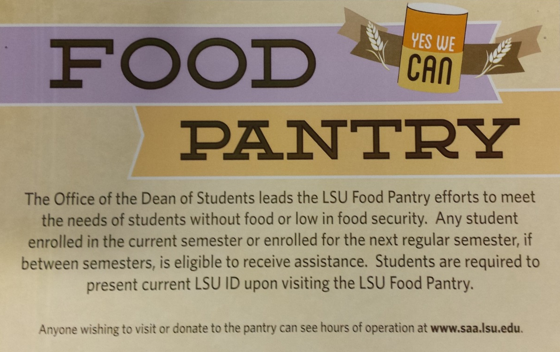
Serving Students in Need

Slide 9
7/10
students surveyed hadn’t bought a required textbook due to cost.
http://www.slideshare.net/txtbks/open-education-and-solving-the-textbook-cost-crisis
By David Ernst. This work is licensed under the Creative Commons Attribution 4.0 International License.

Slide 11
Affordability and Satisfaction
How does price influence your selection of required materials for courses?
N=494 35% Very or Extremely Influential
How does the availability of supplemental online material like quizzes or homework labs influence your selection of required materials for courses?
N=493 32% Very or Extremely Influential
What is your level of satisfaction with commercially available textbooks?
N=492 18% Dissatisfied

Slide 12
Campus Environment
Are you aware of any colleagues that have implemented an OA e-textbook or OER in their courses?
N=494 ; 12.1 % yes
Have you received requests from your administration, department, or students to integrate OA or OER resources into your curriculum?
N=493 ; 8.3% yes
Are you aware of any support on your campus to identify or integrate OA or OER resources into courses that you teach?
N=487 ; 11.5% yes

Slide 13
What strategies would be effective at encouraging you to create or adopt OA or OER resources into your course?
Strategies
Education, Class, Workshop or Training 35.65%
List of Resources; Discovery Improvements 23.26%
Relevant content 11.78%
Assurance of Quality 10.88%
Administrative Support or Directive 7.25%
Supplemental Teaching Resources 6.95%
Demonstrate Ease of Use 4.83%
Evidence of Peer Usage/Support 4.23%
Course Release/Time 3.93%

Slide 14
Libraries are positioned to reduce the costs of education for students by:
Curating collections
Designing and supporting systems
Delivering educational programming
Advocating for institutional policies

Slide 15
Two LOUIS Strategies
Promote and Expose Open Educational Resources (OER) through Open Textbook Network Partnership
Support Curriculum Driven Acquisitions (CDA) of Licensed eBooks and eTextbooks
FREE Content
FREE to Students

Slide 16

Open Textbook Initiatives

Slide 17
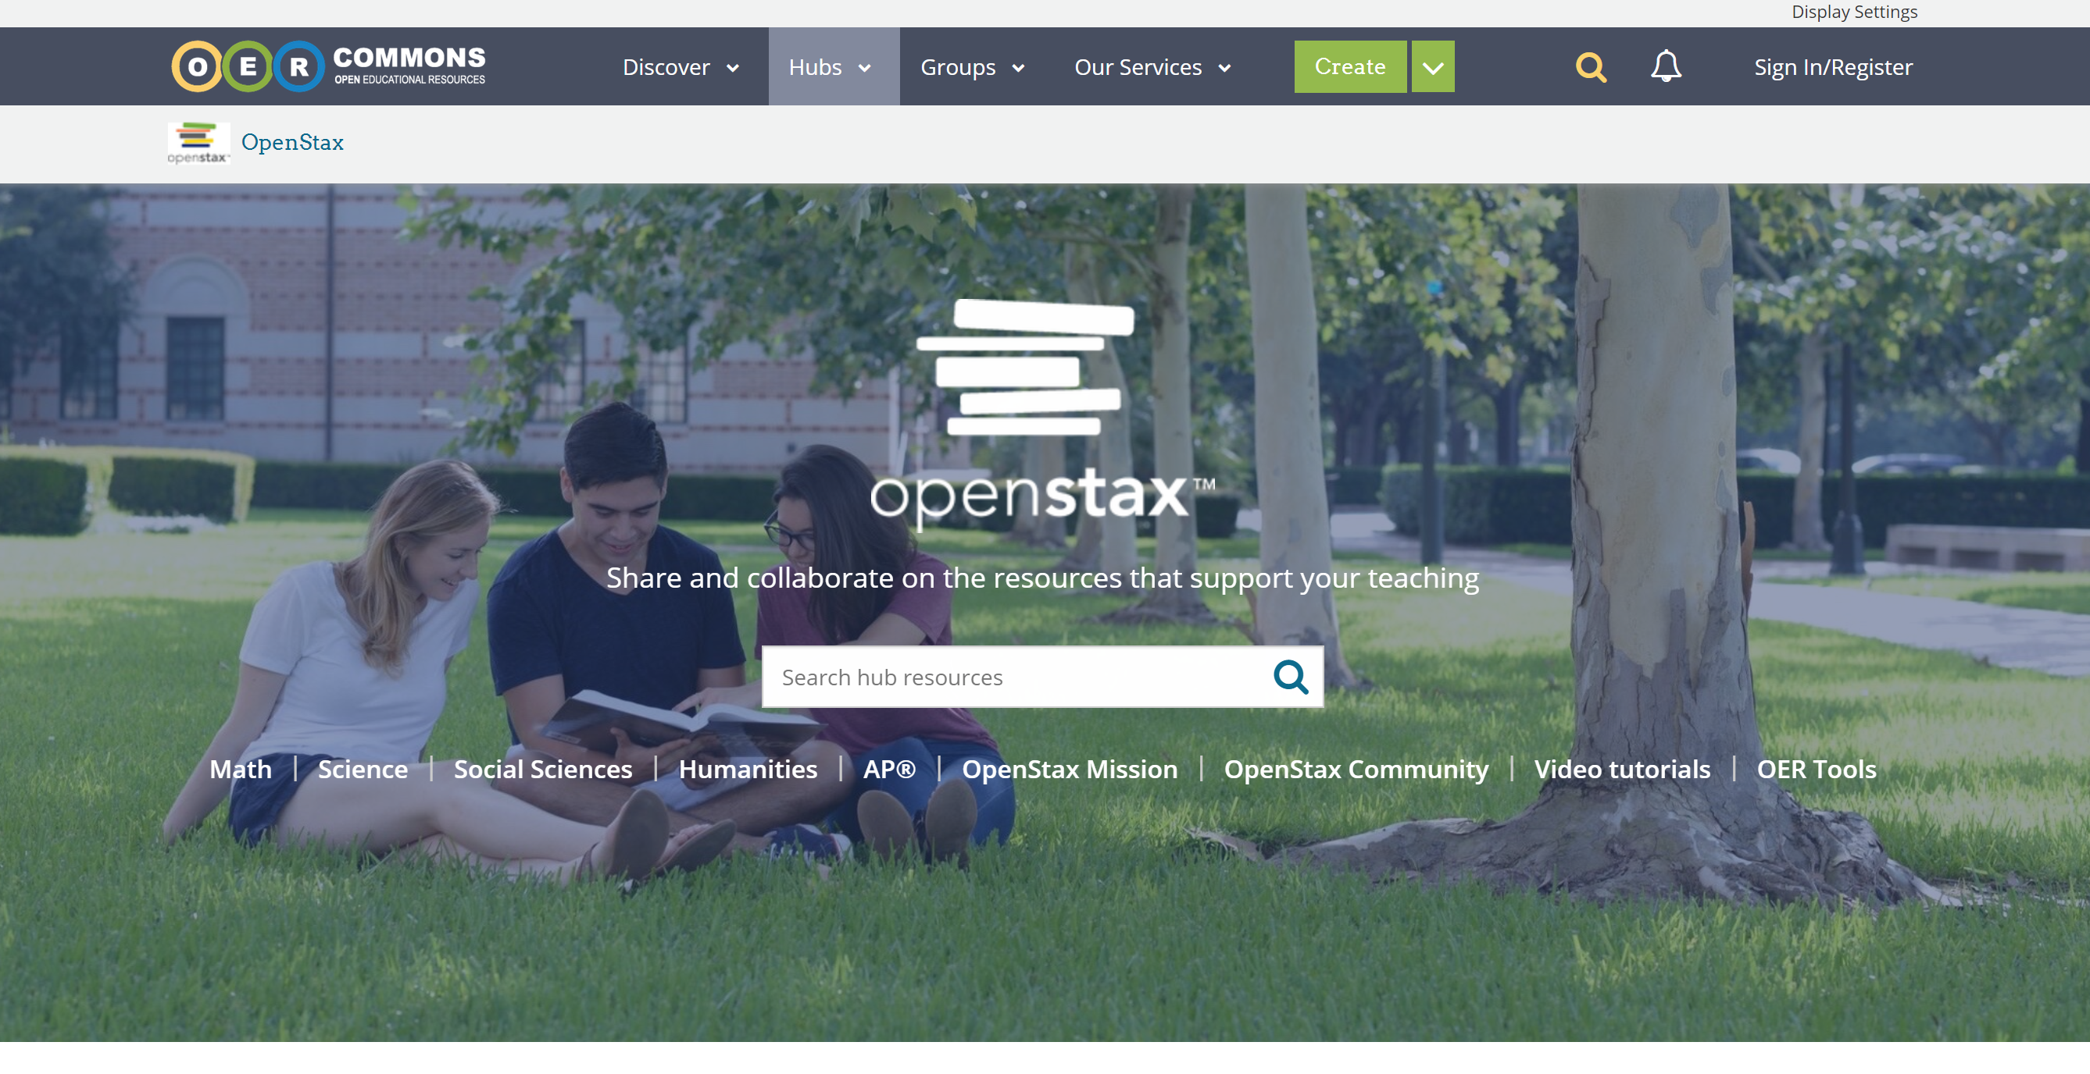
Instructor Resources for OpenStax https://www.oercommons.org/hubs/OpenStax

Slide 18


771 Students = $76,000 saved
Notes:
mcneese

Slide 19
Open Textbook Network Pilot
~60 Trainers Statewide
15 workshops
~ 120 Faculty Reached
53 Projected Open Textbook Adoptions between Fall 2017 & Fall 2018

Slide 20
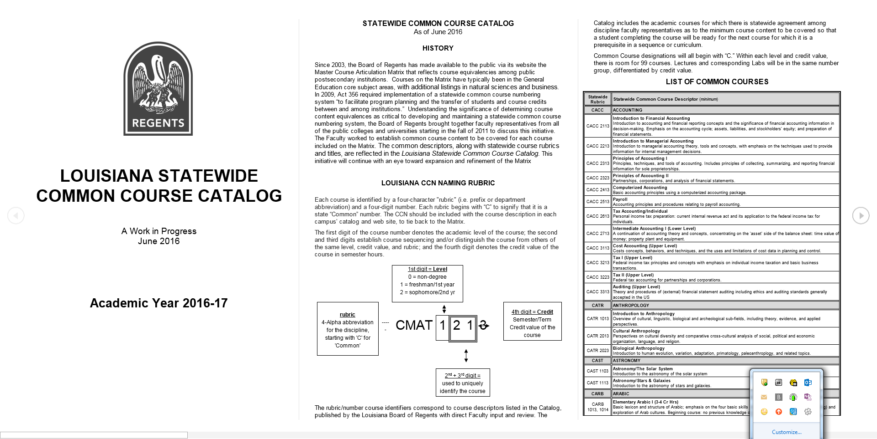
LOUISIANA Crosswalk
Master Course Articulation Matrix + Open Textbook Network =
Find Textbooks

Slide 21
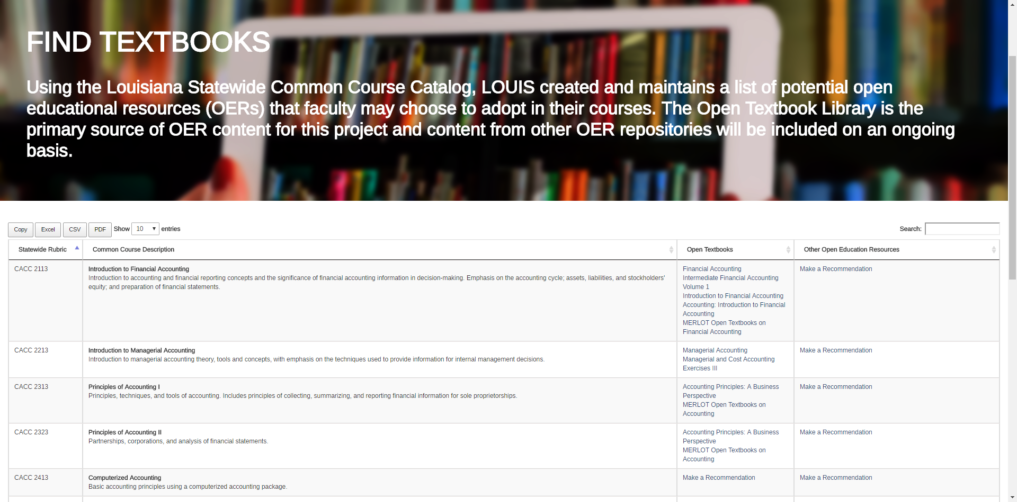
louislibraries.org/alearningla/find-textbooks

Slide 22
Licensed ebook STRATEGIES
The University of New Orleans Example:
$3,322.08 : Expended on Library Licensed eBooks
859: Students Served
$50,270.20 : in Textbook Expenses Avoided

Slide 23
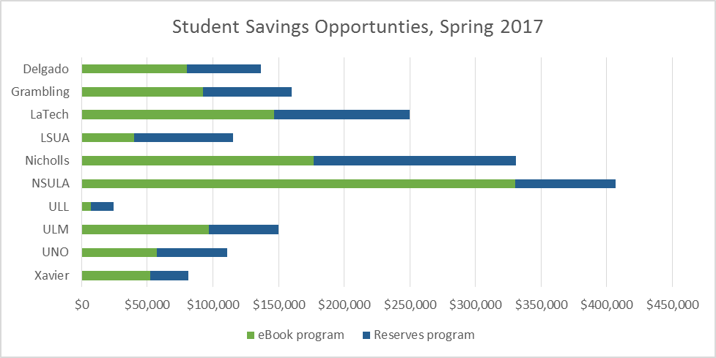
Ten SCHOOLS: TEXTBOOK ADOPTION OPPORTUNITIES

Slide 24
Statewide eBook Collection Building
LSU model # of course adoptions
GVRL: $5,428 for 2 titles
Oxford: $6,118.75 for 8 titles
JSTOR: $9,010 for 10 titles
CRC: $33,612.18 for 7 titles
Taylor & Francis: $40,499.31 for 23 titles
ProjectMuse: $54,879.30 for 51 titles
Cambridge: $65,219.25 for 29 titles
ScienceDirect: $130,624.50 for 22 titles
Knovel: $153,146.80 for 15 titles
Wiley: $155,507.50 for 33 titles
Springer: $229,647.20 for 20 titles

Slide 25
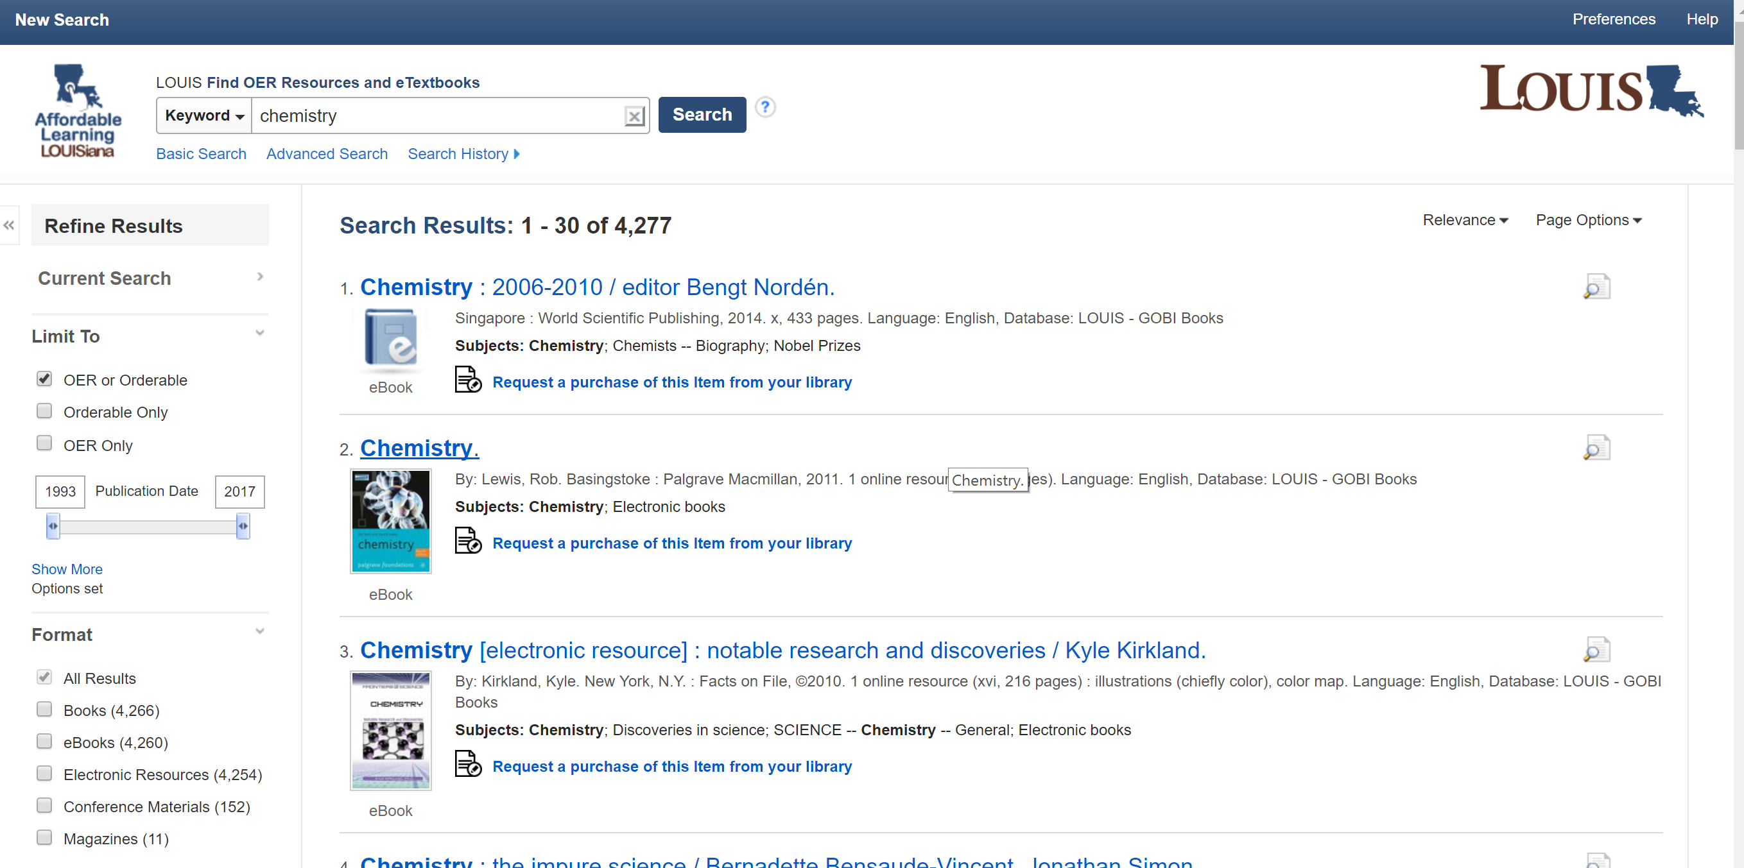
Faculty Portal

Slide 26
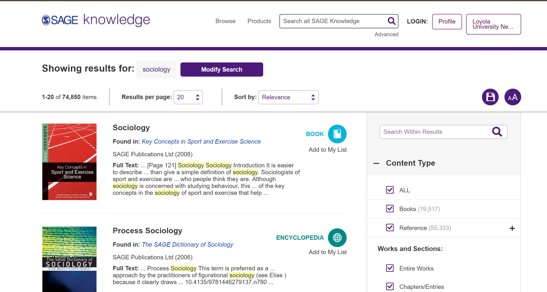
SAGE Ebook Collection

Slide 27
ALL Plan: Short Term Recommendations
Recommendation 1:
Implement an affordable learning technology and staffing infrastructure within LOUIS to support accessible eTextbook acquisitions, and the provision and adoption of open educational resources.

Slide 28
ALL Plan: Short Term Recommendations
Recommendation 2:
That funds be allocated to expand LOUIS Statewide eBook, eTextbook, and video collections.

Slide 29
ALL Plan: Short Term Recommendations
Recommendation 3:
Creation of an Affordable Learning Support Fund for Faculty and Academic Support Services that would include professional development, stipends or mini-grants targeting specific programs including the review/evaluation of materials and development of OER courses.

Slide 30

Where Can I Find AFFORDABLE Course Materials to ADOPT
FREE: Open Textbook Network (print on demand services)
FREE: LOUIS: “Find Textbooks”
FREE & LIBRARY-AVAILABLE: LOUIS “Faculty Portal”
LIBRARY AVAILABLE: SAGE EBOOKS
OTHER LIBRARY AVAILABLE: ASK A LIBRARIAN

Slide 31
What Else Can YOU do?
OPEN as Default
Consultations with Librarian
Senate & Administrative Resolutions of Support
Departmental Conversations
Data Collection
Rebus Community

Slide 32
http://vle.credoreference.com/louis/Affordable-Learning-LOUISiana-Video

Slide 33
What Else Can I do?
teri.gallaway@regents.la.gov
http://vle.credoreference.com/louis/Affordable-Learning-LOUISiana-Video

