Slide 1
Respondus Monitor
Deb Golemon & Kim Taylor
Spring 2018

Slide 2
Respondus Lockdown Browser
Enhanced browser for testing in Moodle
Condensed Toolbar
Disabled Controls
Blocked Features & Applications

Slide 3
Respondus Monitor
Dishonesty Deterrent
Add-on to LockDown Browser
Records students during exams
Webcam and microphone required
After the exam is complete, an instructor can review the recorded videos

Slide 4
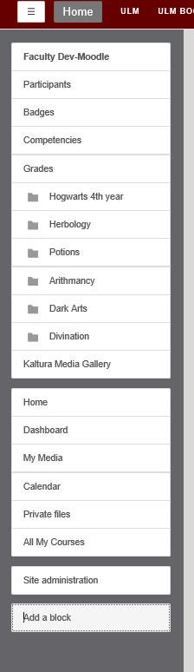
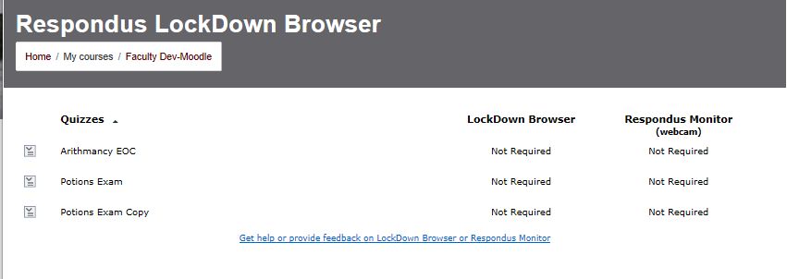
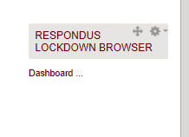
Moodle Block

Slide 5
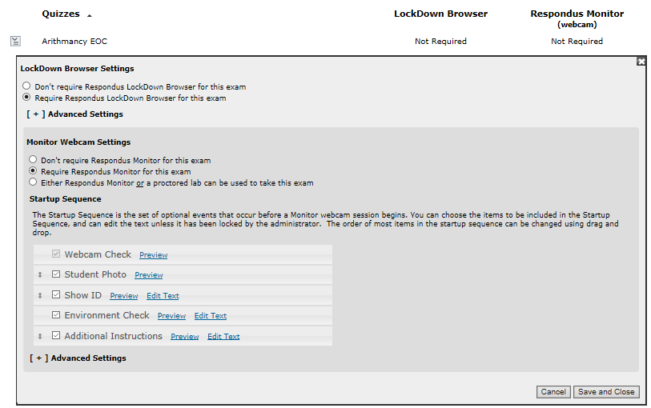

Slide 6
Experiences in an Online Course

Slide 7
Best Practices
Include a “webcam & microphone required for online exams” statement in the class syllabus
Have students take a short practice quiz early in the course to ensure proper set up and expectations

Slide 8
Resources
respondus.com/monitor/resources
Check the Faculty How To’s page on Moodle

