Slide 1
LIBRARY UPDATES
WHAT’S NEW, WHAT’S COMING, WHAT WE WANT TO DO, WHAT WE CAN DO

Slide 2

SESSION AGENDA
INTRODUCTIONS
TOM HOOVER, CIO – WHAT’S NEW, WHAT’S COMING, WHAT WE WANT TO DO
TERI GALLAWAY, LOUIS CONSORTIUM – WHAT WE WANT TO DO, WHAT WE CAN DO
MEGAN LOWE, LIBRARY – WHAT WE CAN DO

Slide 3


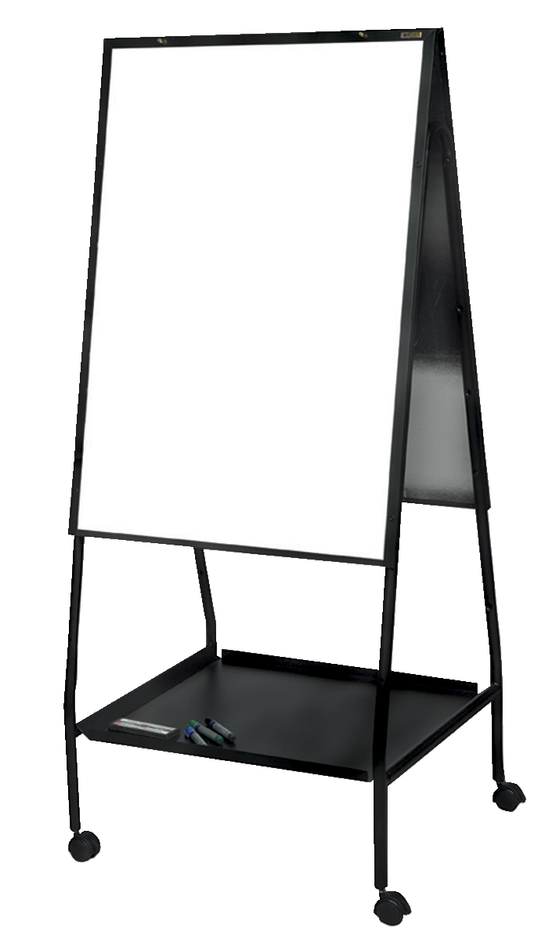
TAKE IT AWAY, TOM!
WHAT’S NEW – SMALL STEPS FOR BIG IMPACT
  VISITING OTHER LIBRARIES IN LA
  WHITEBOARDS
  CHROMEBOOKS {PILOTING}
  SURVEYING LIBRARY SPACES
  UPDATING LIBRARY “INFRASTRUCTURE”
WHAT’S COMING AND WHAT WE WANT TO DO
  PURSUING FUNDING FOR PROJECTS
  FACULTY SHOWCASE
  ENHANCING LIBRARY SPACES
  REBRANDING
  AWARENESS CAMPAIGN
  BIG “THINGS” FOR FALL 2018
  CENTRAL HUB/GEM OF CAMPUS

Slide 4

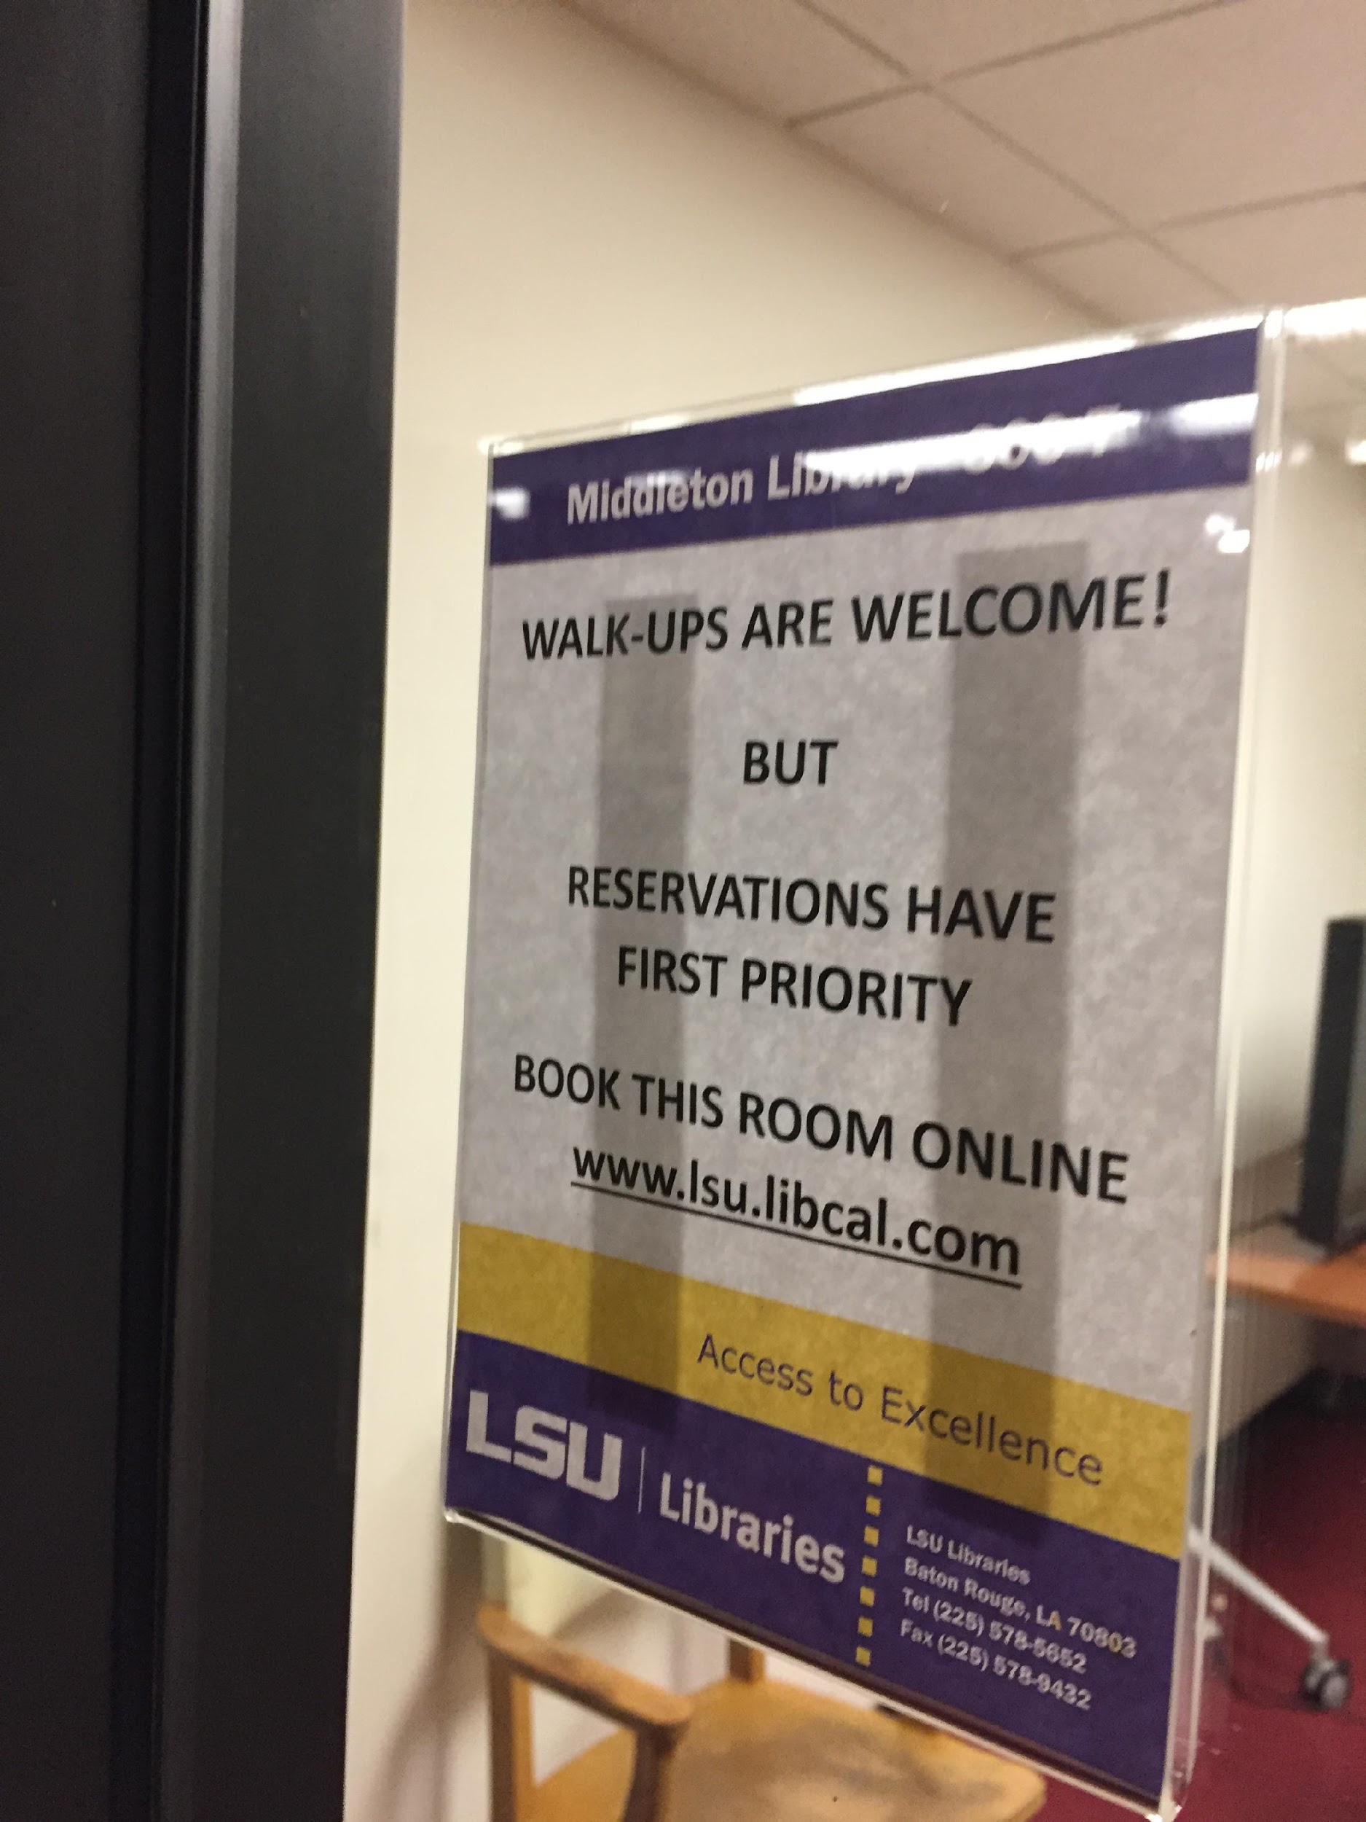
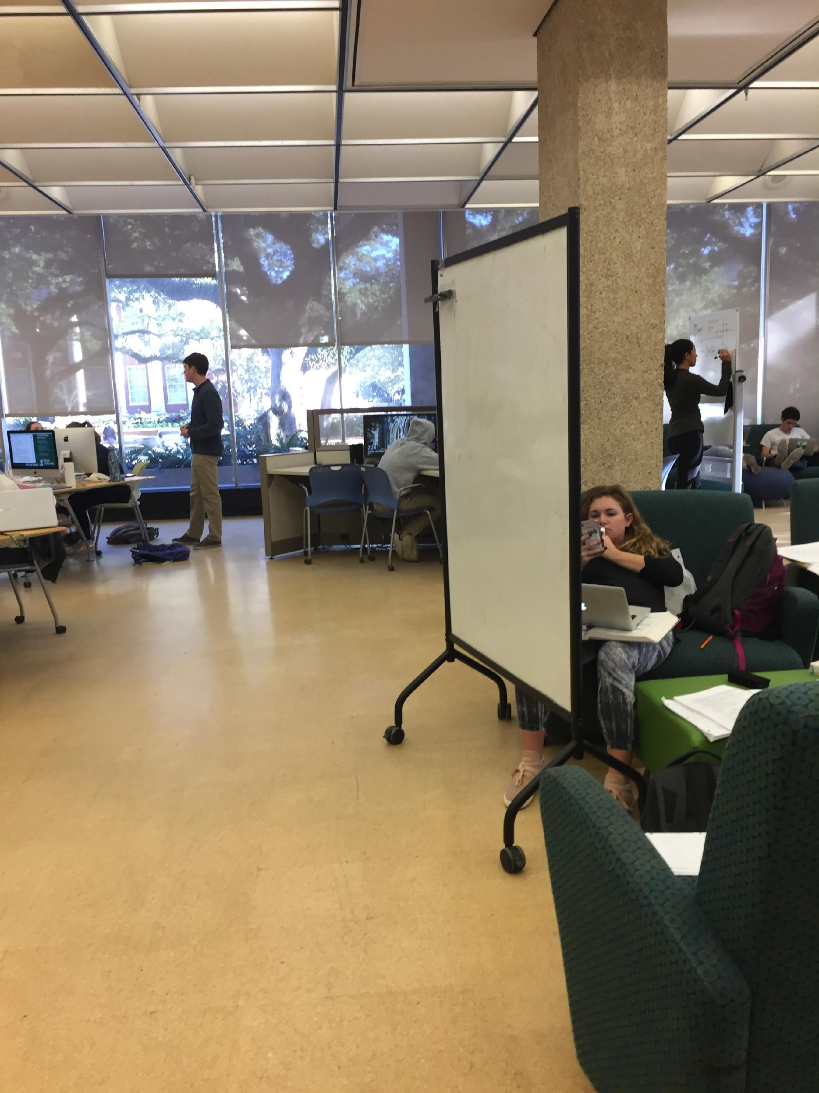
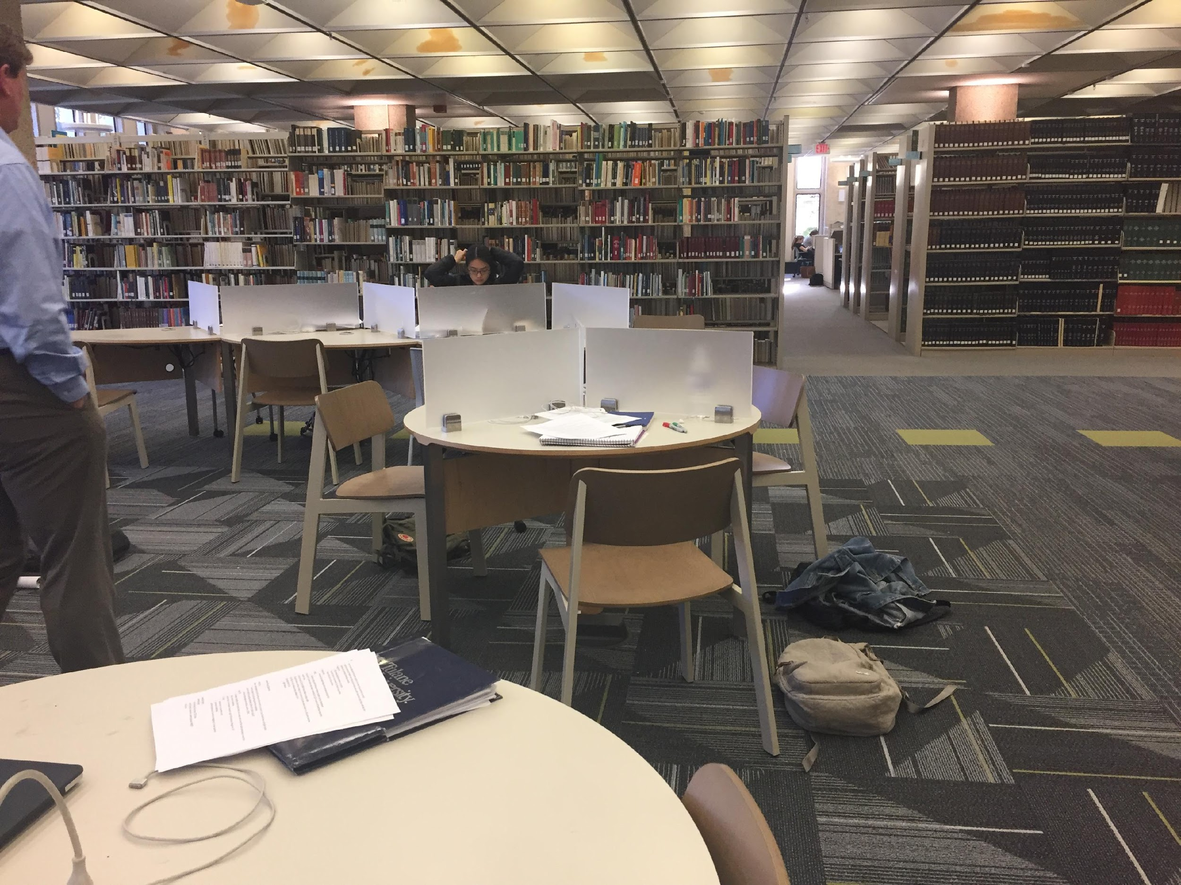
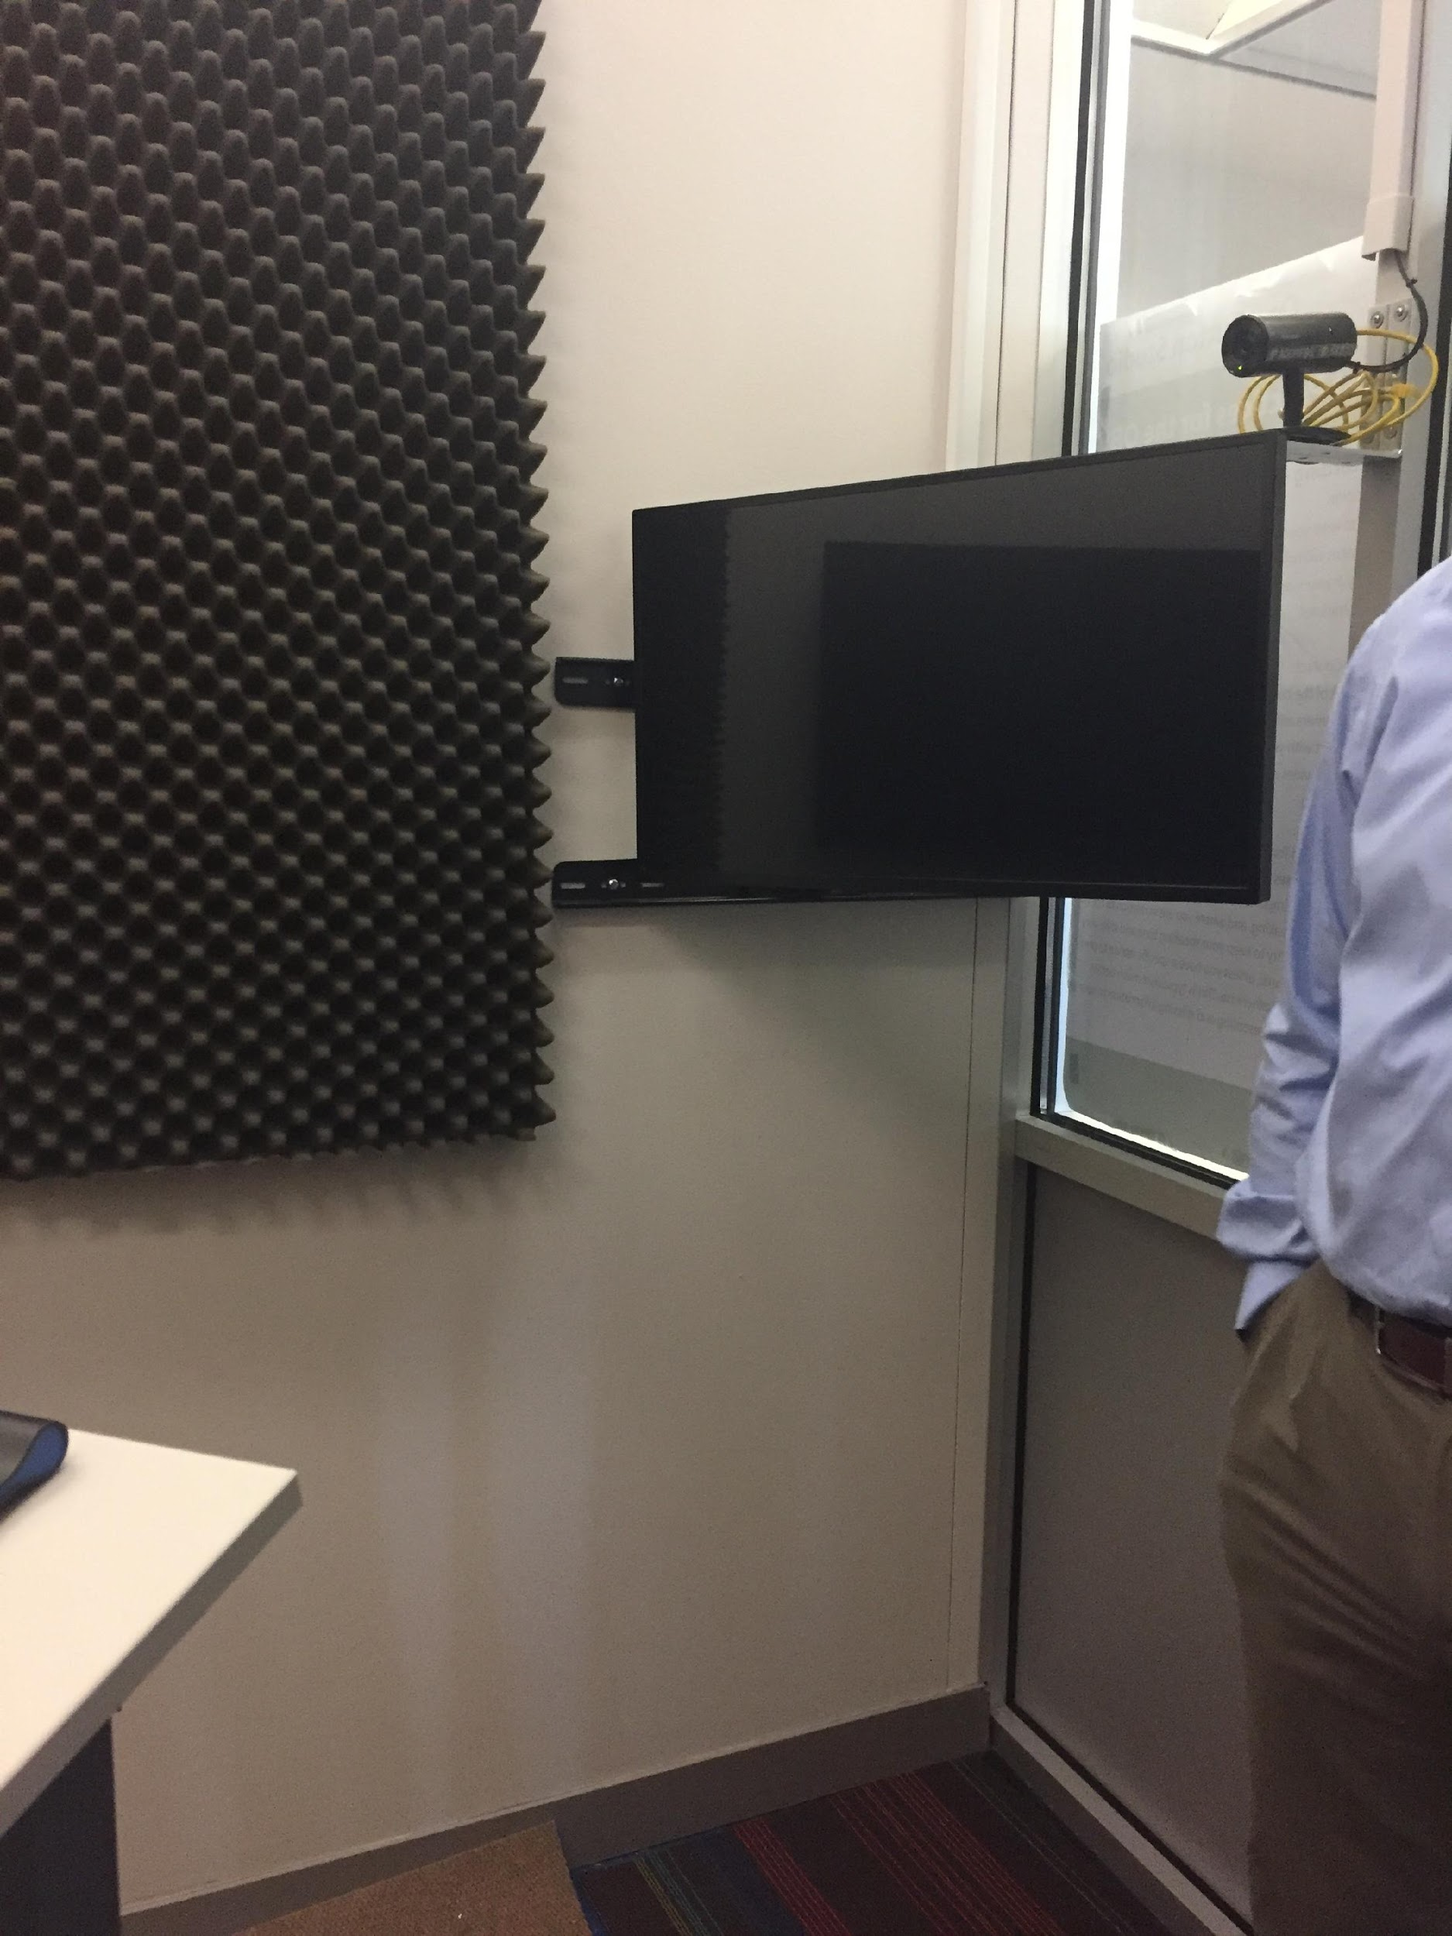
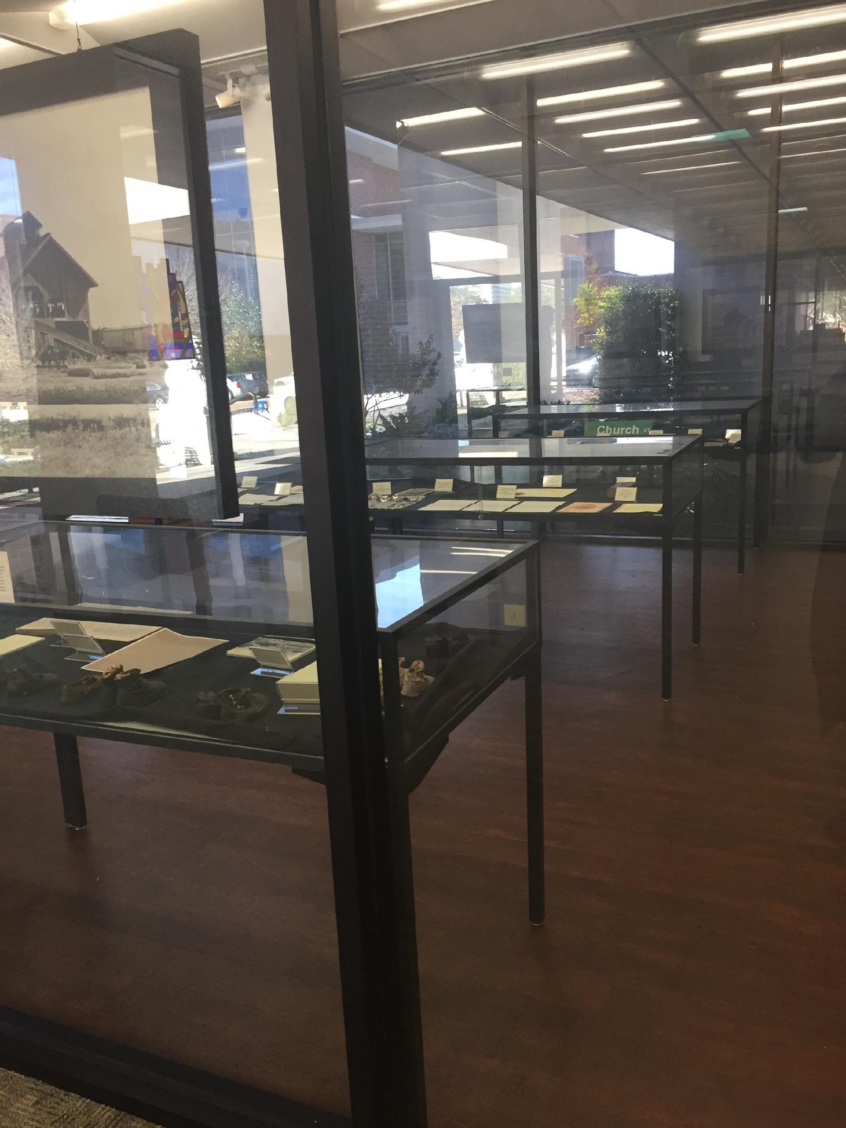
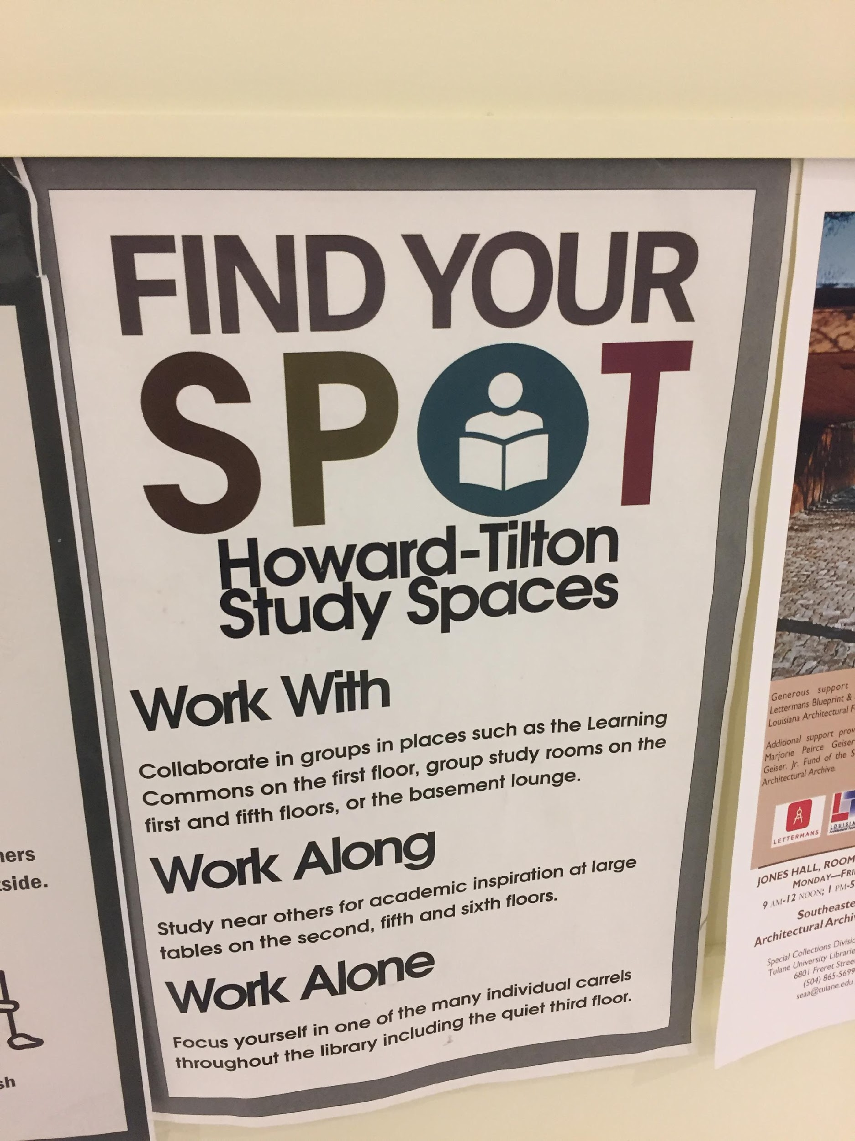
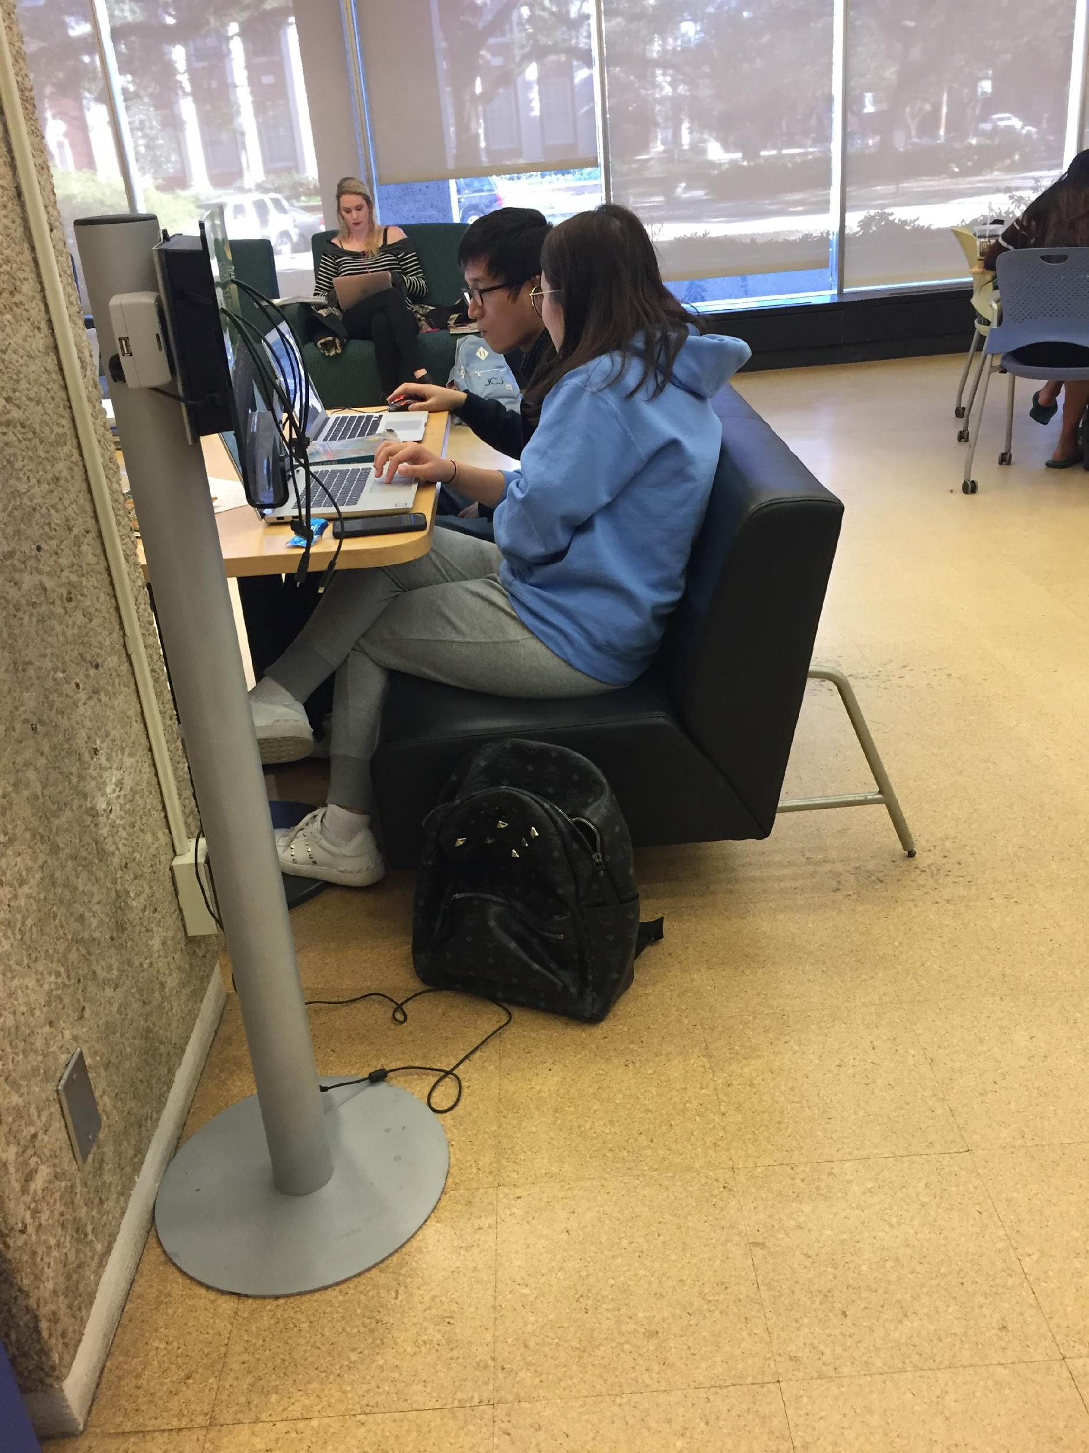
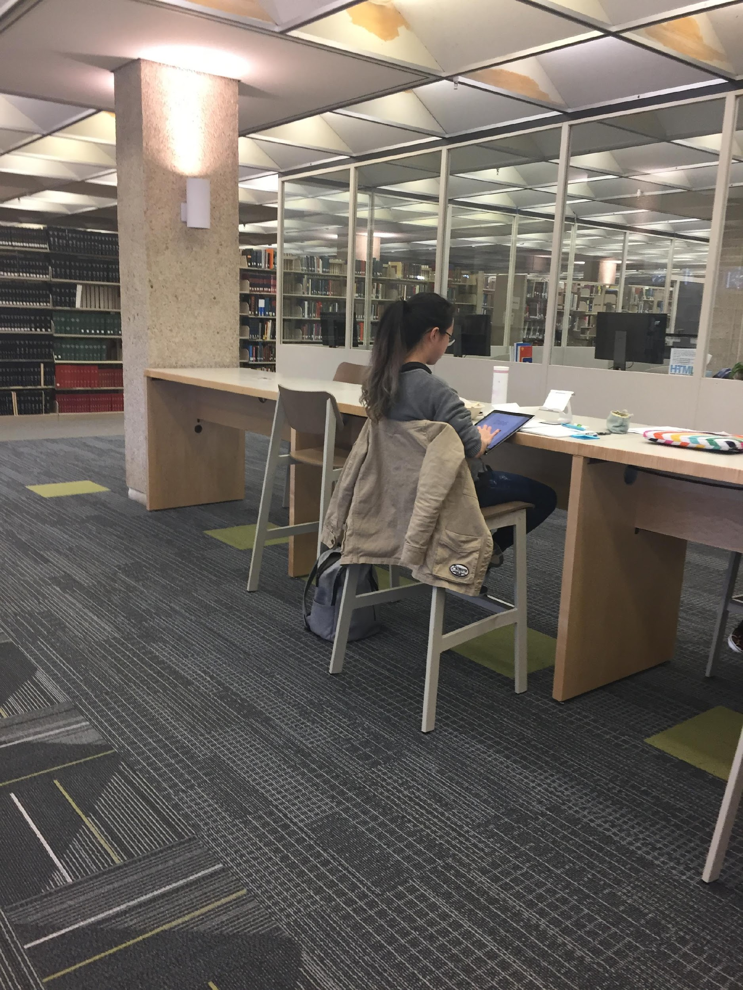
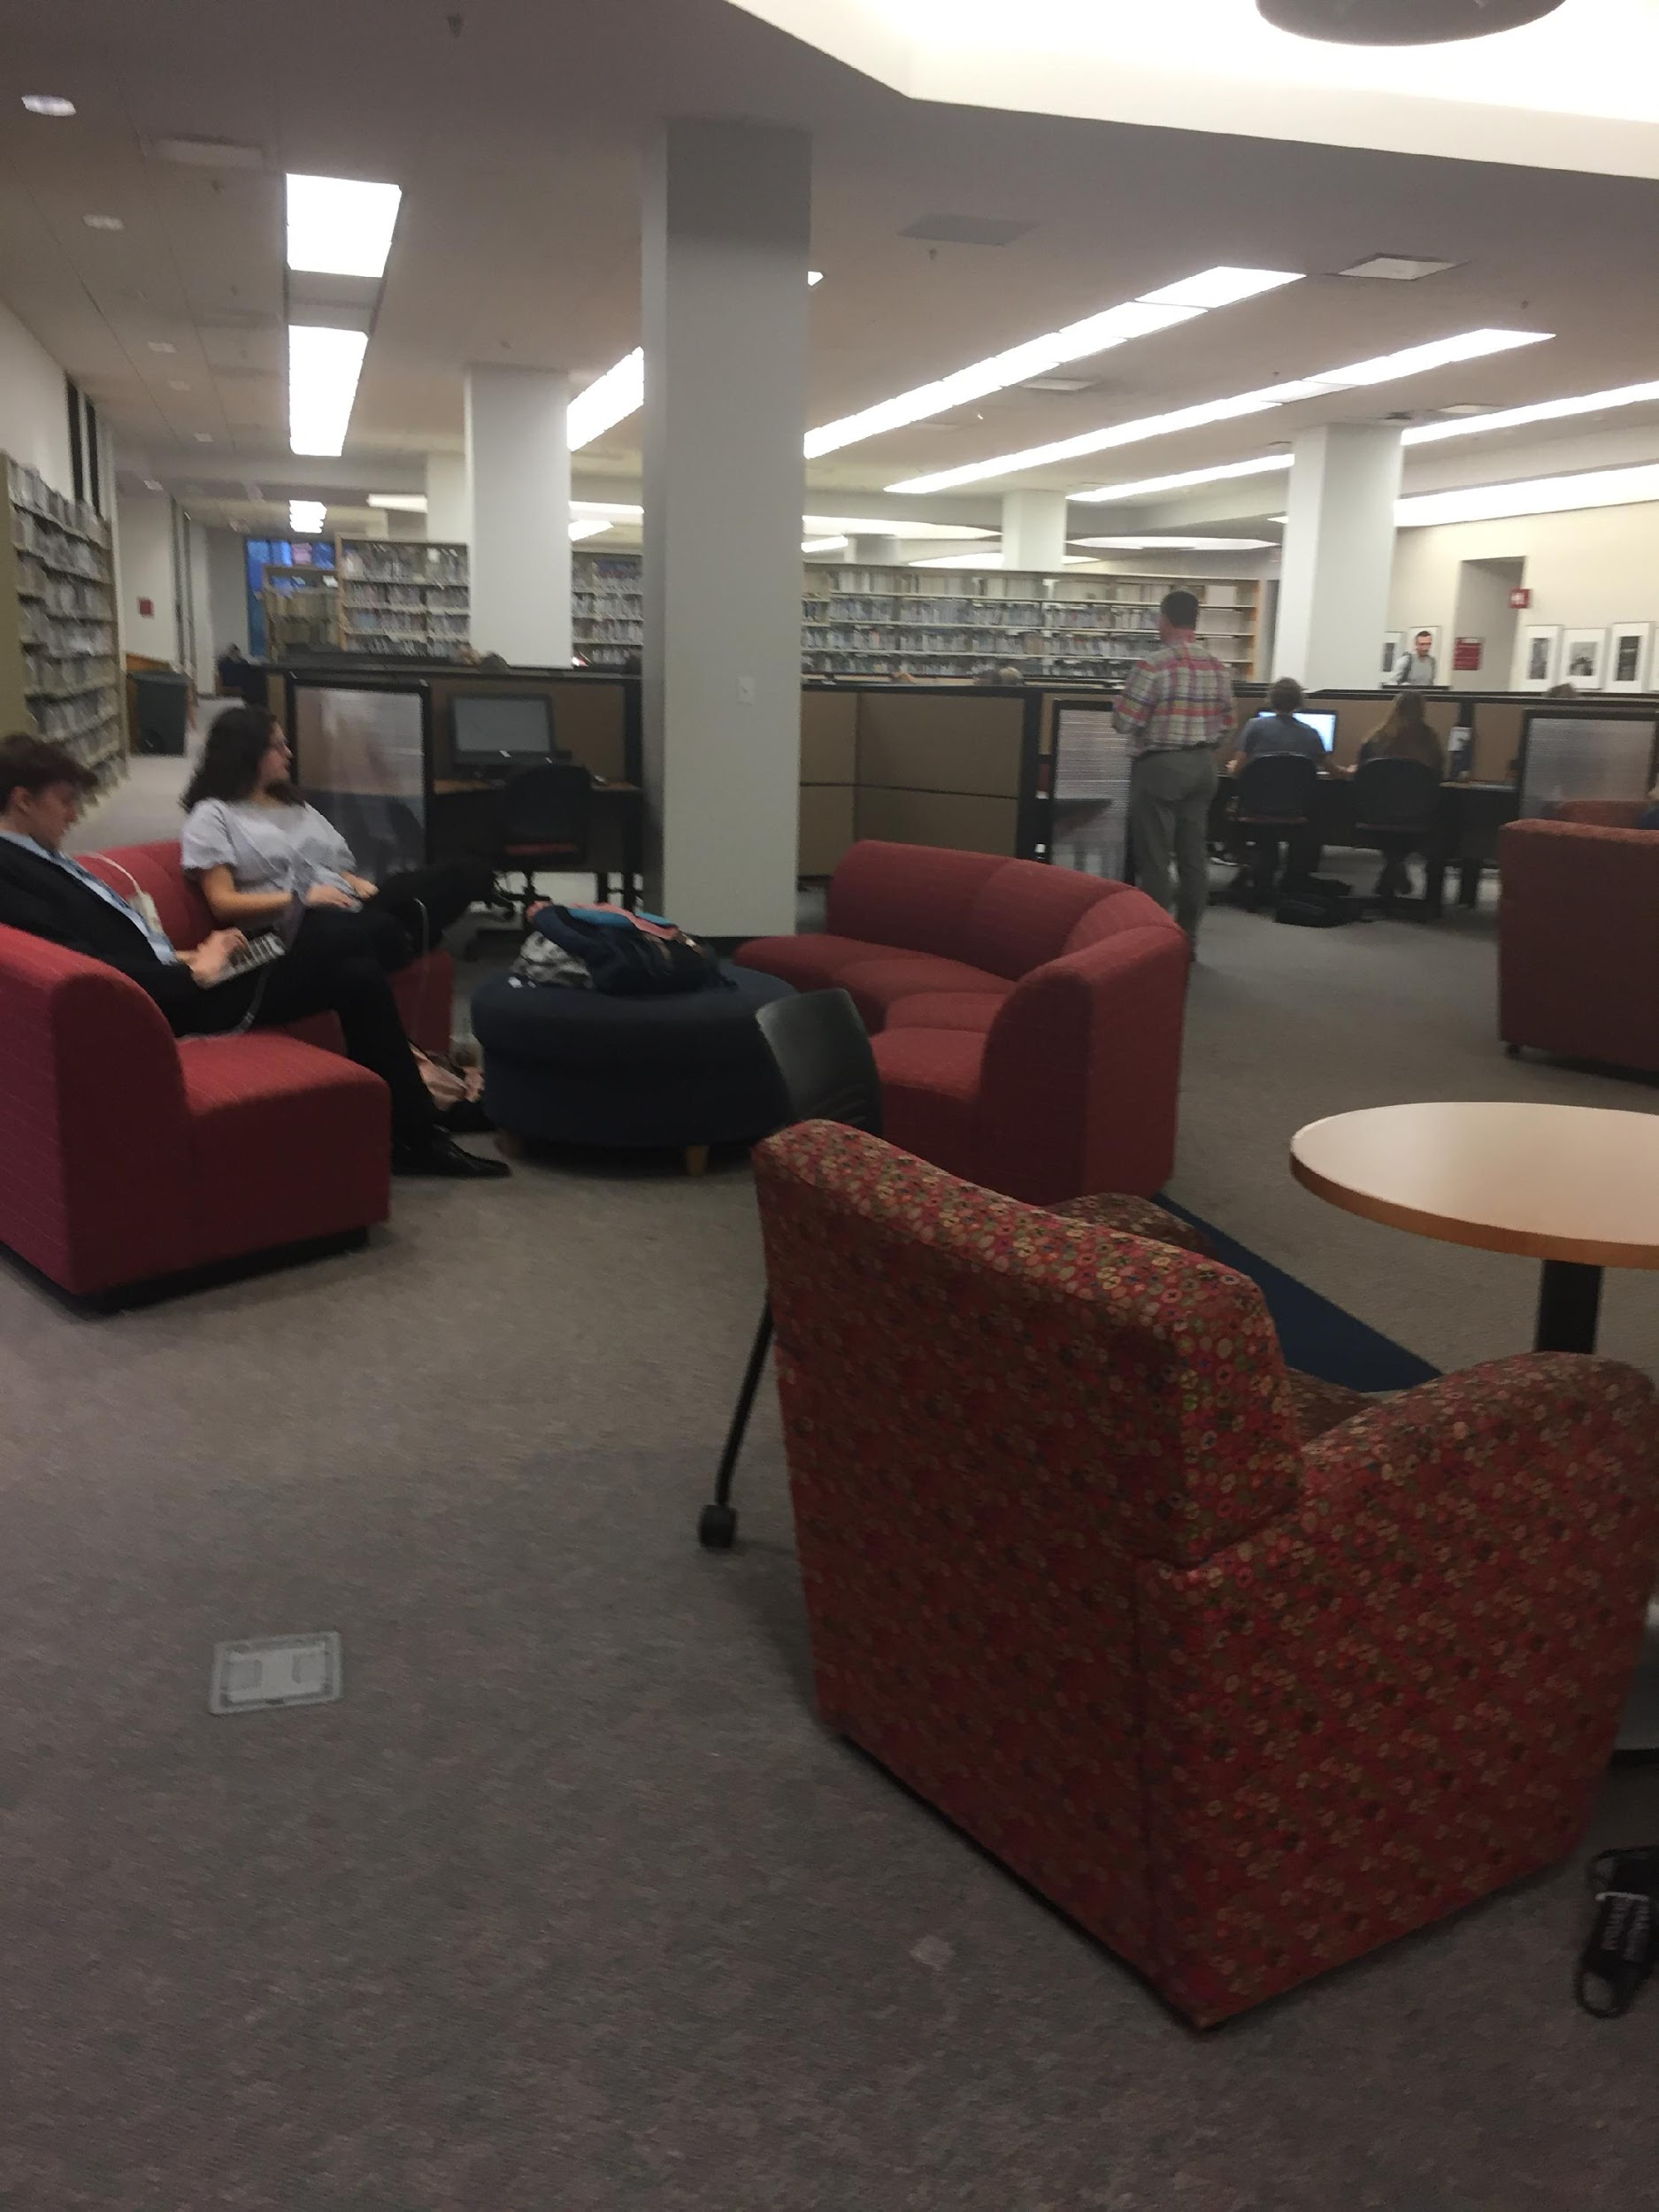
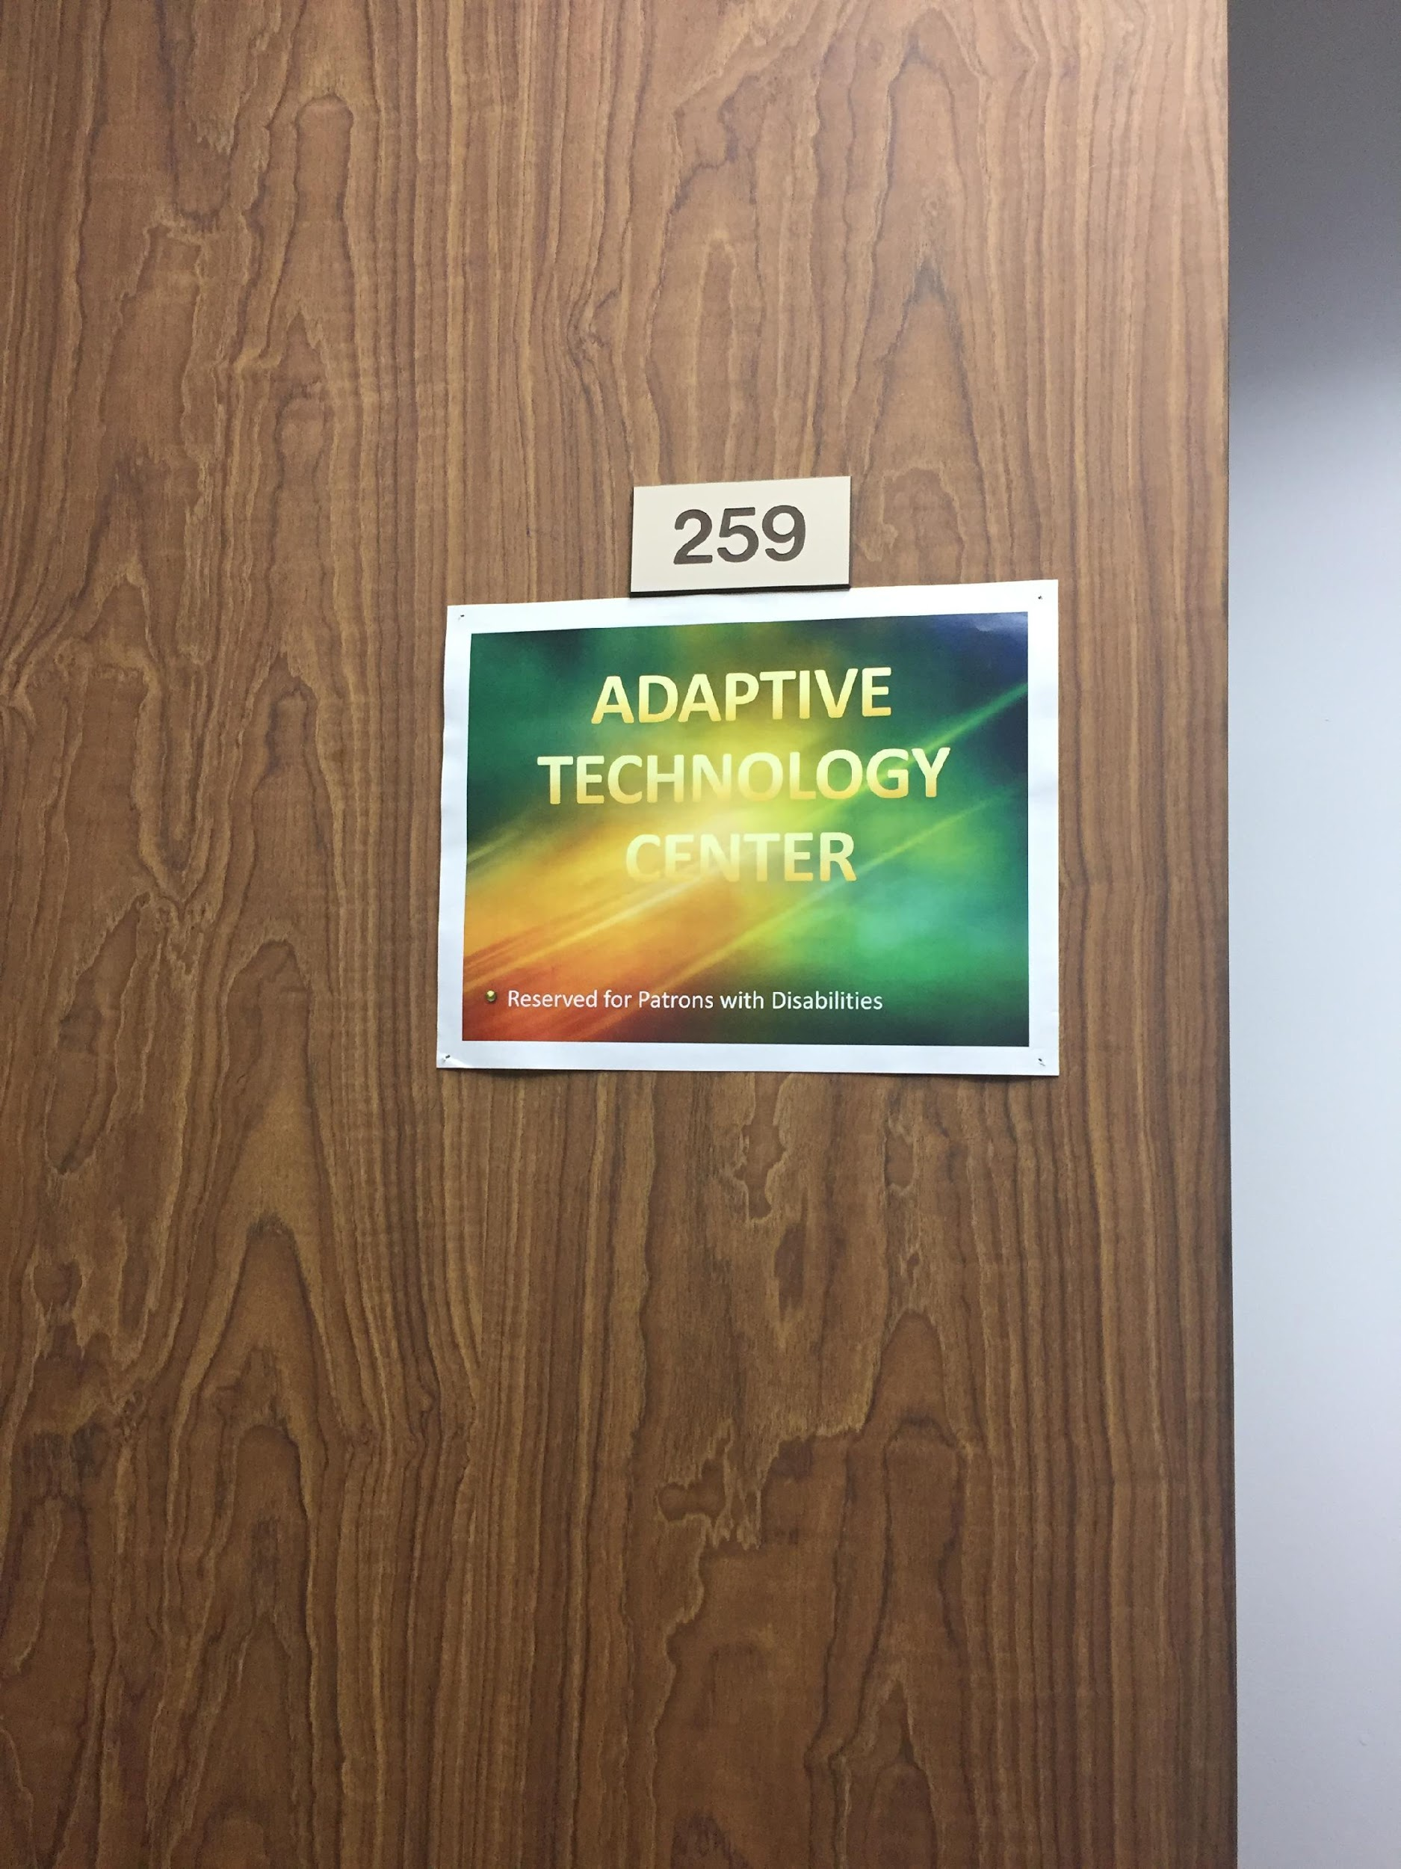
INSPIRATION FROM OTHER LIBRARIES

Slide 5



TAKE IT AWAY, TERI!
WHAT WE WANT TO DO, WHAT WE CAN DO
AFFORDABLE LEARNING LOUISIANA
OPEN TEXTBOOKS, EBOOKS AS TEXTBOOKS, OPEN EDUCATIONAL RESOURCES {OERS}, AND OTHER OPEN ACCESS (OA) RESOURCES
“CHOICE. AFFORDABILITY. ACCESSIBILITY.” – LOUIS
IDENTIFYING APPROPRIATE, RELEVANT RESOURCES AND NEGOTIATING FRIENDLY PRICES FOR LIBRARIES

Slide 6

TAKE IT AWAY, MEGAN!
WHAT WE CAN DO
SOME THINGS HAVEN’T CHANGED {LIKE HOURS AND SERVICES}
WORKING WITH LIBRARY COMMITTEE AND OTHER DEPARTMENTS
STILL OFFERING LIBRARY INSTRUCTION, ONE-ON-ONE RESEARCH CONSULTATIONS, ASSISTANCE WITH DESIGNING MEANINGFUL RESEARCH ASSIGNMENTS, COLLABORATION, FACILITATING…WHATEVER WE CAN DO TO HELP STUDENTS AND FACULTY WITH LEARNING AND RESEARCH!
WE’RE ALWAYS SEEKING OPPORTUNITIES TO COLLABORATE AS A MEANS OF ENHANCING LEARNING AND RESEARCH; WE WANT TO HEAR FROM YOU TO IDENTIFY OPPORTUNITIES AND SOLUTIONS!
Notes:
Departments like MFT and IT; discussing open workshops as an option for faculty who do not have wiggle room in their lesson plans to invite a librarian in to teach; expand video offerings, especially geared towards online/distance learning students; emphasize collaboration and the importance of getting meaningful (realistic) feedback and input.

Slide 7

WHAT WE CAN DO
SO, IF YOU WANT HELP TO DEVELOP RESEARCH ASSIGNMENTS – LET US KNOW!
IF YOU HAVE QUESTIONS ABOUT OUR RESOURCES – JUST ASK!
IF YOU WANT TO PUT CRITICAL RESOURCES ON RESERVES – GET IN TOUCH!
IF YOU WANT US TO COME TO YOUR CLASSROOM TO TALK ABOUT THE RESEARCH PROCESS, CITATION FORMATS, RESOURCES, OR OTHER RESEARCH TOPICS – JUST ASK!
IF YOU WANT TO COLLABORATE TO ENHANCE RESOURCES, LIBRARY SPACES, PILOT SOLUTIONS, OR OTHERWISE ENHANCE LEARNING AND RESEARCH ON CAMPUS – PLEASE GET IN TOUCH!
WE WANT TO ADD VALUE TO THE WHOLE CAMPUS COMMUNITY!
Notes:
We’re totally fine with being “attached” to classes – that is, faculty pointing students towards their subject liaison and adding our names to syllabi and Moodle courses; we’re also cool with faculty linking to our guides and tutorials or downloading them and incorporating them into Moodle courses. Ebsco offers Curriculum Builder (https://www.ebscohost.com/discovery/customization/curriculum-builder). Collaboration is key to success, and we’re open to outside-the-box thinking for sure. We are expanding our social media presense as a means of making contact with our audiences (students, the campus community).

Slide 8

NOW IT’S *YOUR* TURN!
DO Y’ALL HAVE ANY QUESTIONS FOR ANY OF US?

Slide 9
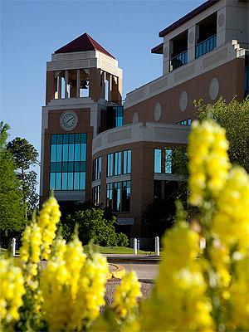
THANK YOU FOR COMING!
PLEASE DON’T HESITATE TO CONTACT US WITH QUESTIONS, CONCERNS, FEEDBACK, IDEAS, SUGGESTIONS, OR JUST TO SAY HI! WE’RE HERE TO HELP AND COLLABORATE WITH YOU!
TOM: HOOVER@ULM.EDU
TERI: TERI.GALLAWAY@REGENTS.LA.GOV
MEGAN: LOWE@ULM.EDU

