Slide 1



Slide 2
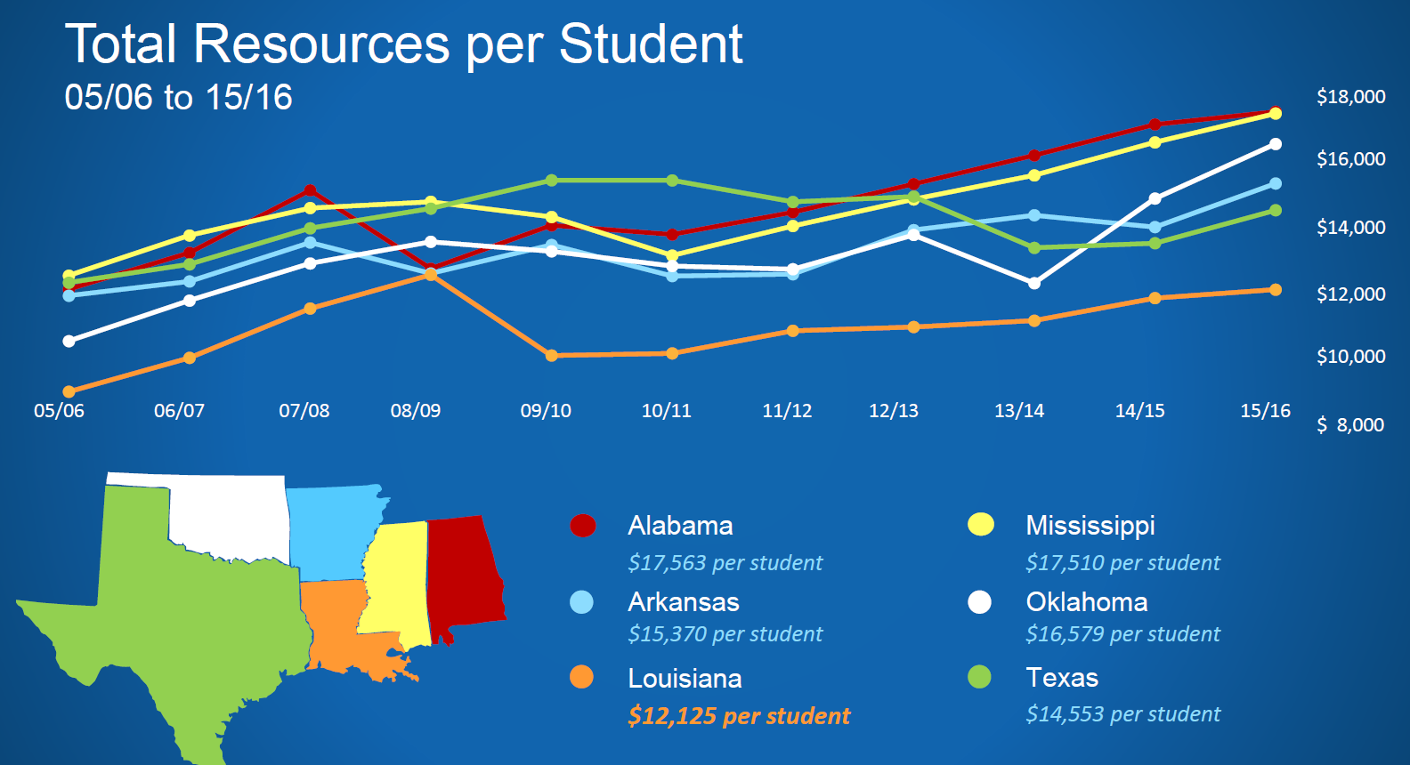
Louisiana’s colleges and universities operate at the lowest unit cost in the country.
The challenge: those “units” are students, and the “cost” is our investment in their future.

Slide 3
Between 1991 and 2015, the share of good jobs going to workers
without a bachelor’s degree fell from 60 percent to 45 percent.
Source: Georgetown University Center on Education and the Workforce analysis of Current Population Survey Annual Social and Economic Supplement (March), 1992 – 2016

Slide 4
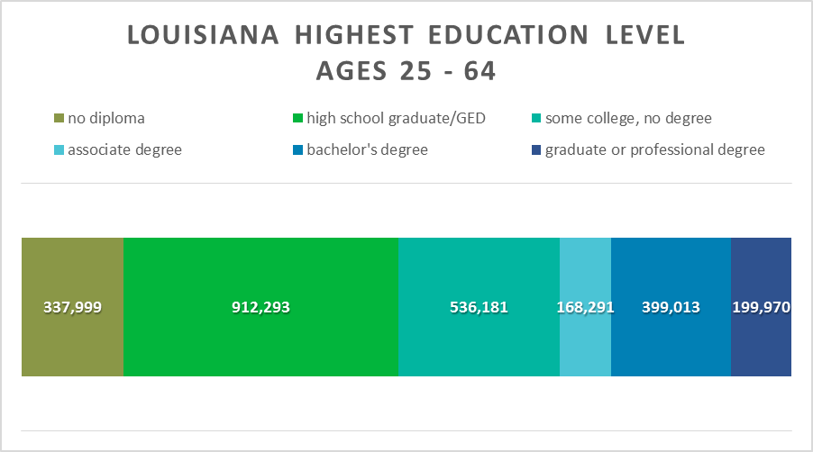
The foundation for workforce development, economic development, and community development is human development.
Source: Lumina Foundation’s A Stronger Nation

Slide 5

FALL ENROLLMENT
2013 – 2017

Slide 6




Academic Success, Student Success and
Educational Attainment
As the largest post-secondary education system in Louisiana, the UL System produces 16,000 graduates annually. Given the documented economic and societal benefits associated with increased levels of educational attainment, our universities are committed to producing Louisiana’s most educated generation in our history. Specifically, by 2025, our System will produce 150,000 new graduates who are prepared for life and career success.

Slide 7
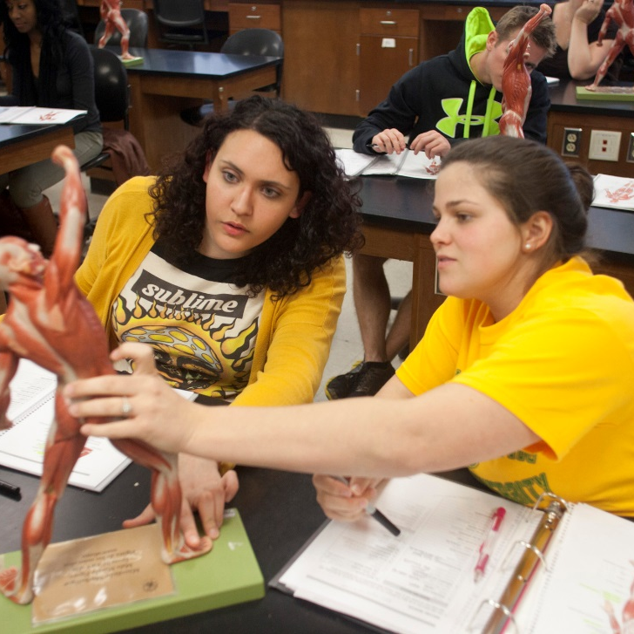

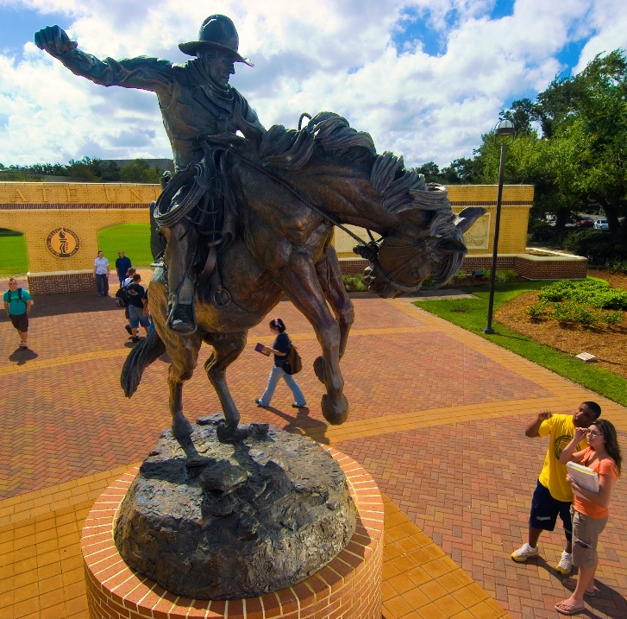
Academic Success, Student Success and
Educational Attainment
Future numbers of high school graduates are forecast to plateau in Louisiana. As a result, increasing the number of Louisiana citizens with post-secondary education will require that more graduates come from non-traditional populations, including sectors of the population that historically have had lower participation and success rates. Accordingly, the Universities of Louisiana will increase participation and success among all populations.

Slide 8


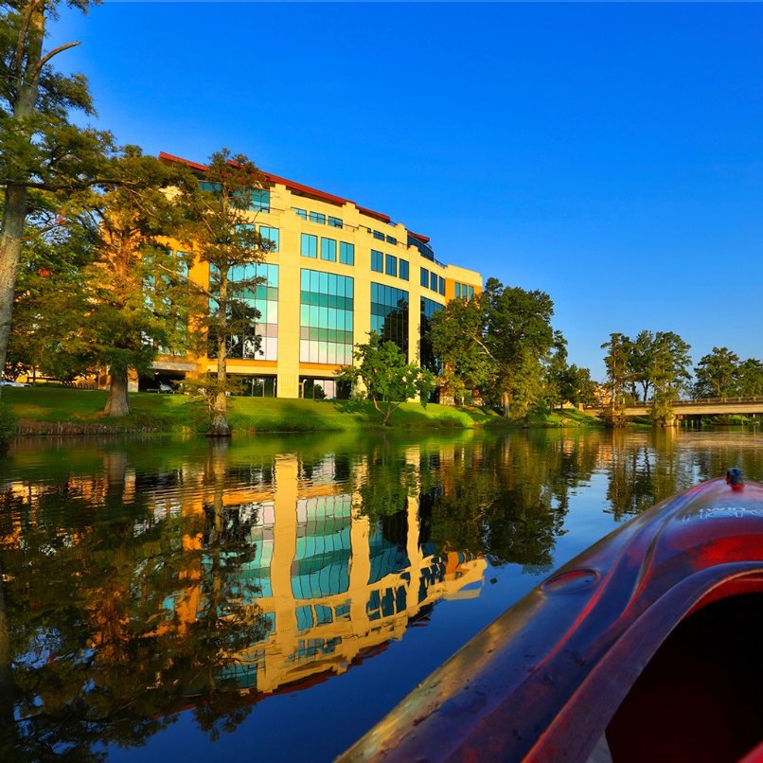
Economic Development, Research and Innovation
Louisiana’s growing knowledge-based economy and the evolution of traditional economic sectors create new opportunities for collaboration with business and industry. All regions of Louisiana have benefited from new and expanded business entities who partner with our universities. Building on these successes, our universities will expand public and private partnerships that enhance economic prosperity.

Slide 9



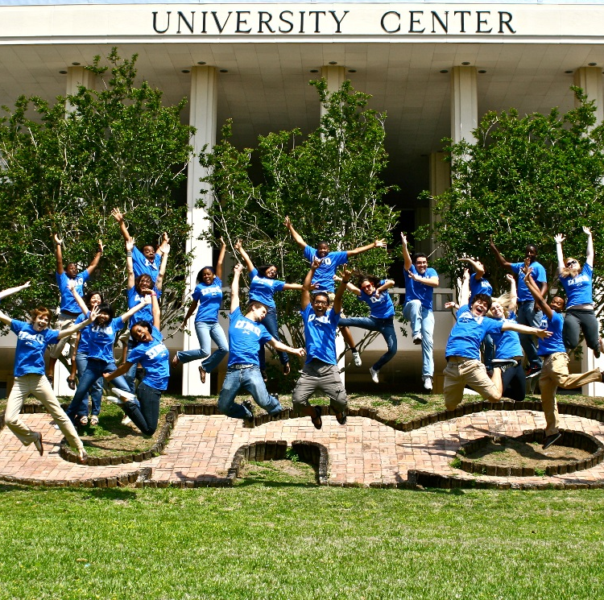
Economic Development, Research and Innovation
Rapidly advancing technology combined with vastly improved data collection and analysis capabilities have led to an unprecedented era of discovery and innovation. The substantial research and graduate education resources of our universities can provide solutions to generational challenges while preparing our state to seize emerging opportunities. The Universities of Louisiana will leverage our collective research capacity to improve quality of life and stimulate economic growth.

Slide 10


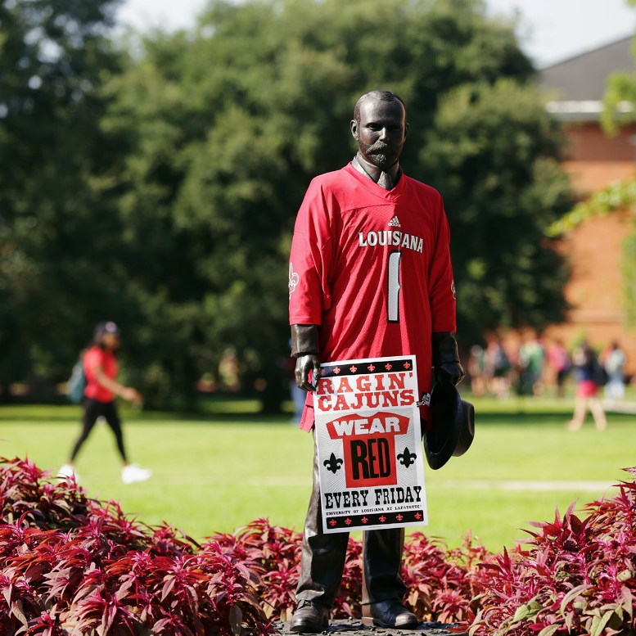
Financial Stewardship and Accountability
The Universities of Louisiana will continue to pursue operational practices that increase return on investment to stakeholders. Already a leader among Southern Region Education Board States in maintaining low administrative costs, our universities will maximize administrative efficiencies resulting in an increased investment in instruction and academic support.

Slide 11
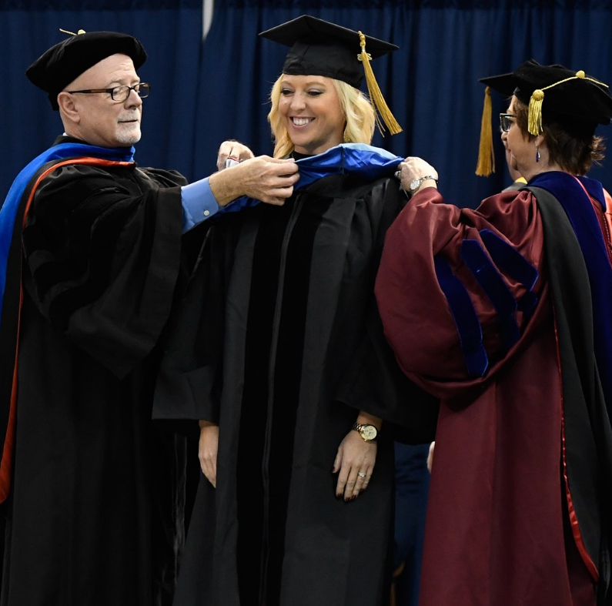


Financial Stewardship and Accountability
Stewardship demands care and responsible management of resources, the most valuable of which is our faculty. They are the connection between the student and the institution. The Universities of Louisiana will increase value to students by recruiting, retaining, and developing the highest quality faculty with a focus on excellence in teaching, research, and innovation.

