Slide 1
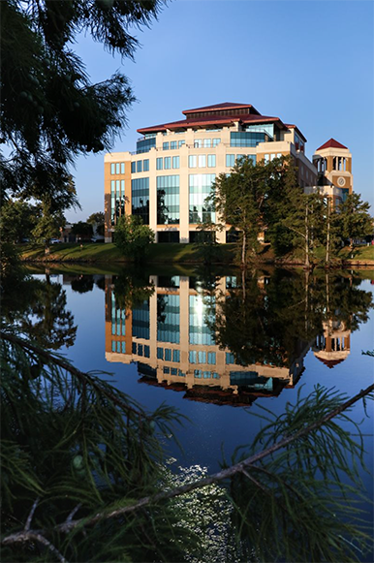
Creating Accessible Links in PPT
Descriptive Links

Slide 2
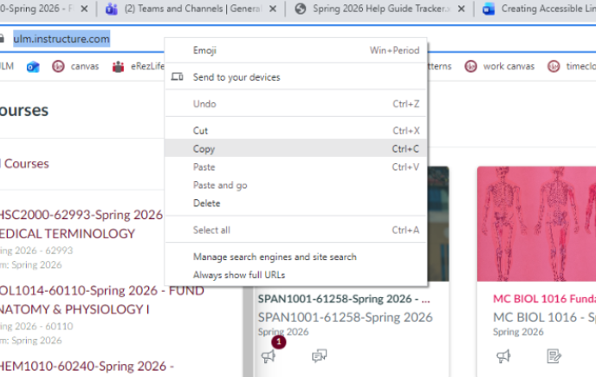
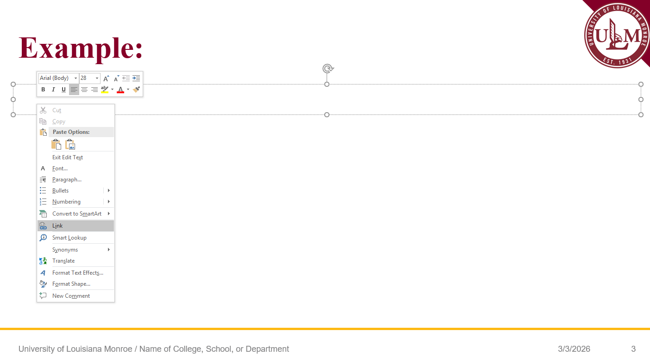
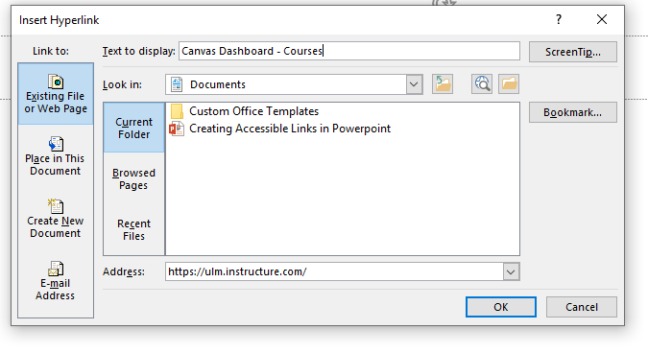
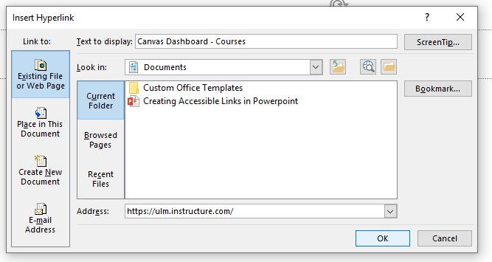
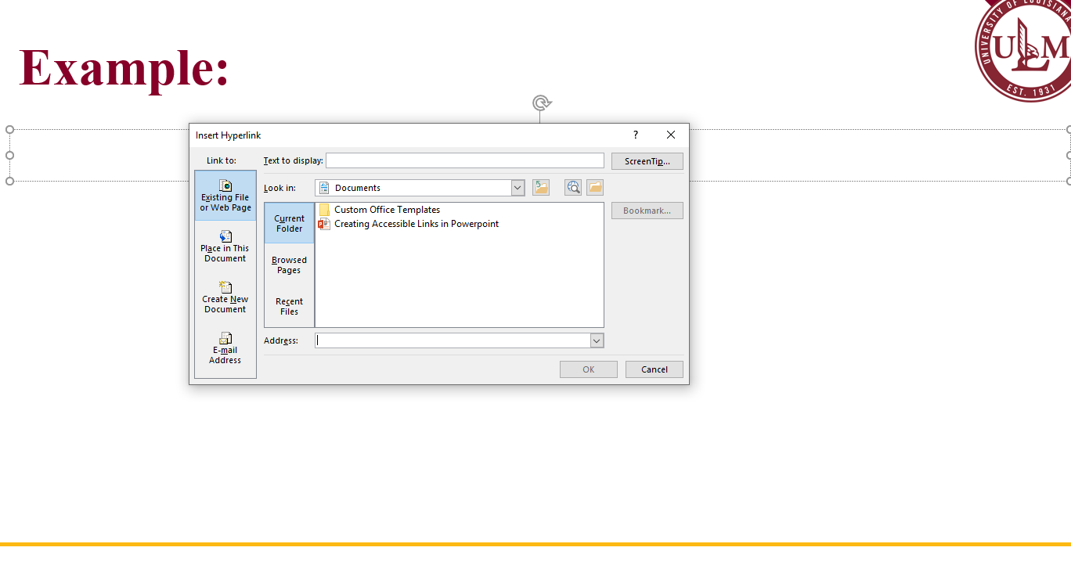
Step 1:
How to:
Step 2:
Step 3:
Step 4:
Copy the Desired Link
Select “Link” on Menu
Insert URL and Title
Insert The Hyperlink
2 Possible Methods
Right click and select “copy”
Ctrl+c
2 Possible Methods
Right click and select “Link”
Ctrl+k
2 Possible Methods
Right click and select “paste”
Ctrl+v
(Title Option Discussion on slide 3)
2 Possible Methods
Select “OK”
Hit the “enter” key

Slide 3
Overview:
Purpose:
  Having a long link with random letters and numbers is hard to read
  INSTEAD, insert a title that describes what the link leads to
Examples of Good Titles:
  Descriptive: “Read the Accessibility Training Guide”
  Action-Oriented: “Submit your project proposal”
  Document Specific: “Download the Lab Report Template”
  Contextual: “Learn more about our guidelines”
Examples of Titles That are Poor Descriptors:
  “Click here or “Click here for more info”
  “Link to [document” or “See document”
  “Read more” or “More”
  Raw URLs
  “Here”

Slide 4
Overview:
Key Tips:
  Use descriptive text: ensure the link tell the user exactly where they are going
  Avoid “Link to”: screen readers already announce that an item is a link
  Keep it concise
  Avoid raw URLs
  Ensure visibility: keep links underlined so that they are identifiable

Slide 5
All done!

