Slide 1


COMPUTING CALL CENTER
TRAINING
University Computing Center (UCC) 2016

Slide 2
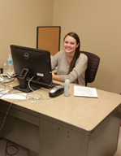
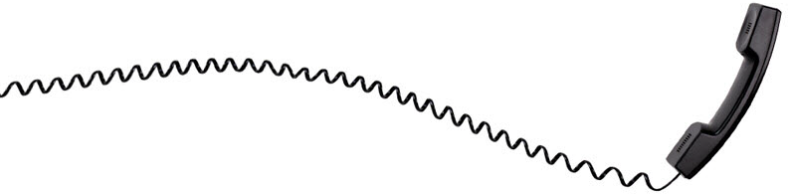

COMPUTING CALL CENTER
Hours
Monday – Thursday 7:30am to 5:00pm
Monday - Friday 7:30am to 11:30am
Call Center
Call Center is an extension of the Helpdesk
Responsible for answering telephone calls from ULM faculty, staff, students, parents, etc.
Telephone
318-342-3333
University Computing Center (UCC) 2016

Slide 3
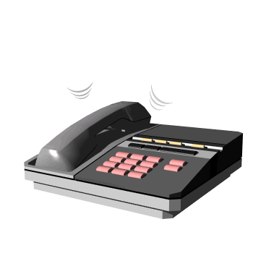
CALL HANDLING
When A Call Comes In…
Answer the phone politely and say, “Computing Call Center.”
Sometimes the caller will begin by telling you they are ULM faculty or staff and would like to submit a ticket.
The caller could be a ULM student or the parent of a ULM student who is requesting assistance with logging on to their myULM account, etc. Each call varies.
Ask the caller, “Are you faculty, staff, or a student?”
If the call says that they are faculty or that they are staff, in most cases, they need to submit a ticket.
University Computing Center (UCC) 2016

Slide 4
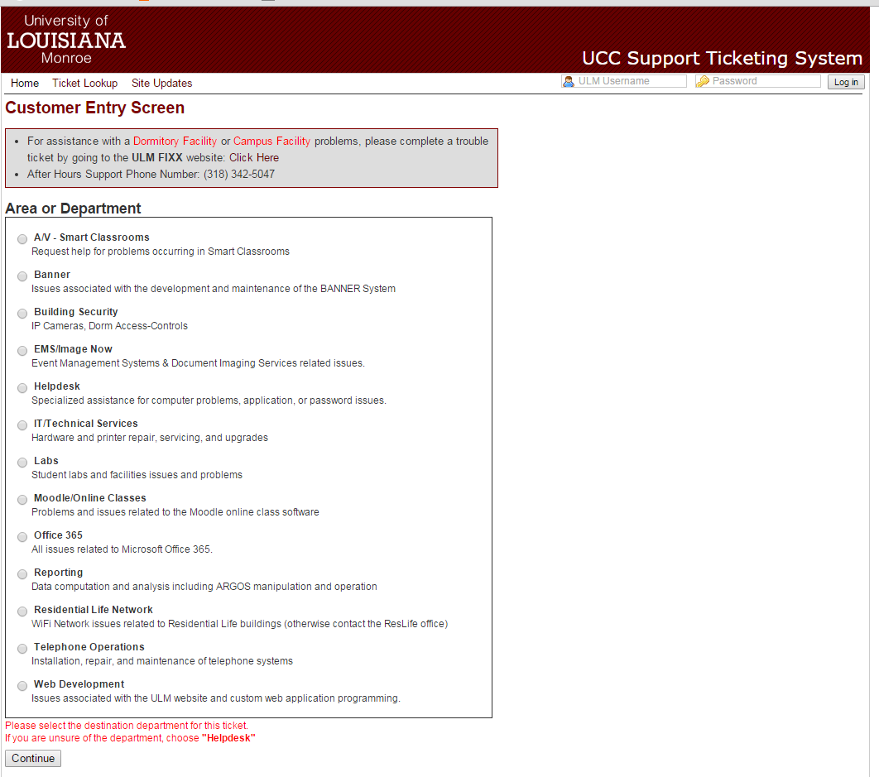
HOW TO SUBMIT A TICKET/WORK ORDER
Go to the UCC Ticketing System at https://webservices.ulm.edu/computersos
University Computing Center (UCC) 2016

Slide 5
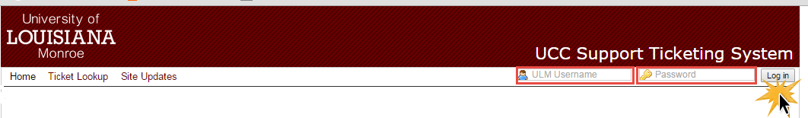
HOW TO SUBMIT A TICKET/WORK ORDER
2. Log in to the UCC Ticketing System using your myULM username and password.
University Computing Center (UCC) 2016

Slide 6
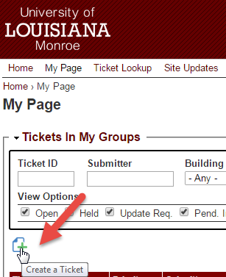
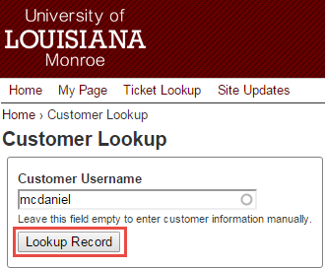
HOW TO SUBMIT A TICKET/WORK ORDER
On your home page, click the “Create a Ticket” icon.
4. You should now see “Customer Lookup”.
Ask the caller, “What is your ULM campus email?
Type in the first portion of the caller’s campus email.
For example: Wayne McDaniel’s email is: mcdaniel@ulm.edu You only have to type in the “mcdaniel” portion and then his name, Wayne McDaniel will appear and you should click on his name and then click the
“Lookup Record” button.
University Computing Center (UCC) 2016

Slide 7
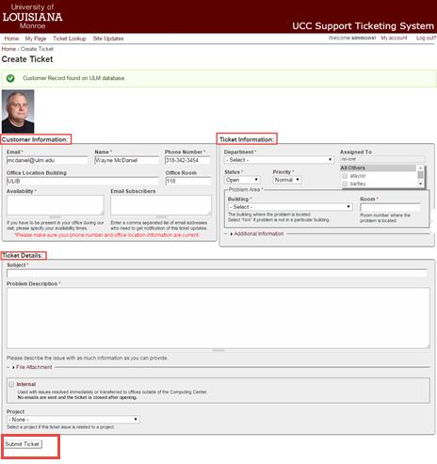
HOW TO SUBMIT A TICKET/WORK ORDER
Create Ticket
You should now see boxes for “Customer Information, Ticket Information, and Ticket Details”
University Computing Center (UCC) 2016

Slide 8
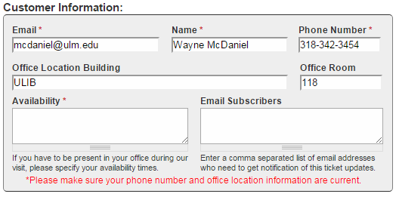
HOW TO SUBMIT A TICKET/WORK ORDER
Create Ticket-cont’d
In the “Customer Information” box:
Most of this box will be automatically filled when the caller’s information is found in the ULM database. But, double check the information with the caller. Be sure you have their correct ULM campus email, name, phone number, and office location.
In the “Availability” box: Ask the caller when they would be available to meet with a Helpdesk worker and type the caller’s available times to meet in that box.
University Computing Center (UCC) 2016

Slide 9
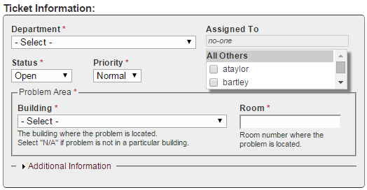
HOW TO SUBMIT A TICKET/WORK ORDER
Create Ticket-cont’d
In the “Ticket Information” box: Under the “Department” drop down box, select either “Help Desk” or “IT/Technical Services” unless otherwise directed. Under the “Building and Room Number” drop down boxes, ask the caller, “Where is the problem located?” and then select from the drop down box the location of the building and type in the specific room number.
University Computing Center (UCC) 2016

Slide 10
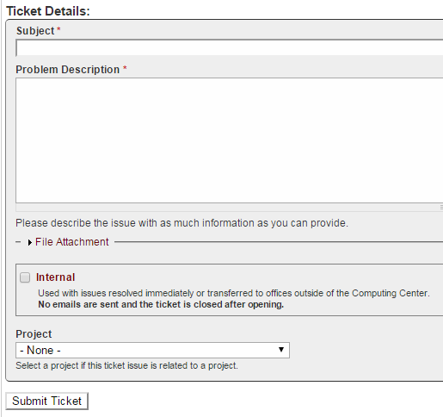
HOW TO SUBMIT A TICKET/WORK ORDER
Create Ticket-cont’d
In the “Ticket Details” box: Ask the caller, “Could you please describe the problem?” Type in anything the caller explains to you and try to get as many details as possible. For example: If the caller explains to you that their desktop is not working properly, you should ask the following questions: Is your desktop a Mac or PC? Have you tried unplugging your desktop? Also, ask specific questions about the desktop’s problems. What about your desktop is not working properly? Is your screen black? Is your screen frozen? Etc.
Once you are finished filling out all of the information boxes, you should then click the “Submit Ticket” button.
University Computing Center (UCC) 2016

Slide 11
HOW TO SUBMIT A TICKET/WORK ORDER
Finally, once you are finished filling in the information for the ticket, ask the caller, “Is there anything else I can help you with?” If yes, continue to assist the call. If no, politely end the conversation with the caller by saying, “I have all of your information and will submit this ticket for you”.
University Computing Center (UCC) 2016

Slide 12
HOW TO SUBMIT A TICKET/WORK ORDER
Before submitting a ticket::
Make sure that all of the caller’s information is correct on the ticket.
Make sure that all boxes marked with a red asterisk (*) are filled in. The ticket will not submit unless all marked boxes are filled.
NEVER give the caller a promise about time. Usually, tickets are worked on by the Helpdesk in the order that they are submitted. If the caller asks for a specific time say, “They will be with you as soon as possible”.
University Computing Center (UCC) 2016

Slide 13
THINGS TO REMEMBER
Always be polite to the caller. Say, “Yes ma’am, no ma’am, yes sir, no sir, please and thank you.” If the caller is rude, aggressive, or condescending, continue to be respectful until the call is finished. Once the call is finished, inform a supervisor (i.e. Wayne) of their attitude with you during the call and they will handle the situation.
Never give a caller your name. If they ask for your name, you may give them and ID number.
If you have a question, don’t be afraid to ask.
University Computing Center (UCC) 2016

Slide 14
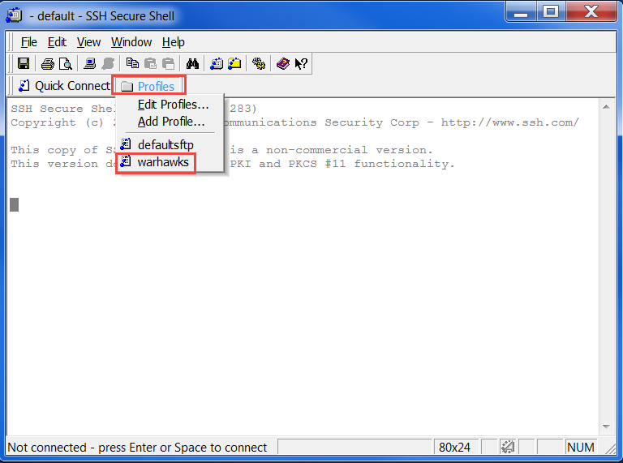
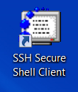
IF THE CALLER IS A STUDENT
Politely ask the student, “How can I help you?
Usually, when students call they either need to have their myULM password reset or they need to find out what their myULM username and password is.
If the student needs to have their myULM password reset:
Go to our “SSH Secure Shell” program.
Click on “Profiles” and then click on “Warhawks”.
University Computing Center (UCC) 2016

Slide 15
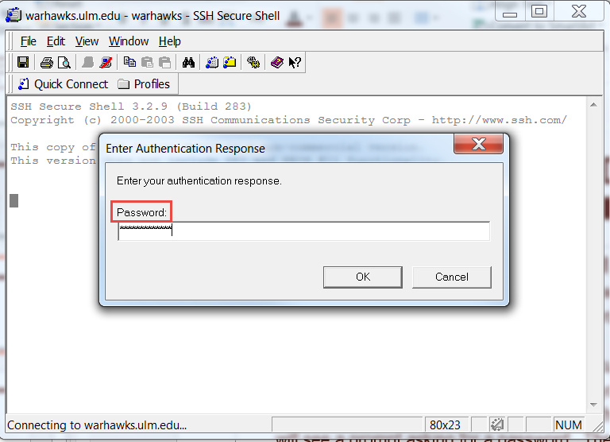
IF THE CALLER IS A STUDENT
If the student needs to have their myULM password reset: cont’d
A pop up box will appear and ask for a password. The password will be provided to you after completing training. After typing in the password, hit the “Enter” button on your keyboard.
University Computing Center (UCC) 2016

Slide 16
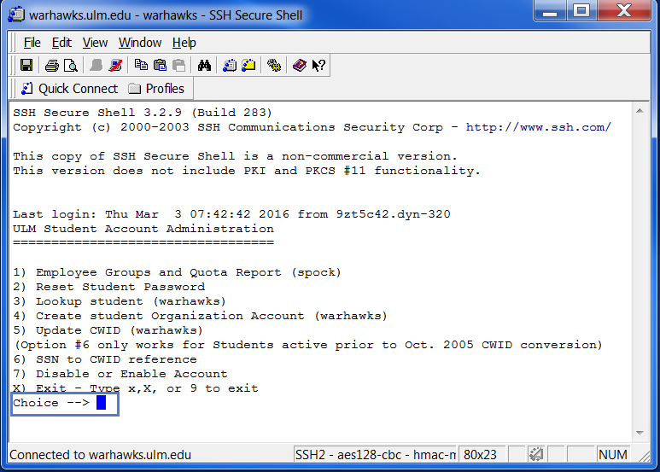
IF THE CALLER IS A STUDENT
If the student needs to have their myULM password reset: cont’d
Now you should see a list of options. Your cursor will be beside the word “Choice→”. Type the number “2”, which as you can see is the number choice to “Reset Student Password”. Once you type the number “2”, click “Enter” and you will see a prompt asking for a password. Type in the password and press “Enter”.
Type the number “2”
University Computing Center (UCC) 2016

Slide 17
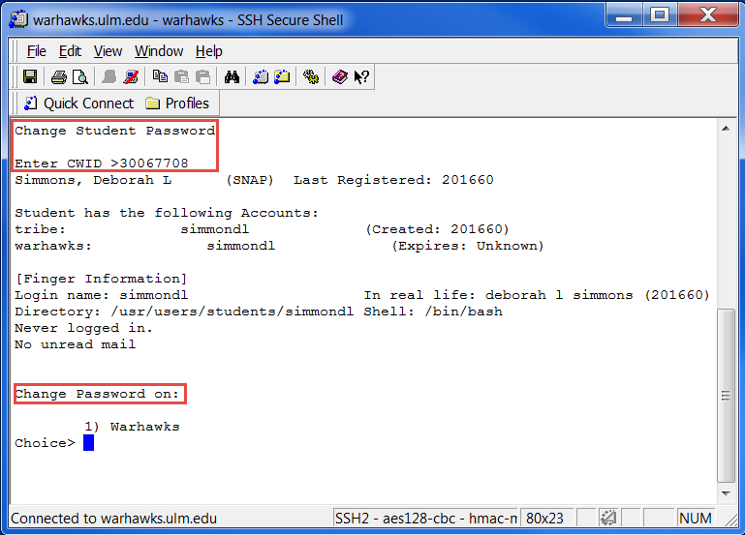
IF THE CALLER IS A STUDENT
If the student needs to have their myULM password reset: cont’d
Now you should see “Change Student Password and Enter CWID”. Ask the caller for their campus wide ID number. Type in their CWID number and press enter. (In the event that the caller does not know their CWID number, you can transfer them to Ace’s Place 342-7777 and they can look up the caller’s CWID number).
Now you should see the student’s name. It is always a good idea to ask the caller for their name to be sure that their name matches the name found for the CWID number. Toward the bottom, you should see “Change password on” with a “choice→” and you should type tin the number “1” and hit enter.
dan l smith
smithdl
smithdl
smithdl
smithdl
smithdl
dan l smith (201660)
Type the number “1””
University Computing Center (UCC) 2016

Slide 18
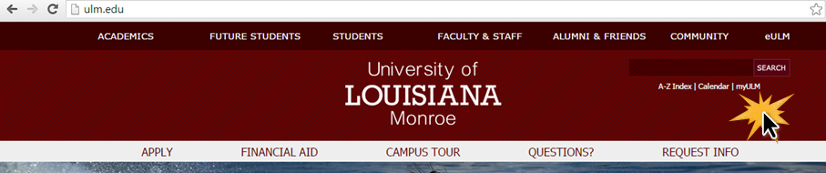
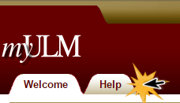
IF THE CALLER IS A STUDENT
If the student needs to identify their myULM username:
Go to the website “ulm.edu”.
Click “myULM” in the top right corner.
In the top left hand corner, click the “Help” tab.
University Computing Center (UCC) 2016

Slide 19
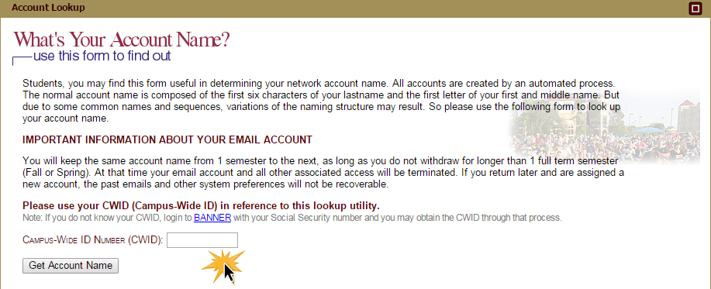
IF THE CALLER IS A STUDENT
If the student needs to have their myULM username: cont’d
To the right you should see “What’s your account name?” and a box where you are prompted to enter a campus wide ID number.
University Computing Center (UCC) 2016

Slide 20
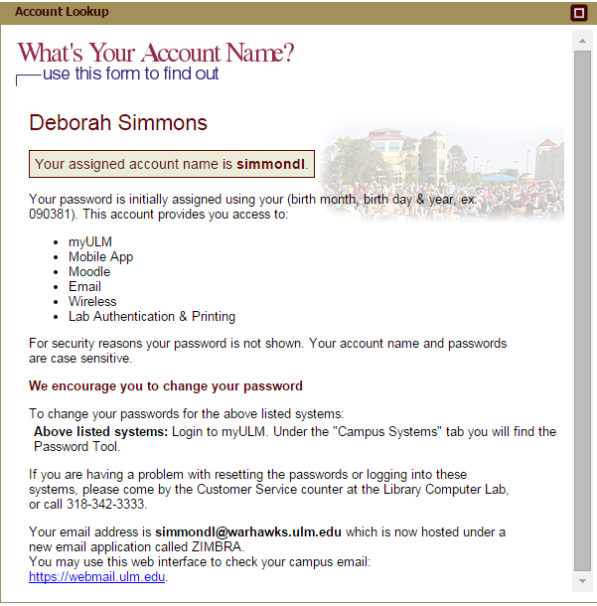
IF THE CALLER IS A STUDENT
If the student needs to have their myULM username: cont’d
Ask the caller for their CWID number, type the number into the box, click enter, and you should now see the caller’s name and “your assigned account name is” along with their account name.
Inform the caller of their username for their myULM account and be sure to tell them to NOT include the “@Warhawks.ulm.edu” portion into their username box.
ULM student’s password is default to their birthday. So, if a student does not know their myULM password, get them to try their birthday in this format: two digit month, two digit day, and only the LAST two digits of their year. For example: June 13, 1994 birthday would be “061394”.
If they are unable to log in to their myULM account, reset their password using the “SSH Secure Shell” (see steps for changing a password).
your name
Dan l Smith
smithdl
smithdl@warhawks.ulm.edu
University Computing Center (UCC) 2016

Slide 21
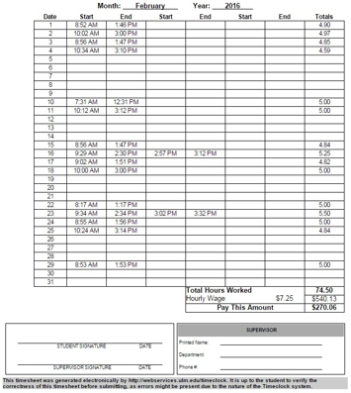
CALL CENTER RULES
Be respectful of your co-workers.
Don’t be late to work. Sometimes a coworker is waiting on the next worker to arrive to work before he/she can leave to go to class. If you are running late, let a supervisor know.
Timesheet example
The university only allows student workers to work a maximum of 20 hours a week (see example).
Student workers are only allowed to work 8 hours total in a day and can only work 5 hours consecutively before you must clock out and take a 30 minute break. For example, you may work from 8:00 a.m. to 1:00 p.m. (5 hours) and then you must clock out of work for at least 30 minutes. So from 1:00 to 1:30 you must be clocked out. After your 30 minute break, you can clock back in to work and at a maximum work 3 more hours in that same day so that you do not go over the 8 hour a day limit. So from 1:30 to 4:30 for a total of 8 hours in one day.
University Computing Center (UCC) 2016

Slide 22
CALL CENTER RULES
You must be answering the phones. If there are three people working at a time, person A gets the first call, person B gets the second call, and person C gets the third call. Rotate the calls evenly and fairly.
Never leave the Call Center unattended. If you must leave, let a supervisor know.
Use proper grammar and complete sentences when entering information. Be specific. Never enter problems like “computer is broken” or “needs help”.
University Computing Center (UCC) 2016

Slide 23
THINGS TO KNOW
Call Center workers are ONLY allowed to change student’s passwords. If a ULM faculty or staff member needs their password updated or changed, transfer them to Brenda Brown at 342-5024.
If a student does not know their CWID number, transfer them to Ace’s Place and they can search it. Ace’s Place: 342-7777.
If a student has formally left the university or has graduated longer than 6 months prior to the present date, their myULM account has been DELETED.
If a former student needs their unofficial transcript, they can still login to their banner account. Instruct them to go to “banner.ulm.edu”. Their user ID will be their CWID number and their password should be their birthday unless they have changed it. In the event that they have changed their password and need it reset, transfer them to the Registrar’s office at 342-5262.
Call Center workers are NOT allowed access to reset anyone’s banner account password. To reset their banner password, transfer them to the Registrar’s office at 342-5262.
University Computing Center (UCC) 2016

