Slide 1

Basic research skills
Presented by the ULM Library Reference Department

Slide 2
Where to Begin? At the Beginning!
Let’s say you need some research resources for a paper you’re writing for a class. You have a general topic – marijuana – and you know you need resources, but you aren’t sure how to get started.
Your impulse would be to start with the Internet, but instead, first consider what you need to find:
quality, credible resources
about or related to marijuana

Slide 3
Narrowing What You Need
“Marijuana” is a very, very broad topic, and trying to research a very, very broad topic is very, very difficult.
You need to narrow the topic down to something more specific – you can narrow the topic by asking yourself questions about the topic, such as…

Slide 4
Need to Narrow? Ask These…
What do I find interesting about the topic?
What might I find useful to learn?
What personal experiences have I had that relate to some aspect of the topic?
What misconceptions do people have about the topic that I’d like to clarify?
What myths exist about the topic that I’d like to dispel?
What would I like to learn more about with regard to this topic?

Slide 5
Asking the questions leads to…
The narrowing and focusing of the topic
The creation of a thesis statement, which becomes the backbone of your paper
From the thesis statement, you can generate keywords
Keywords are the most important parts of your thesis statement and are what you use to conduct searches when looking for resources (but we’ll talk more about keywords and keyword searching later)

Slide 6

Marijuana should be legalized for medicinal purposes.
Medical marijuana should be legalized for medicinal purposes.
Medical marijuana should be legalized for the treatment of seizures, glaucoma, and nausea as a result of chemotherapy.
marijuana
legalized
medicinal
purposes
cannabis
legalization
medicine
medical
“medical marijuana”
law
treatment
seizures
migraines/headaches
glaucoma
“pain relief”
chemotherapy
“case study” (or studies)
doctors
I strongly advocate keeping a list of keywords – it can help you focus and organize!

Slide 7
More on Keywords
Keyword searching is how you’re going to be conducting most of your searching. Keyword searching is the combination of key words (get it?) with operators (AND, OR, and NOT) to produce search strings
Remember, keywords will come from your thesis statement, but you ought to include related words and concepts as well
When using phrases – like couple conflict – you need to put the phrase in quotation marks:
“medical marijuana”

Slide 8
Search string: examples
“medical marijuana” and legalization
“medical marijuana” and legalization and treatment
marijuana and medicine and treatment
marijuana and treatment and migraines or headaches
marijuana and legalization NOT “drug cartels”
* Use AND not + or &. Pay attention to number (singular vs. plural) and spelling.

Slide 9
Brainstorming
Generating a list of keywords is also a means of brainstorming about topics
There are different ways one can brainstorm, though; these other ways can also generate keywords for you to use in your search
If you’re more visually-oriented, don’t be afraid to draw or use more visual methods of brainstorming
You can use research diaries or logs to help you organize your thoughts

Slide 10
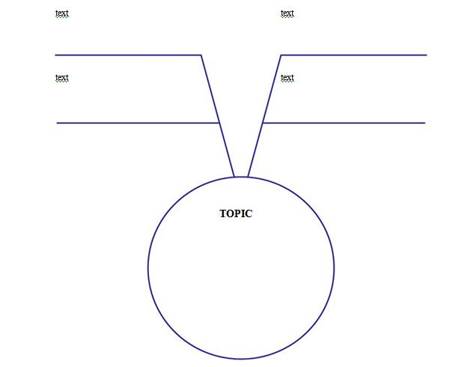
Marijuana has many legitimate medical uses
Marijuana has been legalized in several states for medical use
Marijuana is still illegal in much of the USA
Synthetic cannabinoid drugs have a high instance of toxicity
MARIJUANA

Slide 11
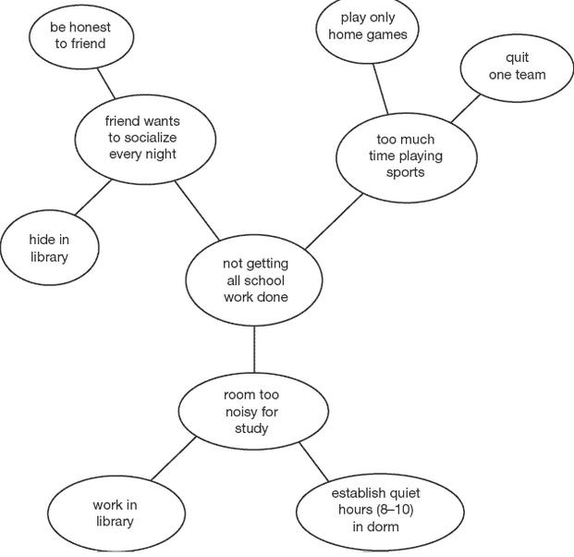
This form of brainstorming is sometimes called a circle map.

Slide 12
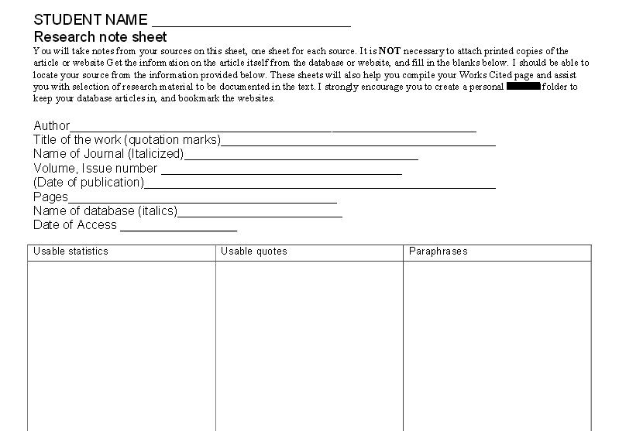
This research diary could be easily adapted and used for books and websites as well – any resource you end up using for your research!

Slide 13
NEXT STEP: *NOT* Searching YET
That’s right – we’re not searching yet. Hold your horses! There’s something you need to know.
Know how most professors (and librarians) cringe when you use Google and other search engines and rely too heavily on websites for your research?
The reason for this is that the Internet is NOT moderated or quality-controlled, and there’s a lot of GARBAGE and RUMOR and outright MISINFORMATION floating around.

Slide 14
*NOT* Searching YET
You don’t want to write a paper or conduct research with GARBAGE, RUMOR, or MISINFORMATION, do you? OF COURSE NOT!
You wouldn’t feed a baby GARBAGE, would you? OF COURSE NOT!
You would feed a baby healthy, safe, clean food, right? RIGHT!
Think of your paper like a baby – you want to fill it with healthy, safe, clean things!

Slide 15
*NOT* Searching YET
“healthy, safe, clean things” = scholarly, peer-reviewed, research-oriented resources
There ARE scholarly, peer-reviewed, research-oriented resources on the Internet – but it usually takes extra effort and time to find them
However, starting with the Library’s resources means that you’re heading straight for those resources right out of the gate – the Library is CHOCK-FULL of scholarly, peer-reviewed resources!

Slide 16
So…what are scholarly resources?
Written by experts
Focus on a particular field, topic, or discipline
Intended for others in that field or career
“Proper” language, technical vocabulary
No ads
RESEARCH ORIENTED
* Journals are scholarly

Slide 17
POPULAR resources are the opposite
Written by journalists
Usually cover broad topics, fields, issues, or disciplines
Usually appeal to a wide audience
Everyday language, slang, even profanity
LOTS of ads
NOT RESEARCH ORIENTED
* Magazines and newspapers are popular

Slide 18
Using the Internet for Research
So, I mentioned earlier how your first impulse might be to go the Internet, but how that’s not a great idea?
And remember what I said, too: The reason for this is that the Internet is NOT moderated or quality-controlled, and there’s a lot of GARBAGE and RUMOR and outright MISINFORMATION floating around.
Let me qualify that: the Internet does have a LOT of GOOD information, too, BUT…

Slide 19
Using the Internet for Research
…sometimes it’s not so easy to tell if a website is appropriate for research or not, because remember: not everything is appropriate for research
But there are ways to tell if a website is appropriate for research or not
When using the Internet for research, use the following criteria to determine if a website is good for research or not – taking the time to evaluate websites will help you obtain GOOD resources

Slide 20
Evaluating Websites for Research
Authority--who created the web page? Are they experts? What are their credentials? Do they provide contact information?
Accuracy--where did they get their information? Are the facts verifiable through another source? Do they list a bibliography of citations from where they obtained their information?
Objectivity--does the site have biases? Is the information presented in such a way to allow the viewer to make his/her own judgment, or does the site try to persuade you to adopt its viewpoint? What is the purpose of the site? ***
Currency--when was the site last updated? Are the facts on the site up-to-date? Is the information current?
Coverage--how much of the topic does the resource cover? Does it attempt to cover all or most of the aspects, or is it vague?

Slide 21
During the Search
Organization is very important – keeping your resources organized means you can lay hands on what you need in an efficient way
  Invest in some folders – pocket folders, manila folders, 3-ring binders, whatever you like!
  Where possible, email yourself copies of the things you print off
  Where possible, save copies of the things you print off to a jump drive or a cloud service (like Google Drive)
That research diary sheet we saw earlier would be appropriate at this stage

Slide 22

After the Searching’s Done…
You have the resources you need, either digitally or physically, if you’ve printed them out
This is when underlining and/or highlighting come into play, as well as notes and sticky notes
Documentation is also important, in order to avoid plagiarism – several of our databases (like Ebscohost) will generate citations for you

Slide 23

After the Searching’s Done…
Note-taking on your resources can help you focus on the important parts of the resource and exclude or ignore the stuff that’s not relevant – it’s filtering
It’ll save you time, too – making note of what’s useful or relevant can save you from having to read the article again and again to find the good bits
Note-taking can also help you begin to formulate how to express or include information from the resource in your own writing

Slide 24
This research diary could be easily adapted and used for books and websites as well – any resource you end up using for your research!

Slide 25
RECAP
DO create a list of keywords
DO underline/highlight/bookmark
DO take notes/sticky notes
DO get organized
DON’T multitask
DON’T procrastinate
DON’T plagiarize

Slide 26
Question & Answer Time

Slide 27
Thanks for your attendance!
Remember, if you need research help, all you have to do is ask the librarians. You can…
Visit the Reference Desk, Library 1st floor
Email us at reference@ulm.edu
Call us at (318) 342-1071

