Slide 1
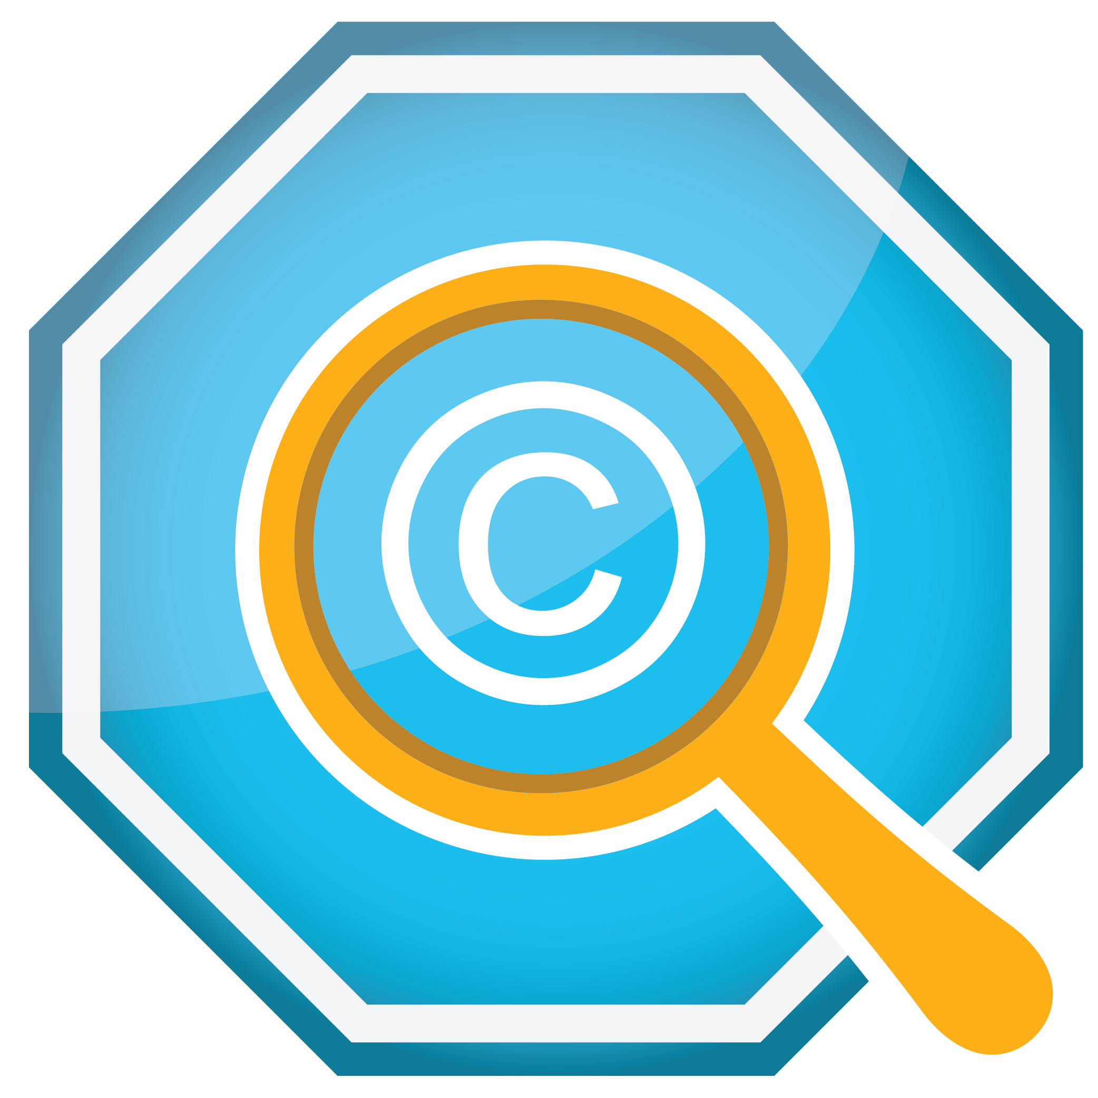

Copyright, Fair Use, and
Creative Commons Licensing
©
Dr. Megan Lowe, Director of University Libraries
Watson Memorial Library, Northwestern State University
This work is licensed under a Creative Commons Attribution-ShareAlike 4.0 International License.

Slide 2

Session Overview
What is copyright?
What is fair use?
What is Creative Commons Licensing (CCL)?
How do they work?
How do I stay compliant with each?
Q & A Time

Slide 3
What *IS* Copyright?
©
Copyright is "a form of protection provided by the laws of the United States (title 17, U.S. Code) to the authors of 'original works of authorship,' including literary, dramatic, musical, artistic, and certain other intellectual works. This protection is available to both published and unpublished works" (U.S. Copyright Office, n.d.).
A work does not have to be published to be copyrighted.
“Certain other intellectual works” is usually understood as a way of attempting to keep up with technology and new forms of content/media.
Being out of print (OOP) does not affect a work’s copyright status.

Slide 4
More on Copyright
©
Key things to understand about copyright:
  It is a bundle of rights intended to protect the author or copyright holder.
  It has commercial implications (this is a really key element to this discussion).
  These rights can be signed away and frequently are, which is how many publishers acquire the rights to work and authors lose control of their works.
There is a certain degree of copyright that is automatically conveyed on a work created in the United States. However, if you want to ensure full and legal protection under copyright, you must apply officially for copyright (there’s a form and a fee to pay).
In most settings, particularly commercial ones, in order to use copyrighted work, formal, documented permissions must be obtained from the copyright holder(s) – this could be the author themselves, their publisher, their estate, or some other legal entity. In some cases, it might require the payment of fees.

Slide 5
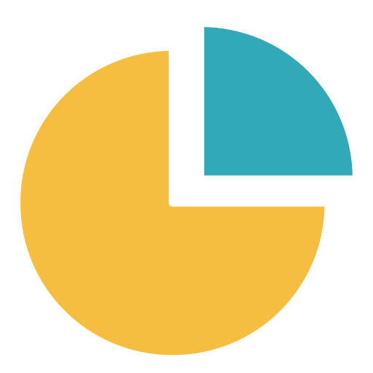
What *IS* Fair Use?
Fair Use is a statute under copyright law that allows for the use of limited portions of a work that has copyright WITHOUT having to have official permission(s) from the official copyright holder.
It was created for the purposes of education and research, i.e., teaching, learning, and scholarship.
However, it is a little harder to pin down than copyright: after all, what qualifies as a limited portion of a work?
Any guesses on what qualifies as a limited portion of a work?

Slide 6
More on Fair Use
The Copyright Office isn't very helpful on defining what a "limited portion" is. It only states that "there is no specific number of words, lines, or notes that may safely be taken without permission." When using someone else's work, it's best to always give credit where credit's due (that is, attribution and documentation), even if using only a small part. If you're unsure, then ask for permission.
It’s worth noting that APA format has its own ideas about what a limited portion is and recommends that 500 words or less is safely within fair use. Beyond that, permissions should be obtained. But APA does not necessarily address other formats (e.g., images or music) and how much would qualify as fair use or abuse of fair use (i.e., copyright infringement).

Slide 7

What *IS* Creative Commons Licensing?
Creative Commons Licenses (CCLs) are “legal tools that creators and other rights holders can use to offer certain usage rights to the public, while reserving other rights” (Creative Commons, n.d.b).
CCL is *not* anti-copyright; in fact, it is built on the fundamentals of copyright. Creative Commons (n.d.b) wants to “help those who want to encourage reuse of their works by offering them for use under generous, standardized terms; those who want to make creative uses of works; and those who want to benefit from this symbiosis.”
Functionally, CCL allows creators to offer a spectrum of options ranging from retaining all the rights commonly associated with copyright and giving up all rights (that is, public domain). Creative Commons calls this approach “Some Rights Reserved.”

Slide 8
More on CCL
There are six (6) Creative Commons licenses:
Attribution (CC BY): other people can take your work and “distribute, remix, tweak, and build upon” that work, even commercially, but they must credit you for the original work (Creative Commons, n.d.a).
Attribution-ShareAlike (CC BY-SA): Similar to Attribution in what others can do with your original work and giving you credit BUT the remixers must also license what they create using the same terms. Creative Commons (n.d.a) compares this practice to “’copyleft’ free and open source software licenses.” *
Attribution-No Derivatives (CC BY-ND): This license permits both commercial and non-commercial redistribution of your work, but the work cannot be changed and must remain in its entirety, and credit must be made to you.

Slide 9
More on CCL
Attribution-Noncommercial (CC BY-NC): Other people can build on, remix, and tweak your work but only for non-commercial purposes; their new works must credit your original work and also be non-commercial. However, any of their derivative works do not have to be licensed on the same terms.
Attribution-Noncommercial-ShareAlike (CC BY-NC-SA): Other people can build on, remix, and tweak your work but only non-commercially; they must credit your original work and license their new works under the same terms.
Attribution-Noncommercial-NoDerivatives (CC BY-NC-ND): This is the most restrictive of the CCLs. Other people can download your creations and share them provided they credit you. However, they can’t modify your works at all or use them commercially.

Slide 10
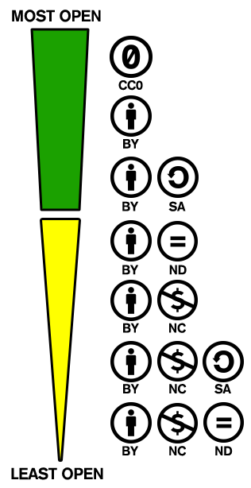
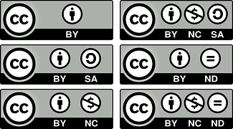
CCL Spectrum of Openness

Slide 11

How Do They Work?
Copyright
Fair Use
CCL
A bundle of rights.
All rights reserved.
Primarily for protecting commercial interests.
Use of an original work requires that explicit, formal permission be acquired – may involve fees.
Can be transferred; a copyright holder may not be the original creator.
A statute under copyright law.
The bundle of rights still applies.
All rights are still reserved.
Meant to foster education and research – this is why we can teach and do research and NOT have to necessarily obtain permissions for what we do.
Attribution and documentation are critical.
Fair use disclaimers can be employed to acknowledge teaching/learning contexts.
Built on copyright.
Some rights are reserved – the original creator can decide how their work can be used.
Meant to foster the creation, sharing, and re-imaging of content shared via the Internet.
Very important part of open access (OA) and open educational resources (OERs).
Use licenses and buttons to make it clear that traditional copyright is not in play.

Slide 12

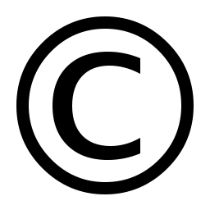
How Do I Stay Compliant with Each?
Copyright
Fair Use
CCL
Attribution and documentation are critical – giving credit where it’s due.
Ensure that you have fair use disclaimers clearly attached or associated with any copyrighted material you are using.
If you are using a lot of a resource and think you might be reaching beyond fair use, get permission(s).
Attribution and documentation are critical – giving credit where it’s due.
Ensure that licenses and buttons are prominently displayed.
Ensure that you fully abided by the terms of the license of material you are using (e.g., if something is SA, then you must SA as well).
If you use someone else’s work, you have to get permission to use that work. This may involve paying licensing fees. It may also be as simple as obtaining formal, explicit permissions from the copyright holder.
Attribution and documentation are critical.

Slide 13
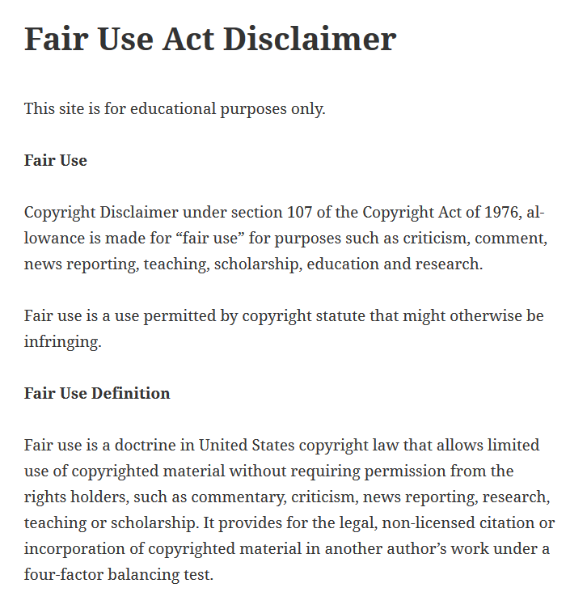
Taken from the Syracuse Journal of Science and Technology Law

Slide 14

Questions? Concerns?

Slide 15
References
Creative Commons. (n.d.a). About the Licenses. Retrieved from https://creativecommons.org/licenses/
Creative Commons. (n.d.b). Frequently asked questions. Retrieved from https://creativecommons.org/faq/
U.S. Copyright Office. (n.d.). Copyright.gov. Retrieved from https://www.copyright.gov/

Slide 16
Thanks for coming and participating!
If you, your colleagues, or students have questions or concerns about copyright, fair use, and/or CCL in the future, please don’t hesitate to reach out to me via email at loweme@nsula.edu!

