Slide 1
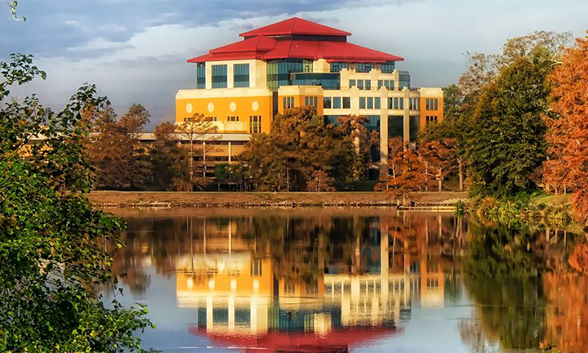
University Library Services for Faculty and Graduate Students
Jessica Louque• Reference Librarian
Notes:
Welcome to this presentation for Library Services for graduate students and faculty. My name is Jessica Louque, and I am a librarian at ULM Library. We will go over some resources today that will hopefully help you have an optimal experience using all the services that ULM Library offers.

Slide 2
Welcome to Fall 2023!
The University Library is here to support you and your students in research, scholarship, writing, and creating.
Here are a few of the services I’ll cover in this presentation:
Access to article databases & other online resources
Online catalog for print books & ebooks
Interlibrary Loan (ILL) for resources not held at ULM
Virtual Reference Desk: help with search strategies, citations, refining topics…
Information literacy instruction: a liaison librarian can visit your class with a presentation tailored to topic, level, and/or specific assignment
In-building checkout of group study rooms, device chargers, and webcams

Slide 3
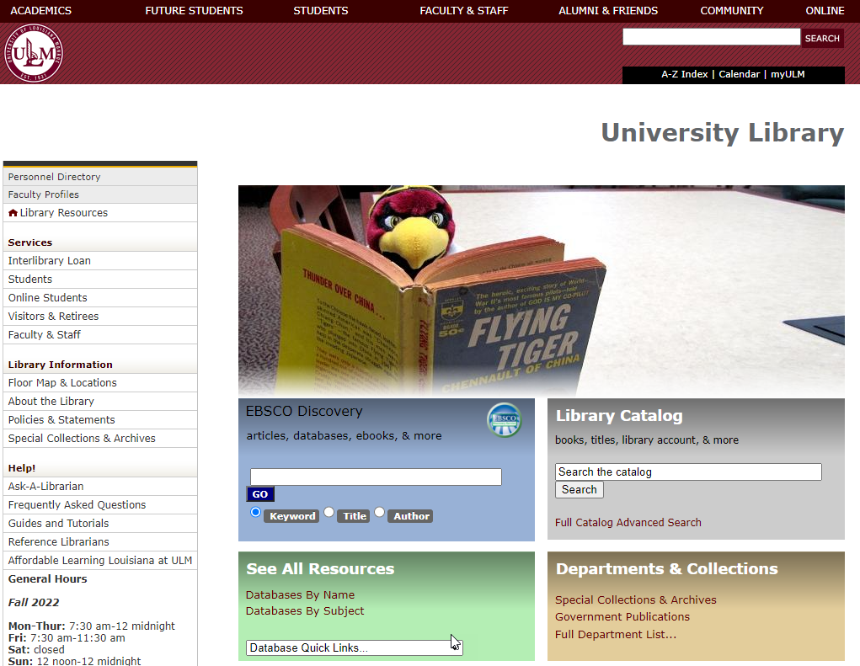
Our website: ulm.edu/library
Notes:
On the ULM Library homepage, to the left, under services, you will see Interlibrary Loan, which we will talk about later in this presentation, and a Faculty and Staff link. The faculty and staff link lists some services available to faculty and staff. In the silver Library Catalog box, you can search for books, e-books, government documents and more in the library catalog. In the green box that says see all resources, you will see links for Databases by Name and Databases by Subject, which we will talk about next.

Slide 4
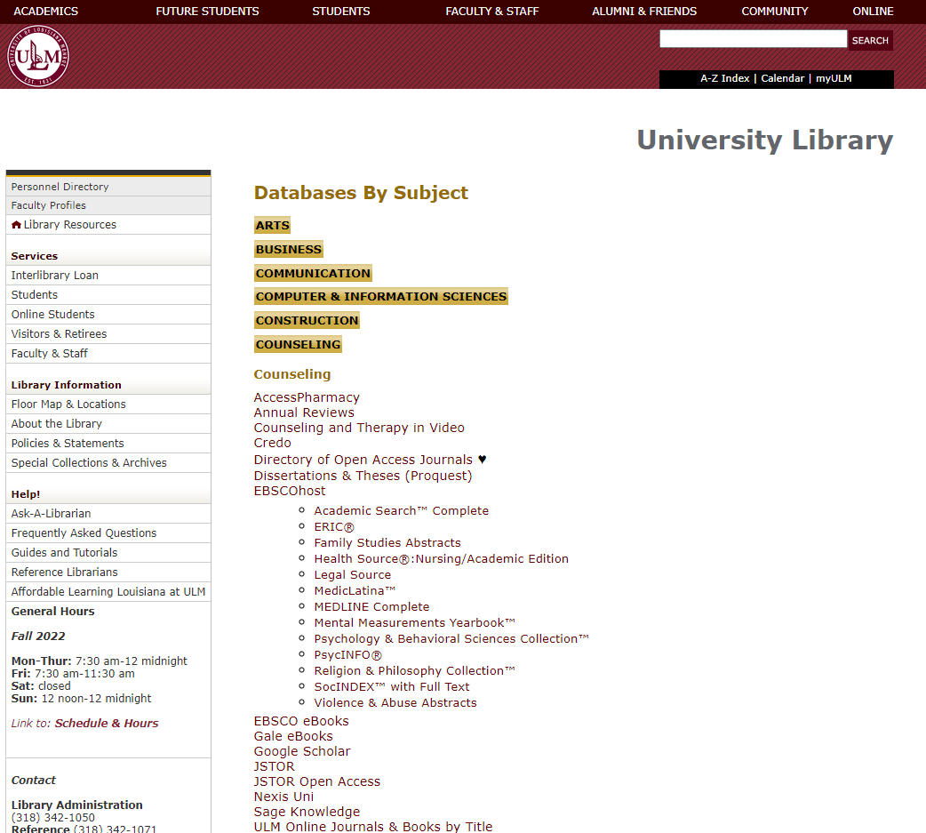
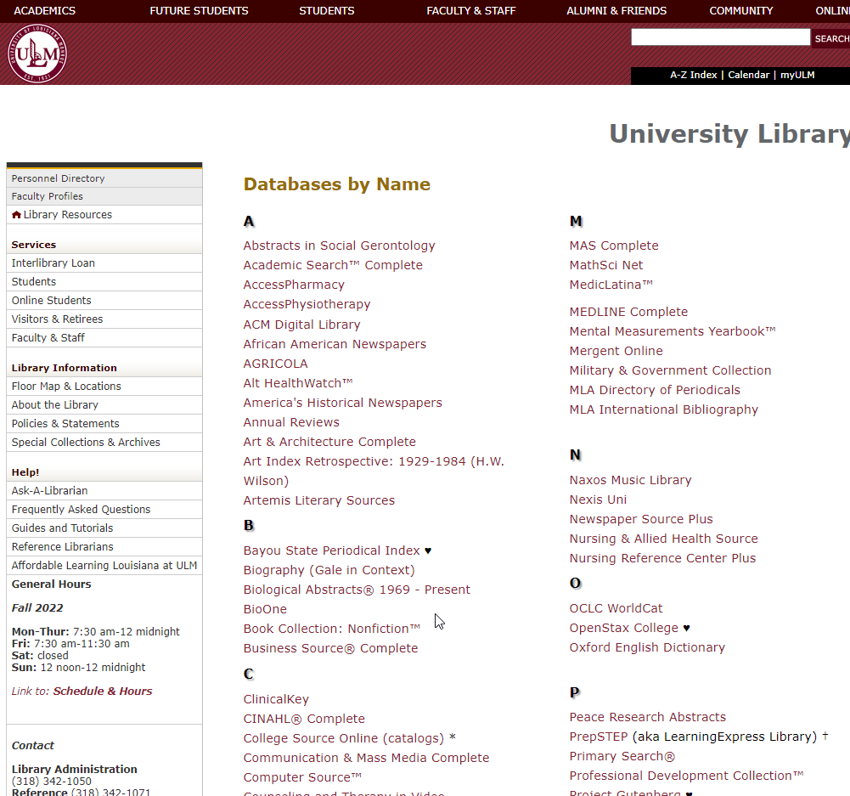
Online journals & databases
Notes:
Under databases by subject you will see different academic subjects listed. If you click on Counseling, for example, you will see a list of databases that are recommended for students and faculty in the field of Counseling. If you click on Databases by Name on the library home page, you will get the option to look at databases by name and can choose one of those databases to search for resources.

Slide 5
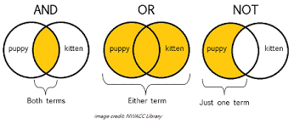
Search Terms and Databases
Boolean:
Combine your search terms using boolean logic (AND, OR, NOT):
ex. (puppy AND Kitten), (puppy OR kitten), (puppy NOT kitten)
Notes:
When you search a database, it helps to have some search strategies so you search more efficiently. We will now told about different ways to string keywords together for more effective searching. This graphic shows you how putting different Boolean operators (AND, OR, or NOT) between two keywords affects the search. See how if you search puppy and kitten you will retrieve articles that have the both of the words puppy and kitten in your search results. You will see however if you search puppy OR kitten in the database you will get all of the results that have the words puppy and all of the results that have the word the word kitten in one set of search results. If you search for puppy NOT kitten. You will get articles that have puppy in the results but exclude the word kitten.

Slide 6
Search Terms and Databases
Wildcards:
*- any ending. example: child*= child, children, childhood
“quotes”- keeps the words together. example: “French Revolution” = French Revolution
?- missing letter. If you are concerned about a letter in a word, use a ?.
example: wom?n= woman, women, and womyn (feminist spelling)
Also handy when dealing with diacritics (accent marks over foreign words- über, cómo, año)
Example in French : forêt (forest)= for?t
Notes:
There are some database tricks that will make searching more effective for you. If you put the asterisk symbol at the end of a word or root, such as child* then the database would look for child and other forms of the word such as children and childhood. Phrase searching occurs when you put quotation marks around two or more words. For example, if you put quotes around “French Revolution” when those words are searched in the database, the articles will only be retrieved if these two words occur together in the record. You can also use the question mark to replace a missing letter. This might be useful if there are different forms of a word such as with woman, women and womyn, which is a feminist spelling. The question mark is also helpful for dealing with diacritics. For example you can type for?t in place of forêt .

Slide 7
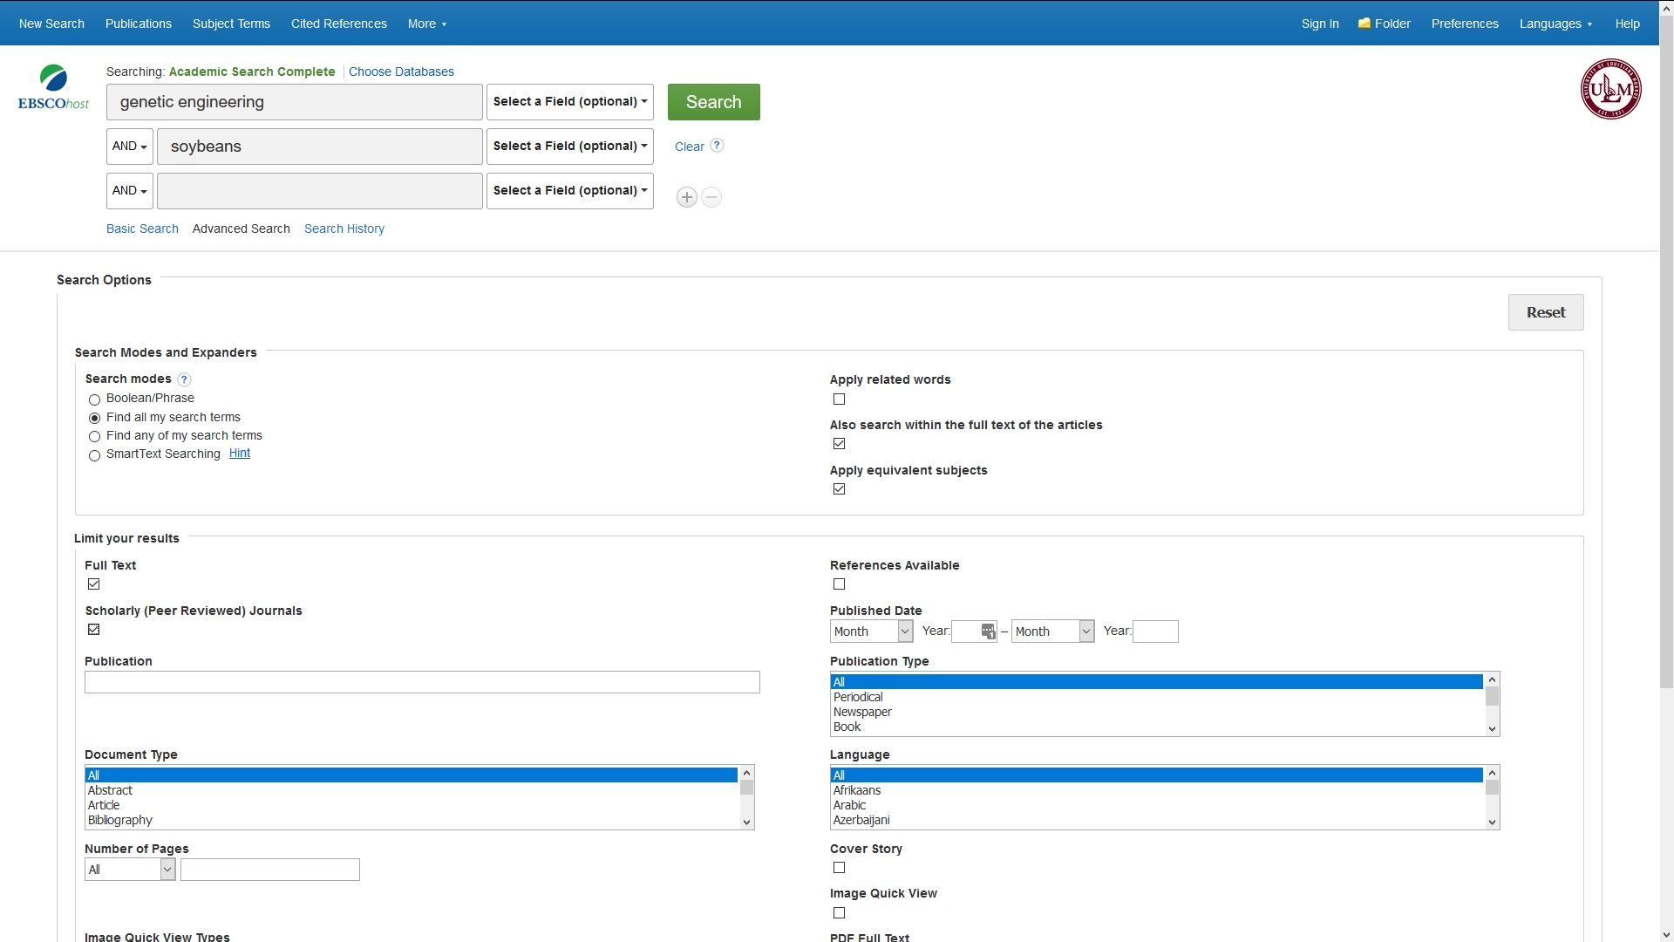
Online journals & databases
Notes:
Next, we will talk about searching databases. This database is called EBSCO and this database like many others contains academic journal articles, some popular resources, and other resources such as ebooks. To access EBSCO, go to the blue box on the library homepage. Once you enter search terms, you will see a screen like this. If you check full-text, you will get search results that contain articles and more where ULM Library subscribes to the content. If you do not check this box you will get more results, some of which we do not subscribe to. However, you have the option of getting these items through out Interlibrary Loan service. So leaving this box unchecked expands your search results past content that we subscribe to. If you check the box scholarly/peer reviewed, all results you will receive will be scholarly and peer reviewed resources.

Slide 8
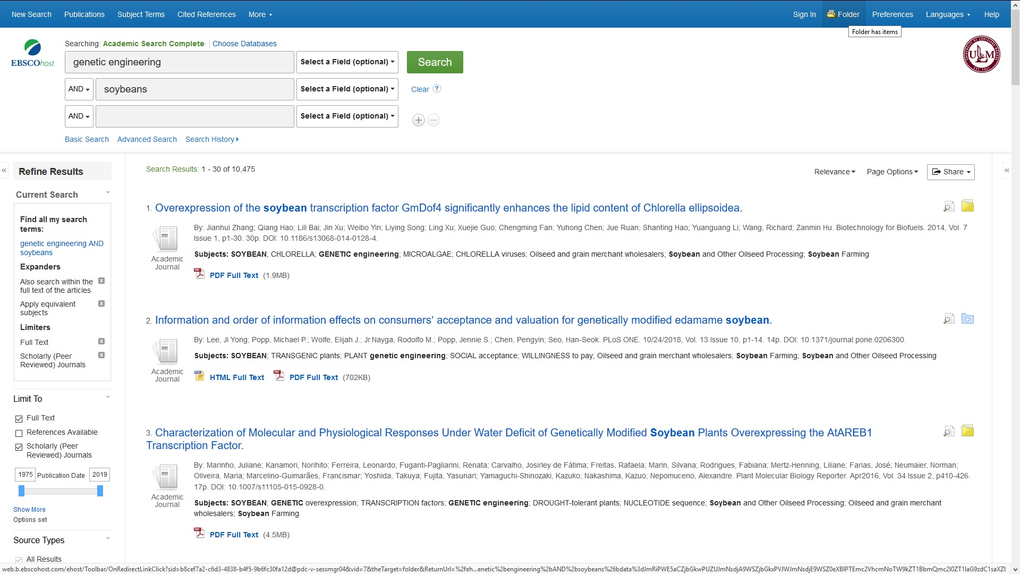
Online journals & databases
Notes:
On our homepage you can type in your initial search results into EBSCO in the blue box. After you have done so, I recommend clicking on the Advanced Search option. You will have multiple search boxes to enter your keywords. There is a dropdown box to the right of genetic engineering in the image and you have different options to search for a keyword including all text, author, title and subject term. One tip you can change that dropdown option to “Title” and you can use this feature to look for a certain keyword to appear in the title of an article. You can click on HTML full text and PDF full text to pull up an article to read or print it.

Slide 9
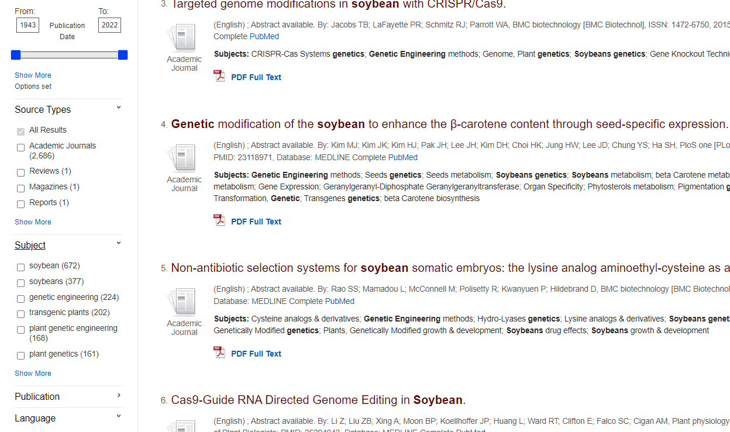
Online journals & databases
Notes:
Once you have search results, you will have options on the left hand side of the screen to narrow your search results. In the first box, you can limit your search results by date. In the second box, you can limit search results by the type of item, for example if you just wanted journal articles. Another handy tip in the third box is you can limit by subject, In our search for soybeans and genetic engineering, if you were interested in reading more articles that have the subject transgenic plants, you can check on the subject box and your results will be cut down just to the 202 articles that have transgenic plants as a subject in the article.

Slide 10
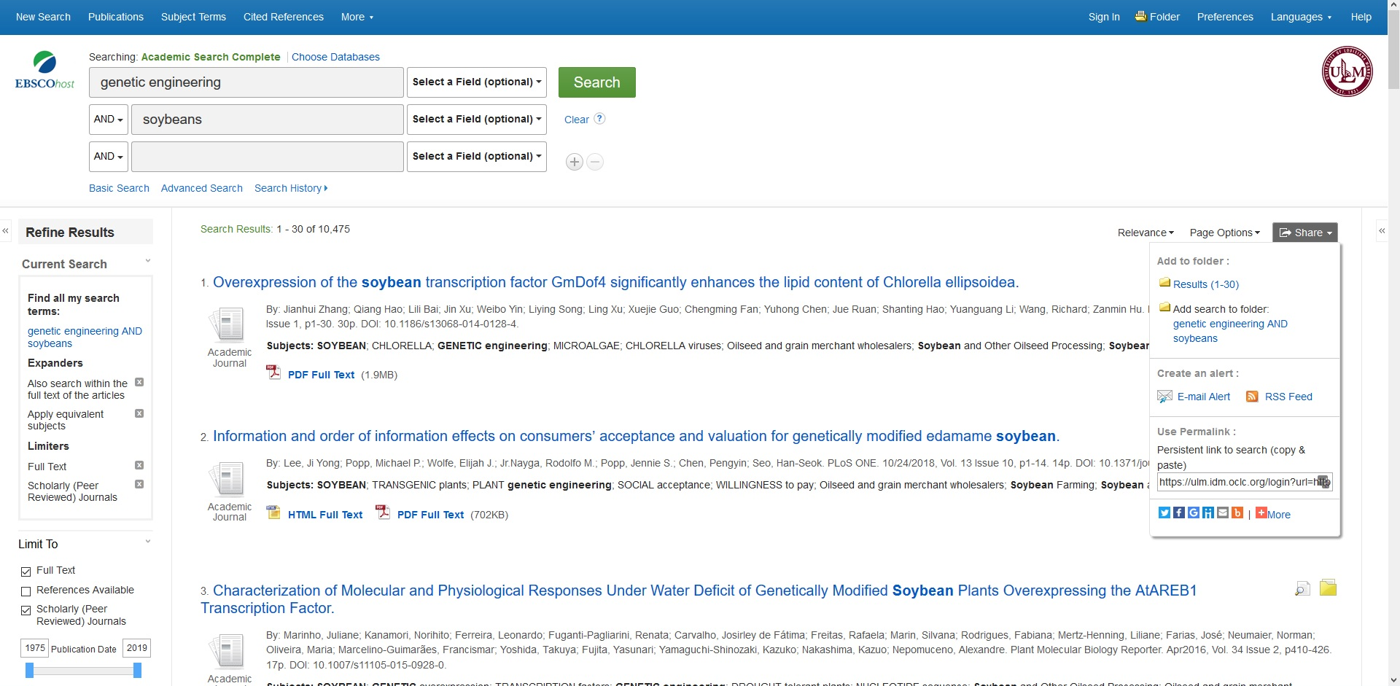
Online journals & databases
Notes:
If you click on the share option, you will have the option to add the first 30 results to a folder, but you have to be signed in which we will discuss later. You can also create an email or rss alert, which is useful for getting new content from a particular journal sent to you. You can also use the permalink to email or instant message the link to the article to someone else if you think they would be interested in a particular article.

Slide 11
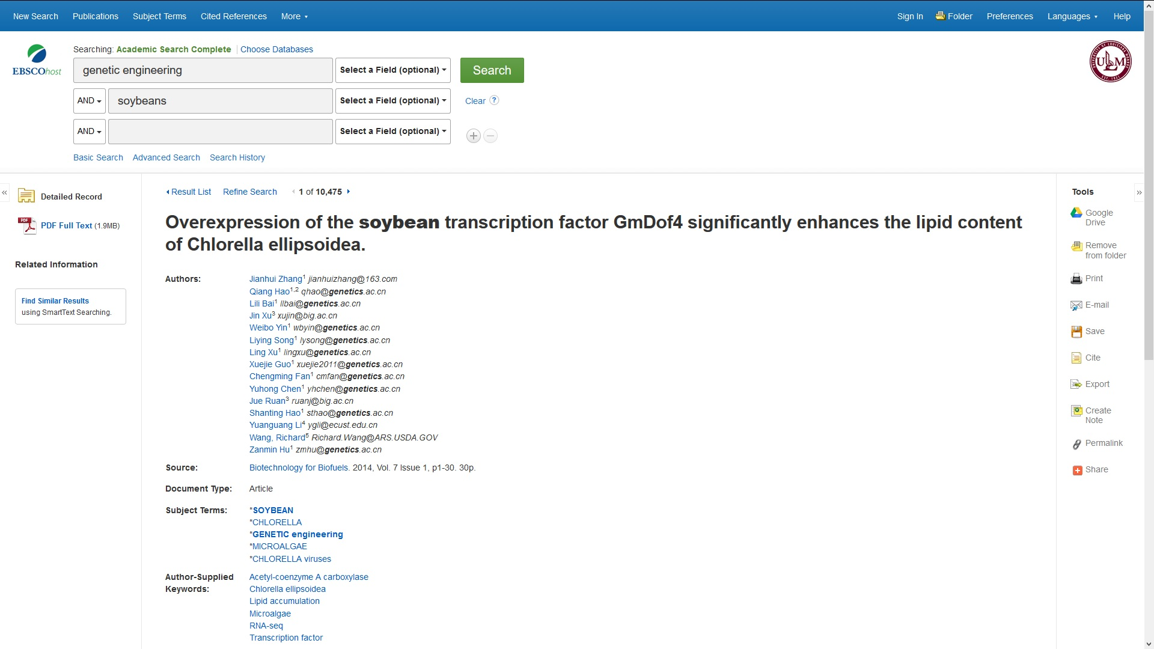
Online journals & databases
Click any of these links to search by author or subject
Click on journal title (“source”) to browse all available issues
Notes:
On the right hand side you will see a list of tools, Google drive is useful for saving items to your google drive account, but you have to be signed into EBSCO to do it. Use the cite button to get a neatly formatted citation in your preferred citation style for your reference list. Also use the permalink feature to share the article with others. If you click on the title of an article in your result list, you will see the list of authors for an article which you can click on to see other articles by that author if you wish. You will also see the source title, which in this case the source is an academic journal Biotechnology for Biofuels, Additionally, you will see a list of subject terms. Some of these might be good words to use in your database searches. This list of subjects here are the key subjects that appear in the article. In some cases you will also get author supplied keywords which may be useful in your searches. Next, I will show you the options you get if you click on the link to a particular journal.

Slide 12
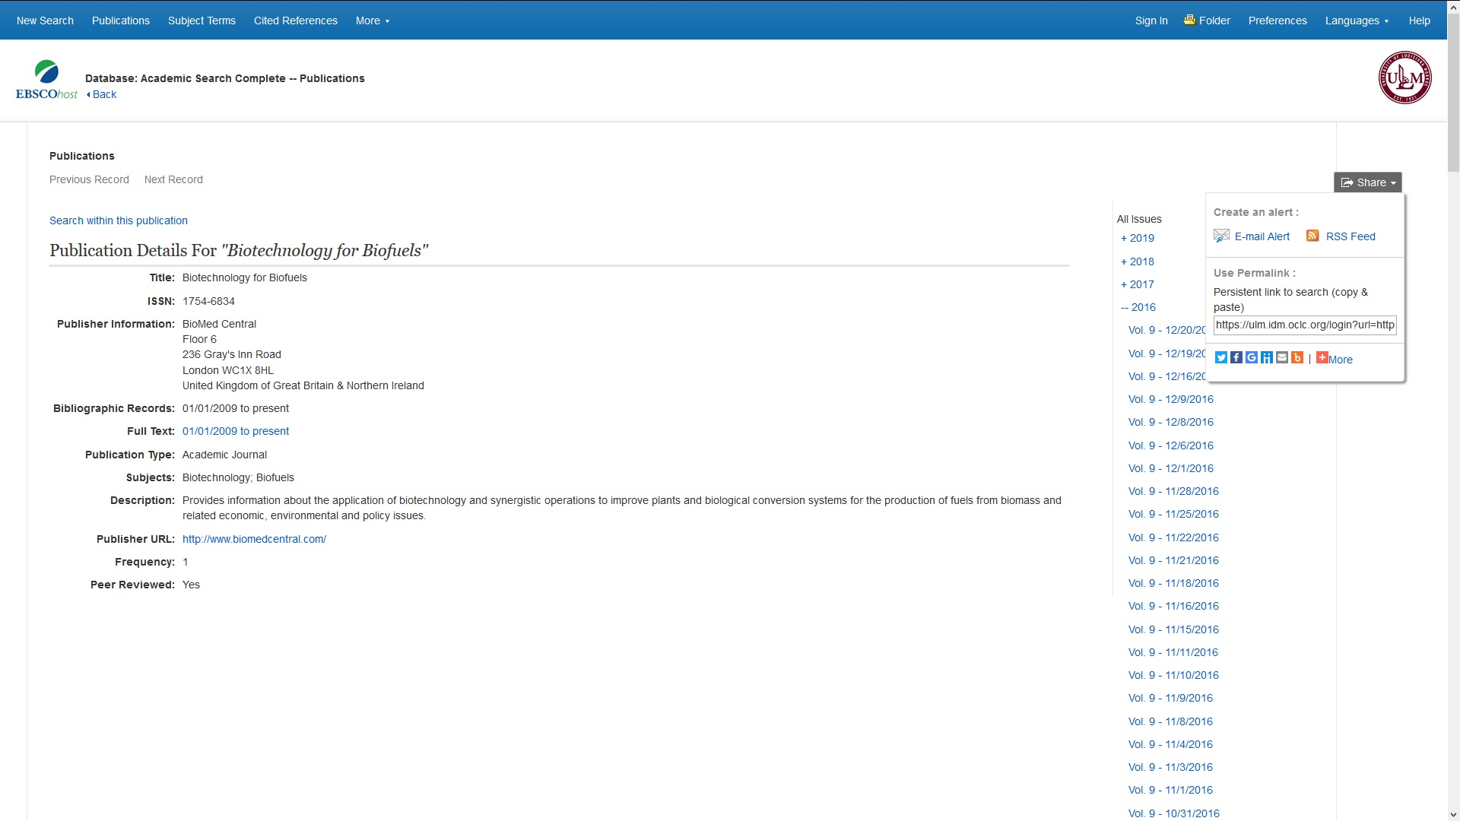
Online journals & databases
If you don’t see the issue you want, check this date to see if we have access. Use ILL if not!
Notes:
First you will see a list of all issues we have for that particular journal title. They are organized by year and under each year you will see volumes and issues. You have the option on this screen to click share. You can create an email or rss alert for content from a journal that has been published for example in the last year to be sent to your email or rss feed. Use the permalink if you want to share the link to the journal with someone else. Lastly, if you don’t see the issue you want in the journal list, check this date to see if we have access to the article date that you are looking for. If not, you can submit an Interlibrary loan request for that article.

Slide 13
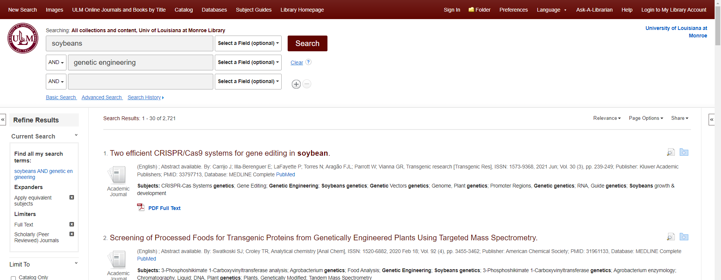
Creating an EBSCO Account & Saving Searches
Notes:
Next, we will talk about setting up an EBSCO account, so that you can save articles in folders to the left of the article title. First up at the top, click sign-in to go sign up for an EBSCO account. Once you are signed in, you can click any folder to the right of an article title to save that item in a folder. You will have an option to name the folder you want articles to be placed into. This can be useful for a specific class or assignment.

Slide 14
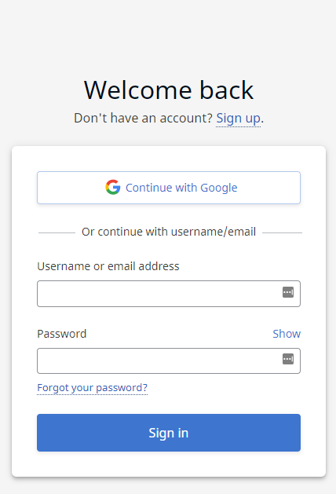
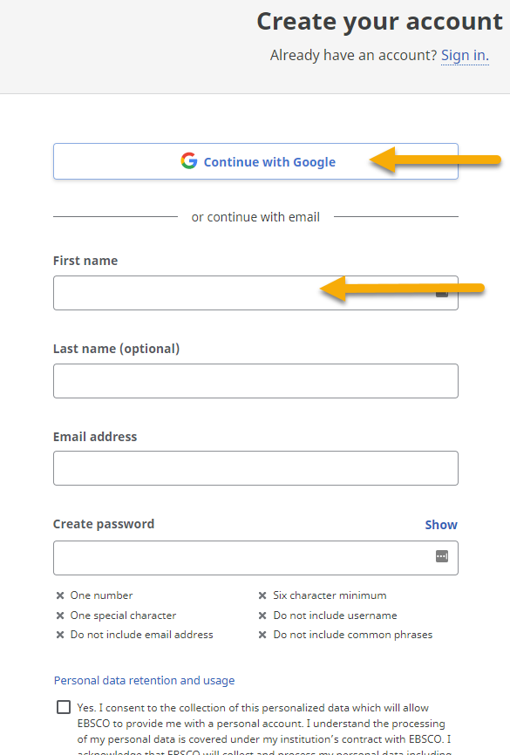
Creating an EBSCO Account & Saving Searches
Notes:
You will have the option to sign in using your Google credentials or to sign in with your name, email address, and a password that you choose.

Slide 15
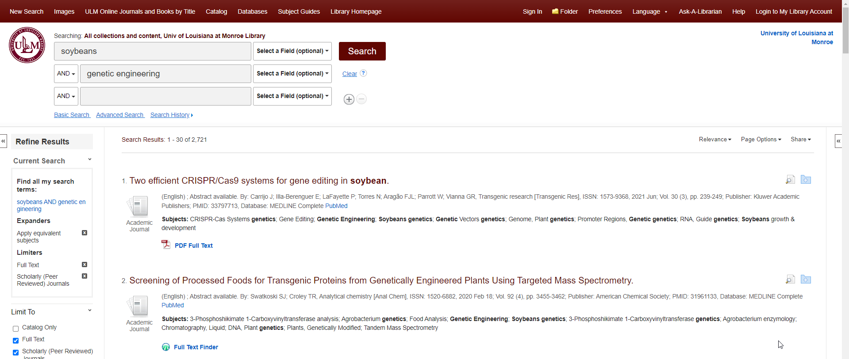
Creating an EBSCO Account & Saving Searches
Notes:
Next we will talk about the search history feature. You can click on Search History to save searches so you can go back to them later.

Slide 16
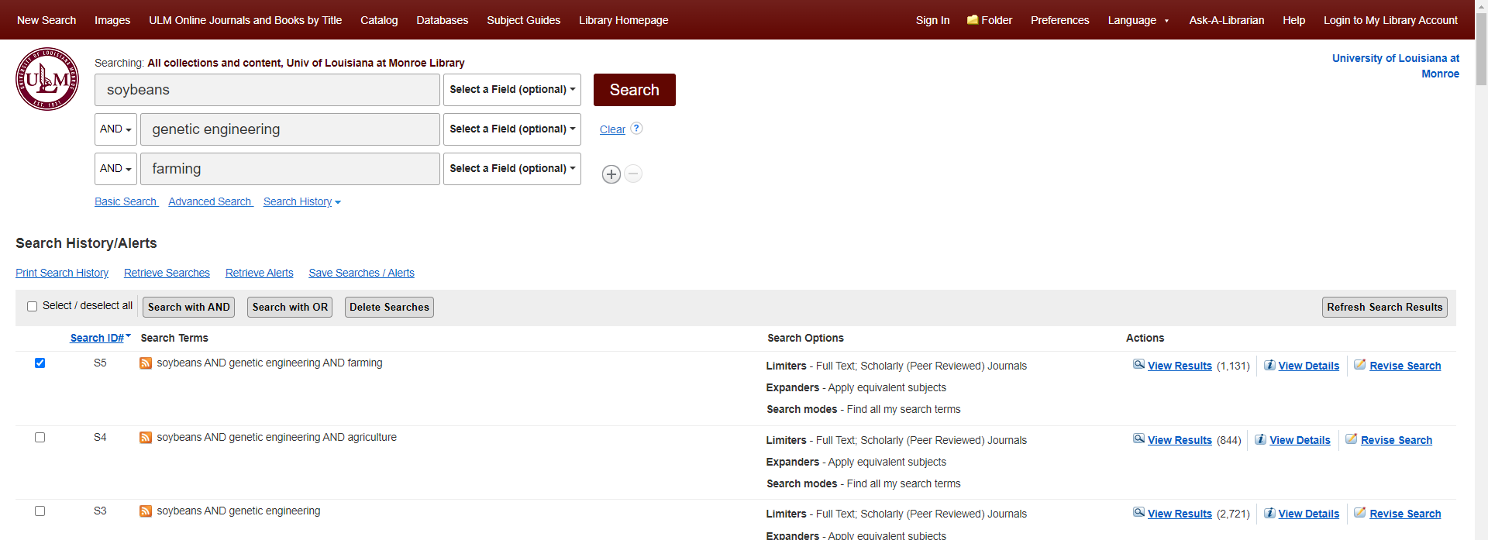
Creating an EBSCO Account & Saving Searches
Notes:
After you click on search history, you will see several options. You can check one of the boxes by a search and click “save searches/alerts” to save a search. But to do this make sure that you are signed into EBSCO first.

Slide 17
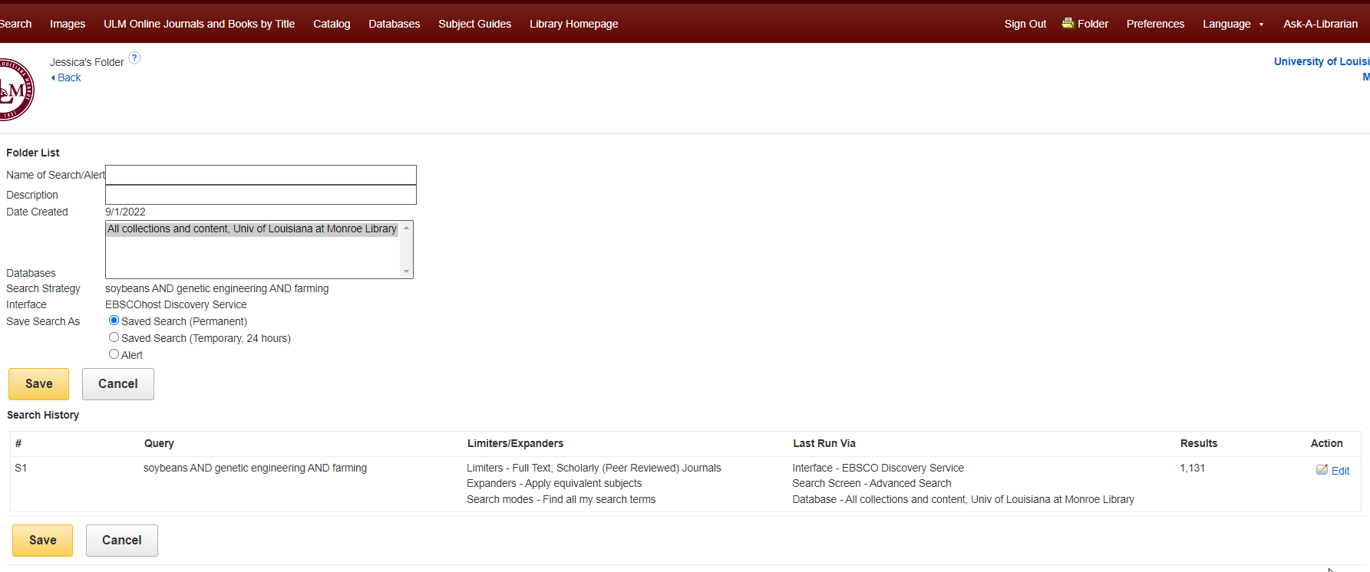
Creating an EBSCO Account & Saving Searches
Notes:
After you click save searches, you can name your search and click save.

Slide 18
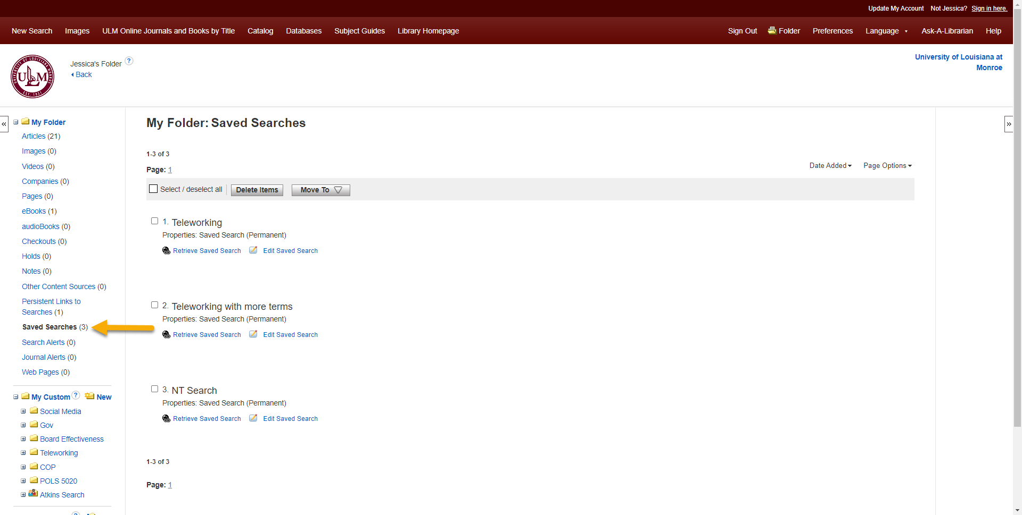
Creating an EBSCO Account & Saving Searches
Notes:
After you click save, you will be able to click on your folders if you already have some and go to the save searches folder to retrieve the search you saved.

Slide 19
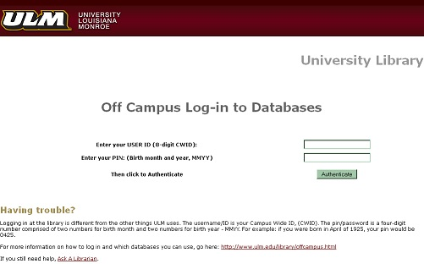
Off-campus access
CWID
PIN = Birth month & year, MMYY
Notes:
Next, we will talk about off campus access. If you attempt to sign on to a database from off campus, you will be prompted to sign in with your Campus Wide ID and Pin. Make sure you use the Birth Month and Year format shown to login. If you still can’t call in, call the ULM Library Circulation Desk and ask for help.

Slide 20

Library catalog
Notes:
On the ULM Library webpage, there is a gray catalog search box. To search for books, e-books, or government documents, enter a search in the search box.

Slide 21
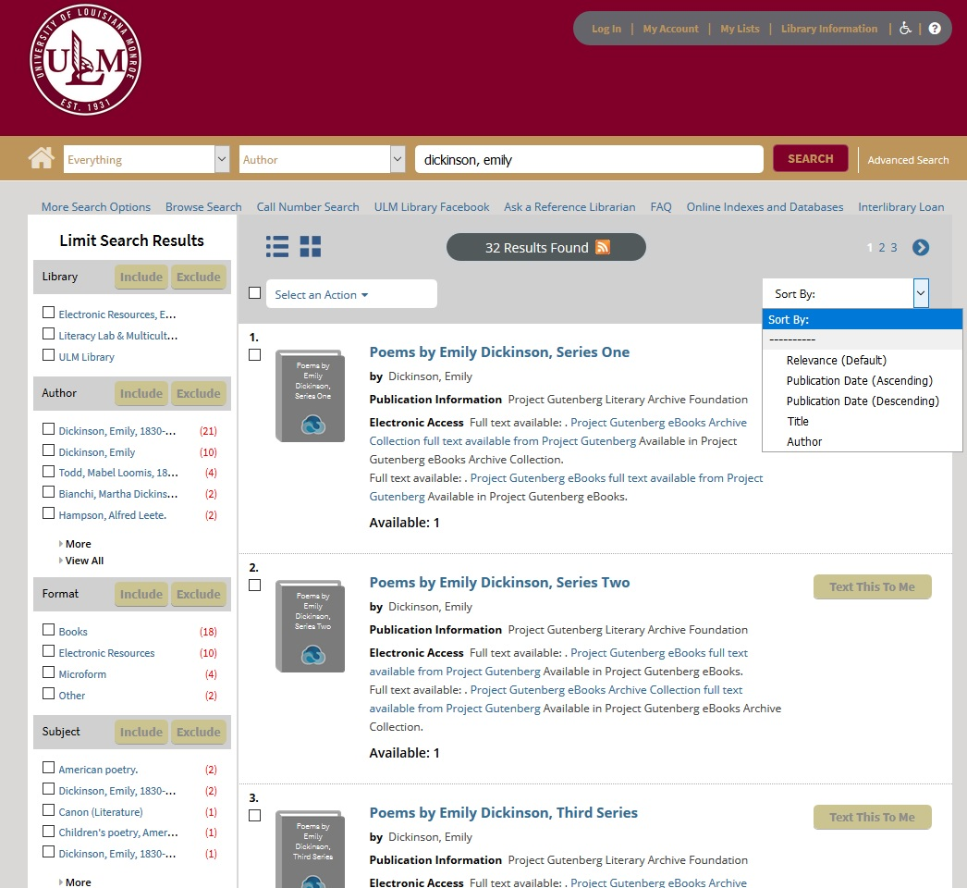
Library catalog
Notes:
You can sort your results by relevance, publication date, title or author. On the left hand side, you can also limit your search results by the type of library, author, format, and subject.

Slide 22
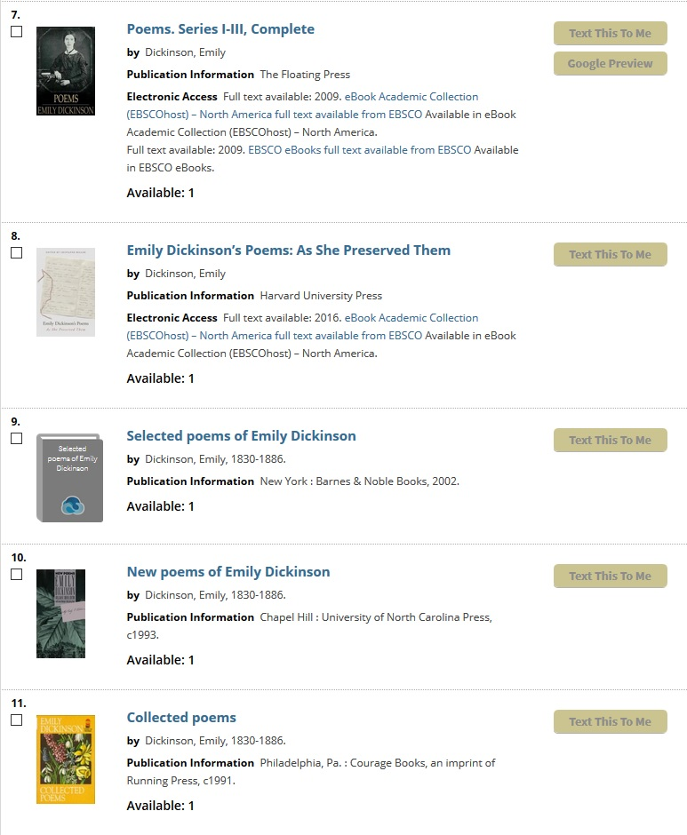
Library catalog
Ebooks
Print books currently on the shelf & available for checkout
Notes:
In the following search results, one of the results is e-books. If you want to read one of them, you click on the link after Electronic access: Full-text available. For print books click on any title to see the location information for where it is on the shelf.

Slide 23
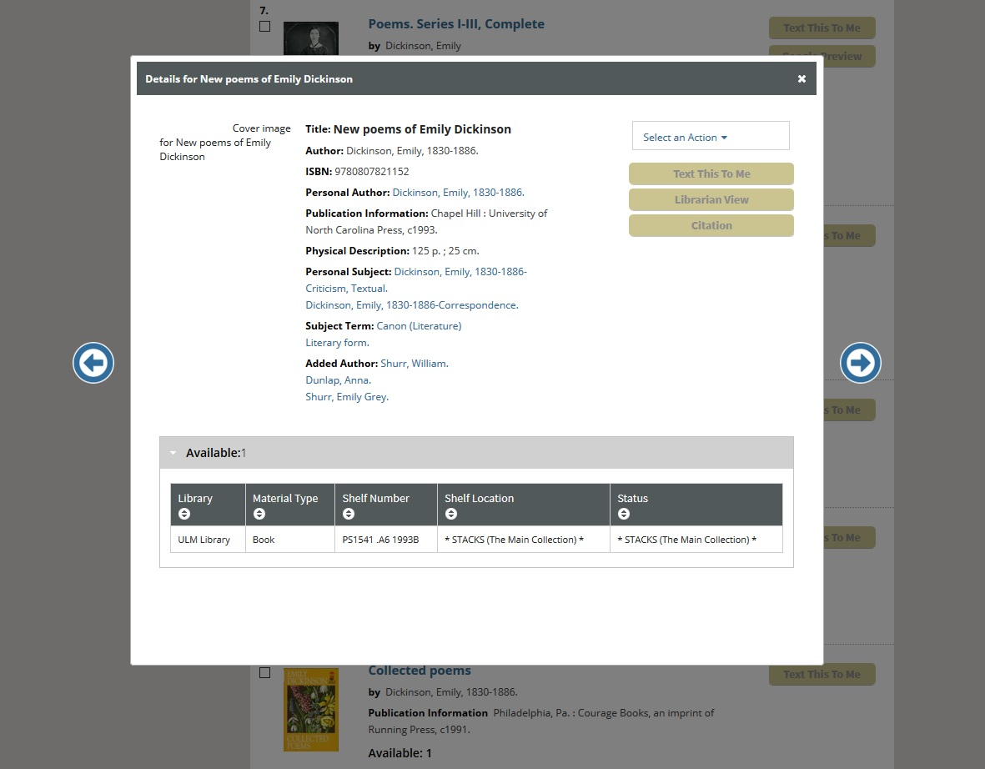
Library catalog
If it’s checked out, this shows the due date instead.
Notes:
You will see a shelf number, which is like a street address except for the library. To get to this book, you would walk to the P’s on the library 3rd floor and look for PS, then look for PS1541 on the shelf, then look for PS1541 .a6 1993B. IF the status says Stacks, the book is available for check out. If it shows a due date instead that shows when the book will be due back to the library, and the book is not available for checkout right then.

Slide 24
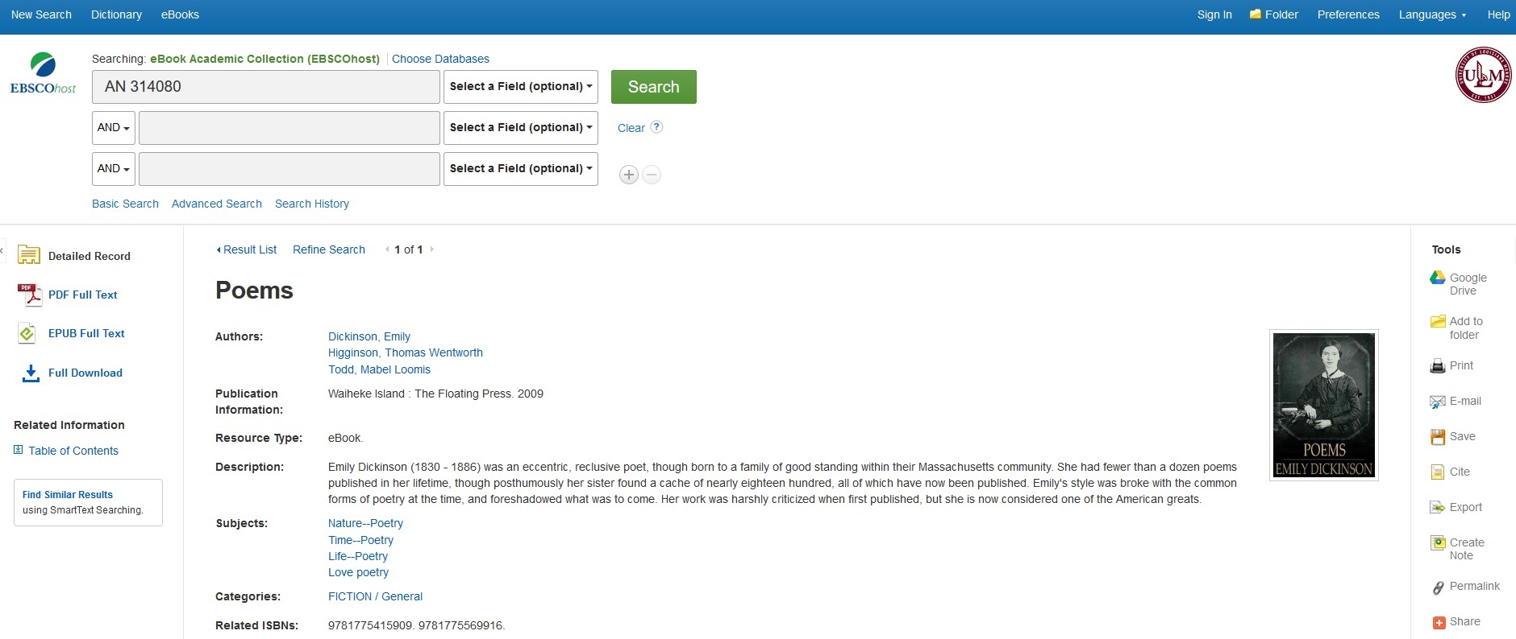
Ebooks
Notes:
If you click on one of the e-books in the catalog, there are different ebook providers but for EBSCO you would get a screen like this. You will have the options on the left to view the PDF or EPUB of the book. For a full download, you will have to be signed in with your EBSCO account. You also have the option in some cases of viewing a book’s table of contents.

Slide 25
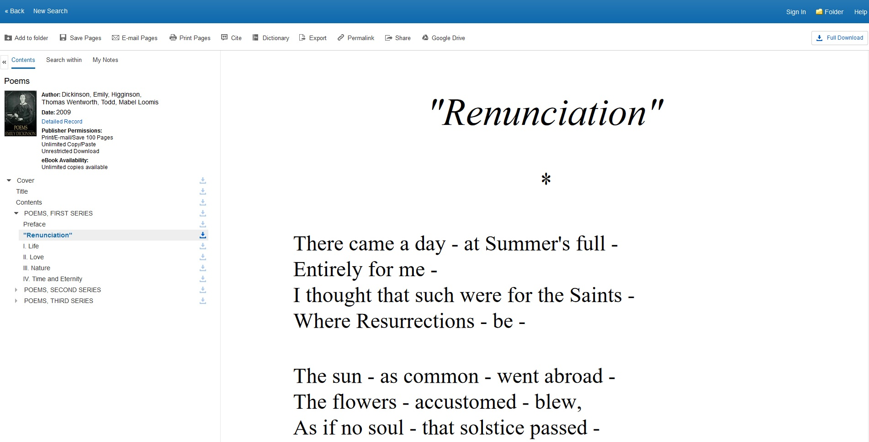
Ebooks
Notes:
In the table of contents, you can choose to download sections of the e-book. Usually there is a limit that you can download from this screen of around 100 pages. From this screen, you can also choose to search within the content of an ebook.

Slide 26
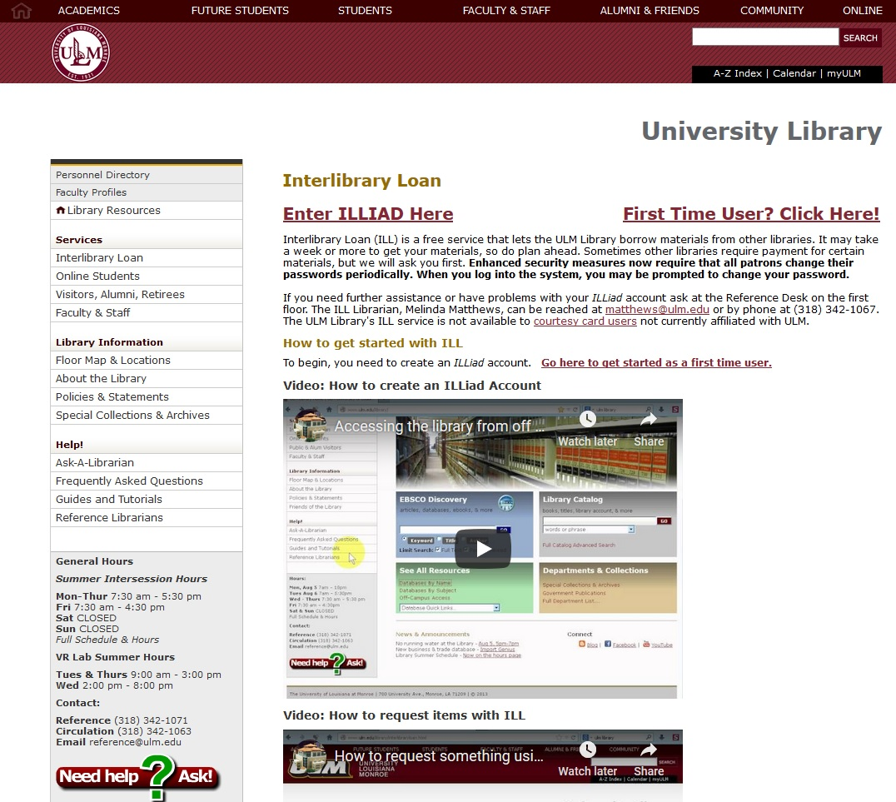
Interlibrary Loan (ILL)
Notes:
Sometimes there are materials that ULM Library does not own. ULM has a service where you can borrow books and other materials. This service allows book chapters and articles for content we do not subscribe to be e-mailed to you for free. If you go to the ULM Library website, you can click on Interlibrary Loan to access the Interlibrary Loan webpage. If you do not already have an account, click on First Time User? Click Here to register for the service. You will enter your own unique credentials and an email address where shorter materials, such as articles and book chapters may be sent. Longer materials such as dissertations and books will be sent to ULM Library for pickup.

Slide 27
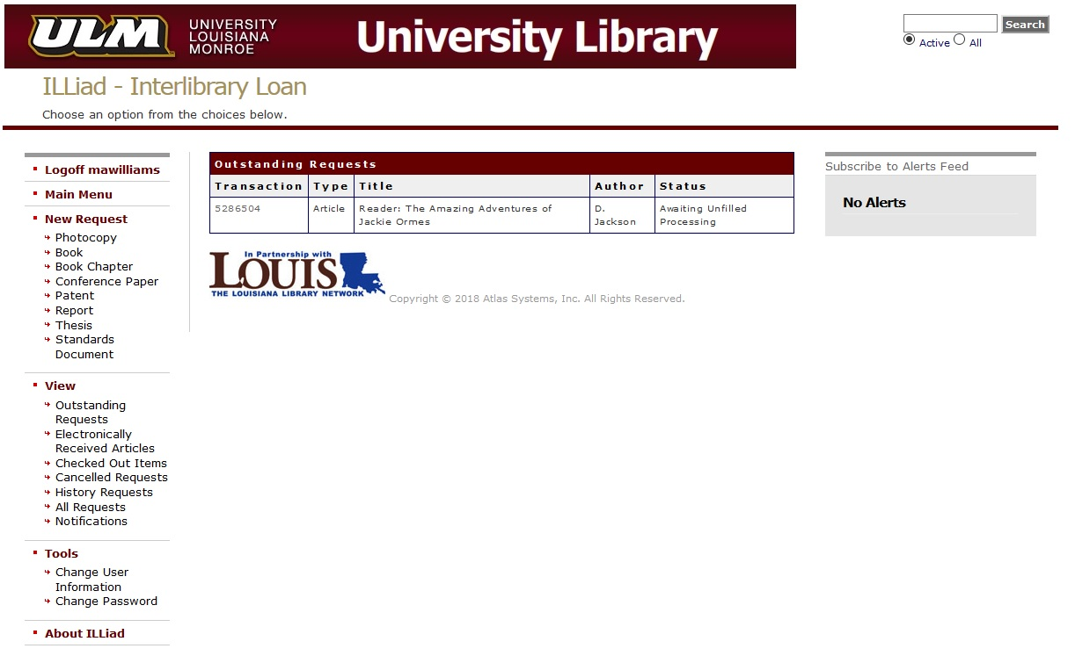
Interlibrary Loan (ILL)
Notes:
Once you are signed in to Interlibrary loan, on the left hand side under new request, our most popular options are to click on photocopy to get articles emailed to you, book to get books sent to ULM Library, and book chapter to get book chapters emailed to you.

Slide 28
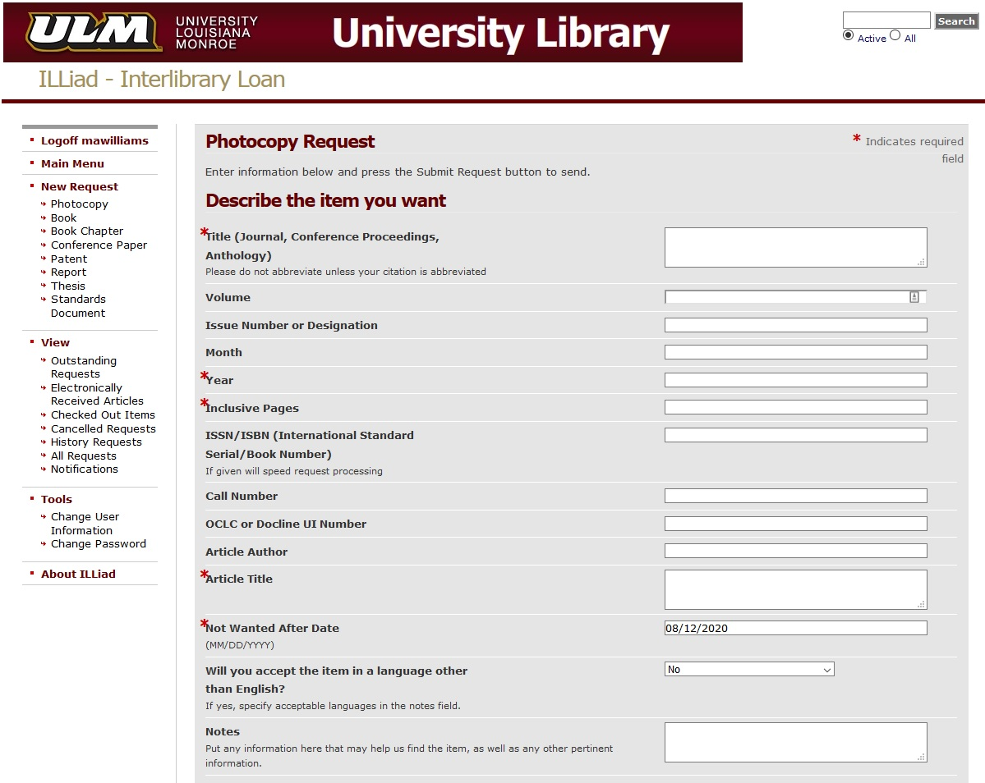
Interlibrary Loan (ILL)
Notes:
Under New Request, if you click on photo copy, you will get the form to fill out to get items such as an article emailed to you. Just enter the information in by each red asterisk. For an article, you would enter in the journal title, year, page range, article title, and a not wanted after date.

Slide 29
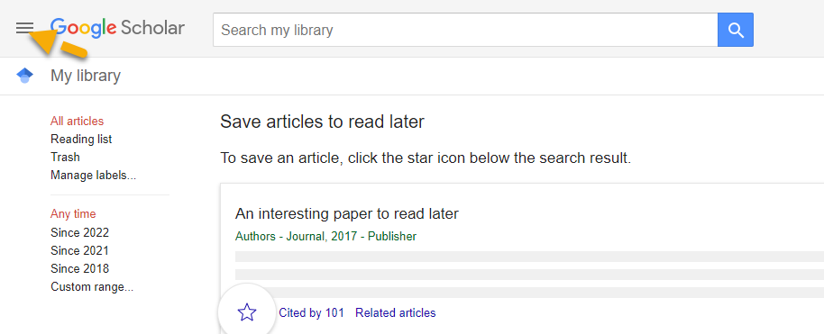
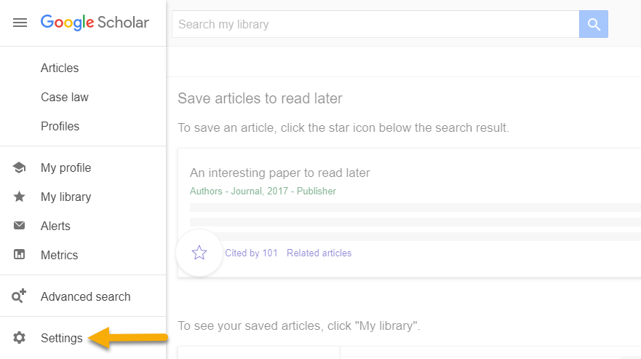
Google Scholar
Notes:
Next we will talk about Google Scholar. Many see Google Scholar as a convenient starting place for finding articles, books, and documents across academic disciplines. We will talk about how you can add a library link in GS to your libraries’ content from GS, but GS also searches for content in other Universities Institutional Repositories which can be helpful. We will go over the steps to add a library link to GS in your Google account to access material available at your ULM library within GS. First begin at scholar.google.com and sign into google or create an account. Click on the three lines at the top left, then on the next screen, select settings.

Slide 30
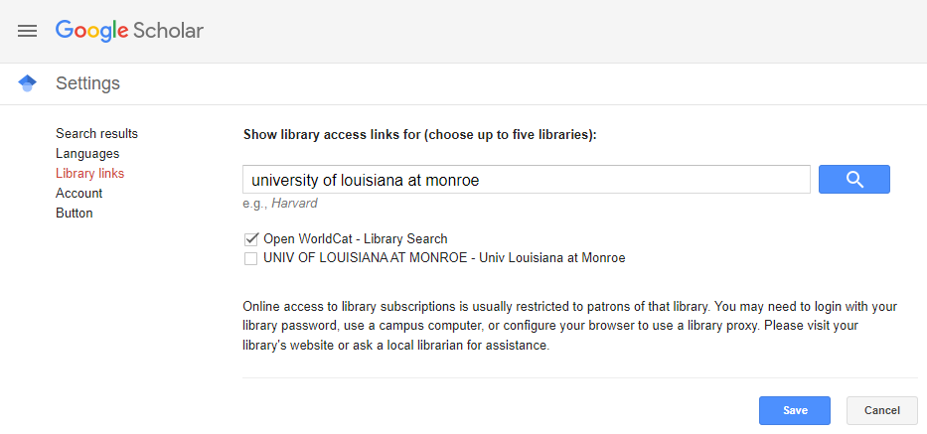
Google Scholar
Notes:
Next, type University of Louisiana at Monroe in the search box and click the magnifying glass. You will get an option to check a box for Univ of Louisiana at Monroe, so check that box to link our library resources to your Google Scholar account. Then click save.

Slide 31
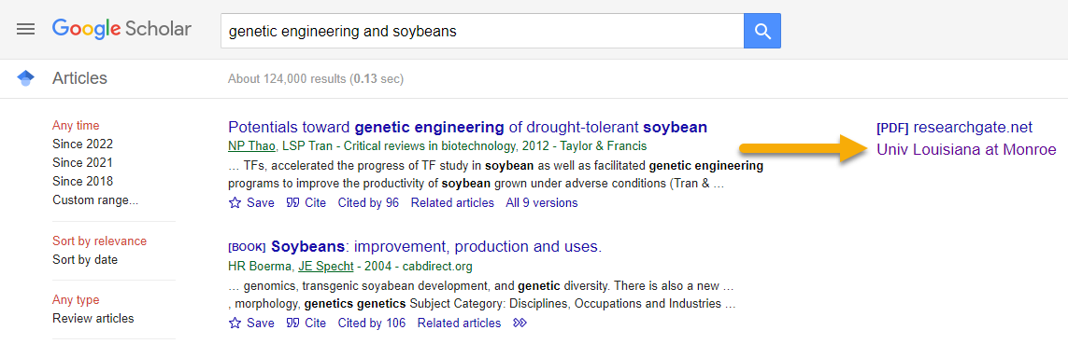
Google Scholar
Notes:
This is an example of a search for genetic engineering and soybeans. If you click on the link for Univ Louisiana at Monroe, you will be brought to the page for the article Potentials toward genetic engineering of drought-tolerant soybean. Also you can see for this particular article, the article was cited by 96 others. If you want to see the list of other articles that cited this article, click on Cited by 96.

Slide 32

Reference email: reference@ulm.edu
Notes:
ULM has a virtual reference service if you have any research or other library related questions. For students we can help with using library resources, search strategies, refining topics, and citations. Email us to set up an appointment. For faculty we also can consult on citations and research. We also help with finding resources and creating or finding tutorials to help with research in your class.

Slide 33
Information Literacy Instruction
Each department has a liaison librarian listed at www.ulm.edu/library/reference.html
We can present to your class on research, citation styles, plagiarism, or anything else library-related!
Contact reference@ulm.edu to schedule
Notes:
For faculty, each department has a liaison librarian listed. If there is a vacancy listed for your subject, we are in the process of hiring librarians. We can come present to your class based on research for a specific assignment, give an orientation, present on citation styles, plagiarism, or anything else library related. E-mail reference@ulm.edu if you would like to schedule a class.

Slide 34
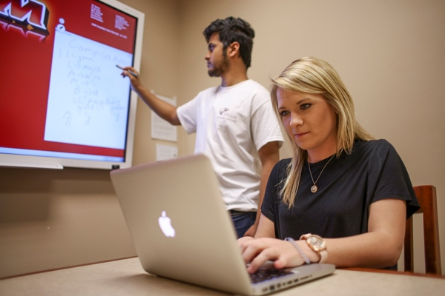
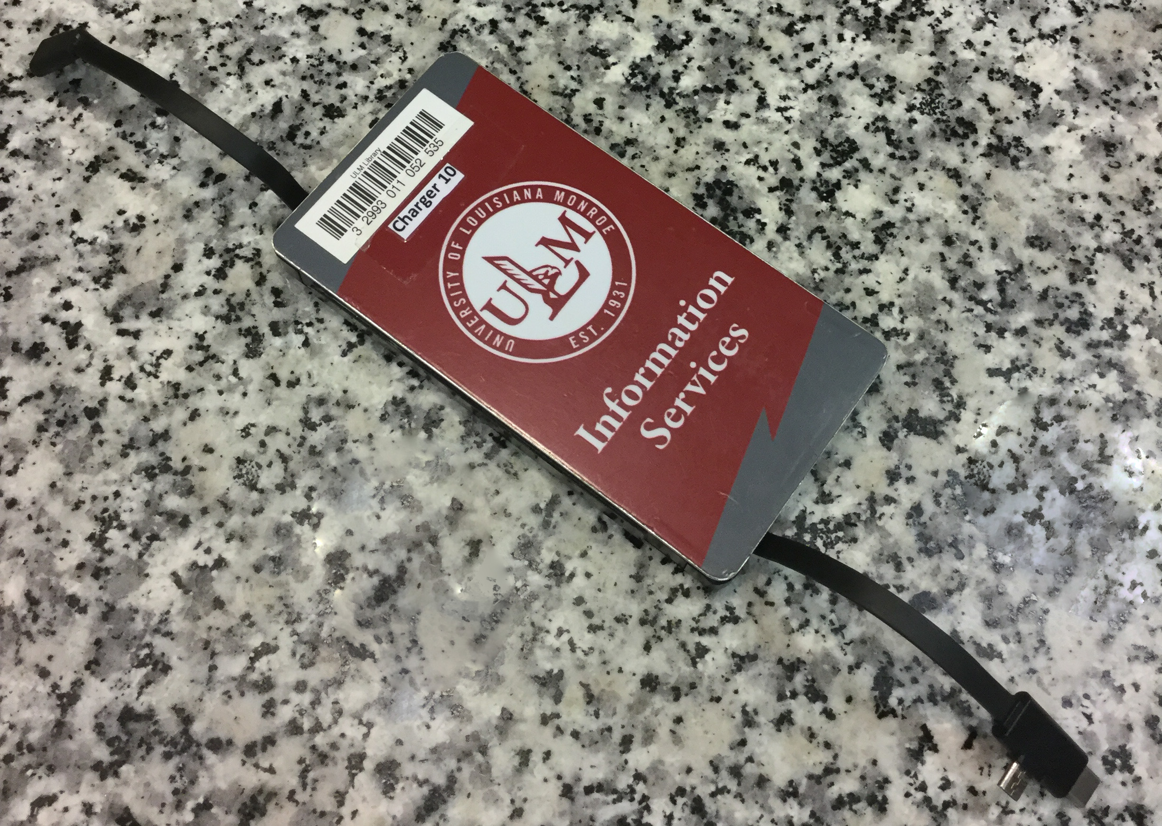
Group study rooms & chargers
Chargers check out in the library for 4 hours & can renew
Includes lightning & USB connections, plus USB inputs for your own cable(s)
2-10 people
Check out for 4 hours; can renew once if nobody is waiting
Most rooms are tech-enabled with a smartboard & computer, or hook up your own device
Notes:
On the first floor of the library, you can check out study rooms for 4 hours at a time. You can also check out charges to charge tablets and mobile devices for 4 hours at a time.

Slide 35

Questions? Contact us!
Visit the Reference desk
Email reference@ulm.edu
Visit www.ulm.edu/library & click:
Notes:
Does anyone have any questions? If you have any questions after this presentation, please email reference@ulm.edu.

