Slide 1
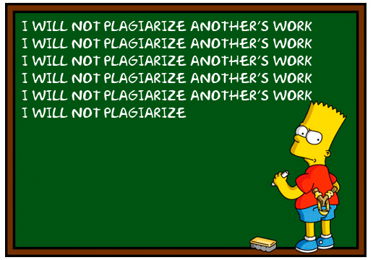
Plagiarism what it is and how to avoid it
Presented by the ULM Library Reference Department

Slide 2
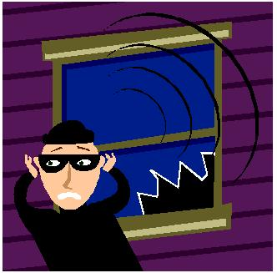
Session Overview
What It Is
  Terminology
  Legal Implications
  Four Types of Plagiarism
How to Avoid It
  Methods
  Proper Quotations
  Proper Citations
Q & A Time!

Slide 3
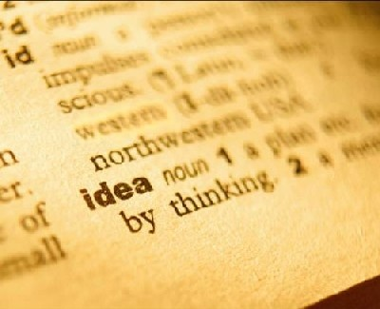
Terminology: Plagiarism
Plagiarism is the act of stealing someone else's work and attempting to "pass it off" as your own. This can apply to anything, from term papers to photographs to songs, even ideas!

Slide 4
Terminology: Copyright
Copyright is "a form of protection provided by the laws of the United States (title 17, U.S. Code) to the authors of 'original works of authorship,' including literary, dramatic, musical, artistic, and certain other intellectual works. This protection is available to both published and unpublished works." (U.S. Copyright Office)
©

Slide 5
Terminology: Fair Use
Fair Use is a statute under copyright law that allows for the use of limited portions of a work that has copyright without having to have permission from the original author. It was created for the purposes of education and research. It’s a little harder to pin down than plagiarism or copyright. I mean, what qualifies as a "limited portion"?

Slide 6
More on Fair Use
The Copyright Office isn't very helpful on defining what a "limited portion" is. It only states that "there is no specific number of words, lines, or notes that may safely be taken without permission." When using someone else's work, it's best to always give credit where credit's due, even if using only a small part. If you're unsure, then ask for permission.

Slide 7
Legal Implications
Is it against the law?
How is it applied at the college level?
  Most schools and universities have policies on cheating and plagiarism.
ULM's policy is very clear:
  First offense: failing grade on assignment
  Second offense: failing grade for the course
  Third offense: suspension

Slide 8
Types of Plagiarism: Copying
The most well-known and, sadly, the most common type of plagiarism is the simplest: copying. If you copy someone else's work and put your name on it, you have plagiarized.

Slide 9
Copying: An Example
"Children are totally insensitive to their parents' shyness; it is the rare child who labels a parent shy [...] This is understandable, since parents are in positions of control and authority in their homes and may not reveal their shy side to their children. Also, since shyness is viewed as undesirable by many children, it may be threatening to think of parents in these terms. At this young age, the parent is still idealized as all-knowing and all-powerful - - not dumb, ugly, or weak."
Zimbardo, Philip G. (1977). Shyness: What it is, what to do about it. Cambridge, Mass.: Perseus Books.

Slide 10

Copying: An Example
This one is pretty straightforward. If a writer copies, word for word, the text from Dr. Zimbardo's book and does not acknowledge in any way that it was Dr. Zimbardo's work, the writer has committed plagiarism.

Slide 11
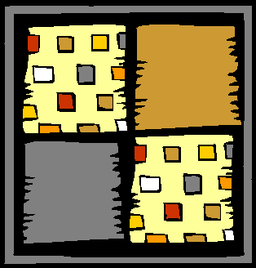
Types: Patchwork Plagiarism
The second kind of plagiarism is similar to copying and is perhaps the second most common type of plagiarism: patchwork plagiarism. This occurs when the plagiarizer borrows the "phrases and clauses from the original source and weaves them into his own writing" (McConnell Library, Radford University) without putting the phrases in quotation marks or citing the author.

Slide 12
Patchwork: An Example
With regard to children, they are totally insensitive to their parents' shyness. Rare is the child who labels a parent shy. It is easy to understand this, since the parents are in positions of control and authority in their own homes and may not necessarily show their shy side to their children. Moreover, since shyness is viewed as unfavorable by most children, it may be threatening for them to think of their parents in that light. During the formative years, the parent is idealized as all-knowing and all-powerful -- not dumb, ugly, or weak.

Slide 13
Patchwork: An Example
Now, had the "author" of this passage put the colored phrases in quotation marks and added a citation after the quotation, like (Zimbardo 62), the "author" would have been safe. Without the quotation marks and the proper citation, the "author" has committed plagiarism.

Slide 14
Types: Paraphrasing Plagiarism
The third type of plagiarism is called paraphrasing plagiarism. This occurs when the plagiarizer paraphrases or summarizes another's work without citing the source. Even changing the words a little or using synonyms but retaining the author's essential thoughts, sentence structure, and/or style without citing the source is still considered plagiarism.

Slide 15
Paraphrasing: An Example
Children are completely insensitive to their parents' shyness and rarely label their parents as shy. Because the parents are the authority and controlling figures in the home, they may not feel shy and therefore not show their shy side. Moreover, during the formative years, parents are seen as omnipotent and omniscient and not stupid, unattractive, or pathetic; it may be frightening for children to view their parents in terms of shyness.

Slide 16
Paraphrasing: An Example
Now, had the "author" of this paragraph used footnotes or parenthetical citations to acknowledge Dr. Zimbardo's work, he or she would have been in the clear. However, since the "author" acts like these ideas are his or her own, and does not acknowledge Dr. Zimbardo, it's plagiarism.

Slide 17
Types: Unintentional
The fourth type of plagiarism is called unintentional plagiarism -- it occurs when the writer incorrectly quotes and/or incorrectly cites a source they are using. How is this plagiarism, if the author didn't mean to do it?

Slide 18
Types: Unintentional
If a writer has incorrectly quoted or incorrectly cited a source, it could be misconstrued as dishonesty on the writer's part. The dishonest usage of another's work is most often considered plagiarism. Therefore, the incorrect usage of another's work, whether it's intentional or not, could be taken for "real" plagiarism.
Also: WE DON’T READ MINDS. We don’t know what you *MEANT* to do!

Slide 19
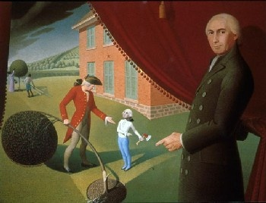
Avoiding Plagiarism
Avoiding plagiarism is quite simple. The best method for avoiding it is to simply be honest; when you've used a source in your paper, give credit where it's due. Acknowledge the author of the original work you've used.

Slide 20

Avoiding Plagiarism
Another way to avoid plagiarism is to use your own work as often as possible. Quoting and citing sources is usually required and inevitable when doing research -- that's how you "back up" your own work. But using someone else's work excessively can be construed as plagiarism.
Another way to it is to quote and/or cite your sources properly.

Slide 21
Proper Quotations
In order to properly quote your sources, you should consult the style manual that would be appropriate for the research. In most cases, your professor will tell you which style manual would be preferred. If your professor doesn't indicate which manual to use, be sure to ask.
The following examples are formatted in MLA, APA, and Chicago (Turabian is similar to Chicago) formats. The text is taken from the passage we saw earlier from Zimbardo.

Slide 22
MLA Quotations
Indirect: Some researchers note that "children are totally insensitive to their parents' shyness" (Zimbardo 62).
Direct: Zimbardo notes that “children are totally insensitive to their parents’ shyness” (62).
Paraphrasing: Some researchers have observed that children seem unaware that their parents are considered bashful (Zimbardo 62).

Slide 23
APA or Chicago Quotations
Indirect: Some researchers note that "children are totally insensitive to their parents' shyness" (Zimbardo, 1977, p.62).
Direct: Zimbardo (1977) notes that “Children are totally insensitive to their parents’ shyness” (p. 62).
Paraphrasing: Some researchers have observed that children seem oblivious to their parents’ bashfulness (Zimbardo, 1977).

Slide 24
Proper Citations
In order to properly cite your sources, you should also consult the style manual that would be appropriate for the research. The following examples are formatted in MLA, APA, and Chicago (Turabian is similar to Chicago) formats. The citation is related to the passage we saw earlier from Zimbardo.

Slide 25
MLA Citations
Book
Zimbardo, Philip G. Shyness: What It Is, What To Do About It, Perseus Books, 1977.
Essay/Chapter in a Book
Copeland, Edward. “Money.” The Cambridge Companion to Jane Austen,
edited by Copeland and Juliet McMaster, Cambridge UP, 1997, pp.
131-48.
** Some of these examples came from the OWL at Purdue, some from the official MLA site **

Slide 26
MLA Citations
Article
Bagchi, Alaknanda. "Conflicting Nationalisms: The Voice of the Subaltern in Mahasweta Devi's Bashai Tudu." Tulsa Studies in Women's Literature, vol. 15, no.1, 1996, pp. 41-50.
Article from a Database
Lorensen, Jutta. “Between Image and Word, Color, and Time: Jacob Lawrence’s The
Migration Series.” African American Review, vol. 40, no. 3, 2006, pp. 571-86.
EBSCOHost, search.ebscohost.com/login.aspx?direct=true&db=f5h&AN=
24093790&site=ehost-live.
** Some of these examples came from the OWL at Purdue, some from the official MLA site **

Slide 27
MLA Citations
Page on a Website
“Curiosity Rover Report (August 2015): Three Years on
Mars!” NASA’s Journey to Mars: Videos, edited by Sarah
Loff, National Aeronautics and Space Administration,
30 July 2015, www.nasa.gov/topics/journeytomars/
videos/index.html.
** Some of these examples came from the OWL at Purdue, some from the official MLA site **

Slide 28
APA Citations
Book
Zimbardo, P.G. (1977). Shyness: What it is, what to do about it. Cambridge, MA: Perseus Books.
Essay/Chapter in a Book
O'Neil, J. M., & Egan, J. (1992). Men's and women's gender role journeys: Metaphor for healing, transition, and transformation. In B. R. Wainrib (Ed.), Gender issues across the life cycle (pp. 107-123). New York: Springer.
** Many of these examples came from the OWL at Purdue **

Slide 29
APA Citations
Article
Scruton, R. (1996). The eclipse of listening. The New Criterion, 15(30), 5-13.
Article from a Database
APA does not require that a citation for an article in a database document that fact. You can cite an article you find in a database the same way you’d cite a regular print article, as in the example above.
** Many of these examples came from the OWL at Purdue **

Slide 30
APA Citations
Website
Lowe, M. (2012). Megan Lowe @ ULM. Retrieved from http://www.ulm./edu/~lowe.
Item Without Author
Merriam-Webster's collegiate dictionary (10th ed.).(1993). Springfield, MA: Merriam-Webster.
** Many of these examples came from the OWL at Purdue **

Slide 31
Q & A Time!

Slide 32
Thanks for your attendance!
Remember, if you need research help, all you have to do is ask the librarians. You can…
Visit the Reference Desk, Library 1st floor
Email us at reference@ulm.edu
Call us at (318) 342-1071

