Slide 1
Utilizing Microsoft
TEAMS
Bobbie Jo Desselle and Caroline Smith
2021 Pharm D. Candidates

Slide 2
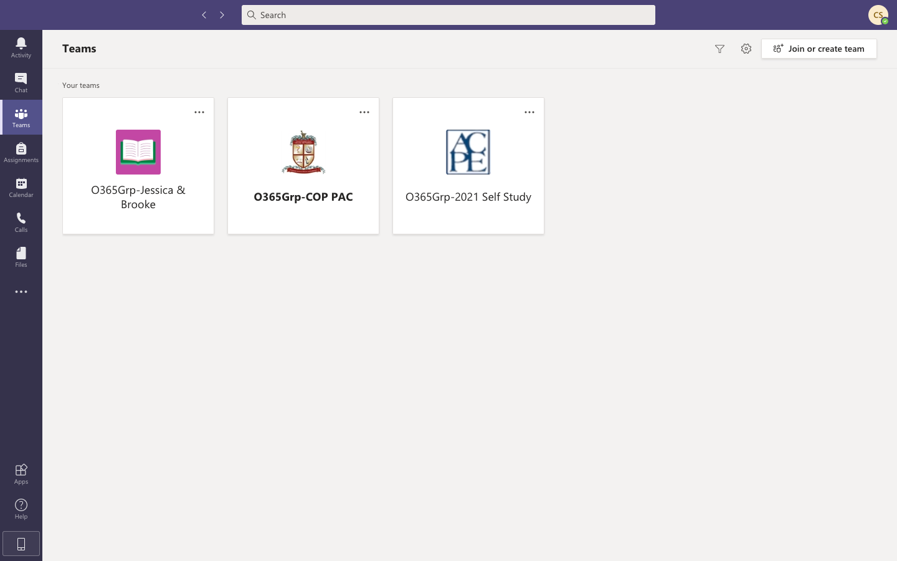
Click here to access all of “Your Teams”

Slide 3
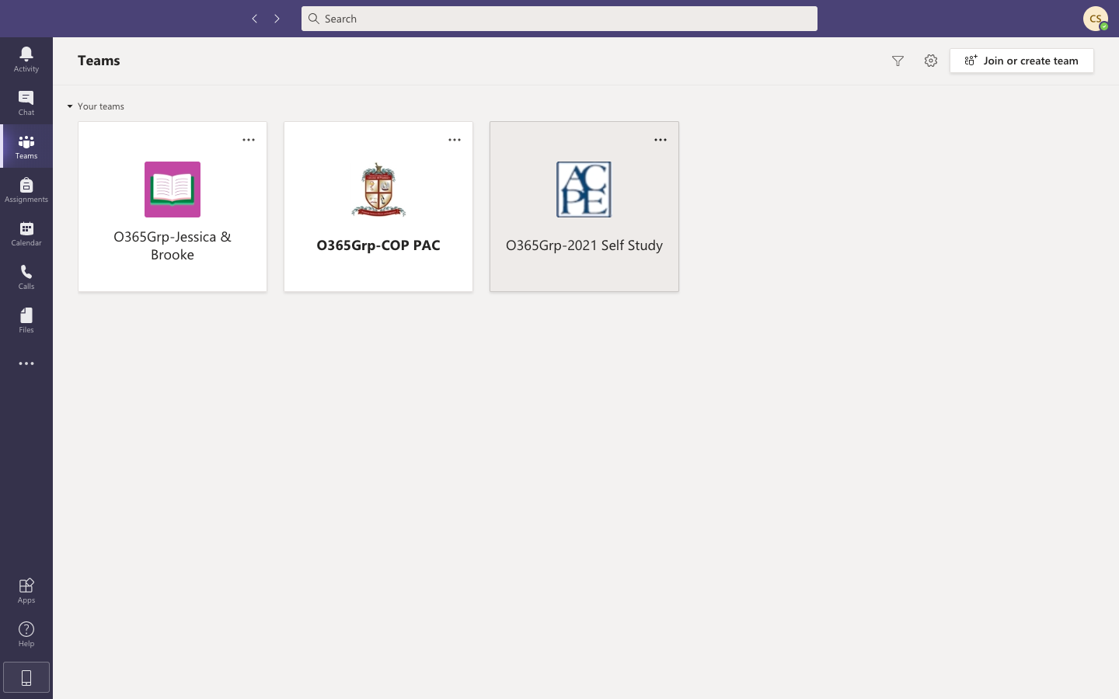
Click on the Team that you want to open.

Slide 4
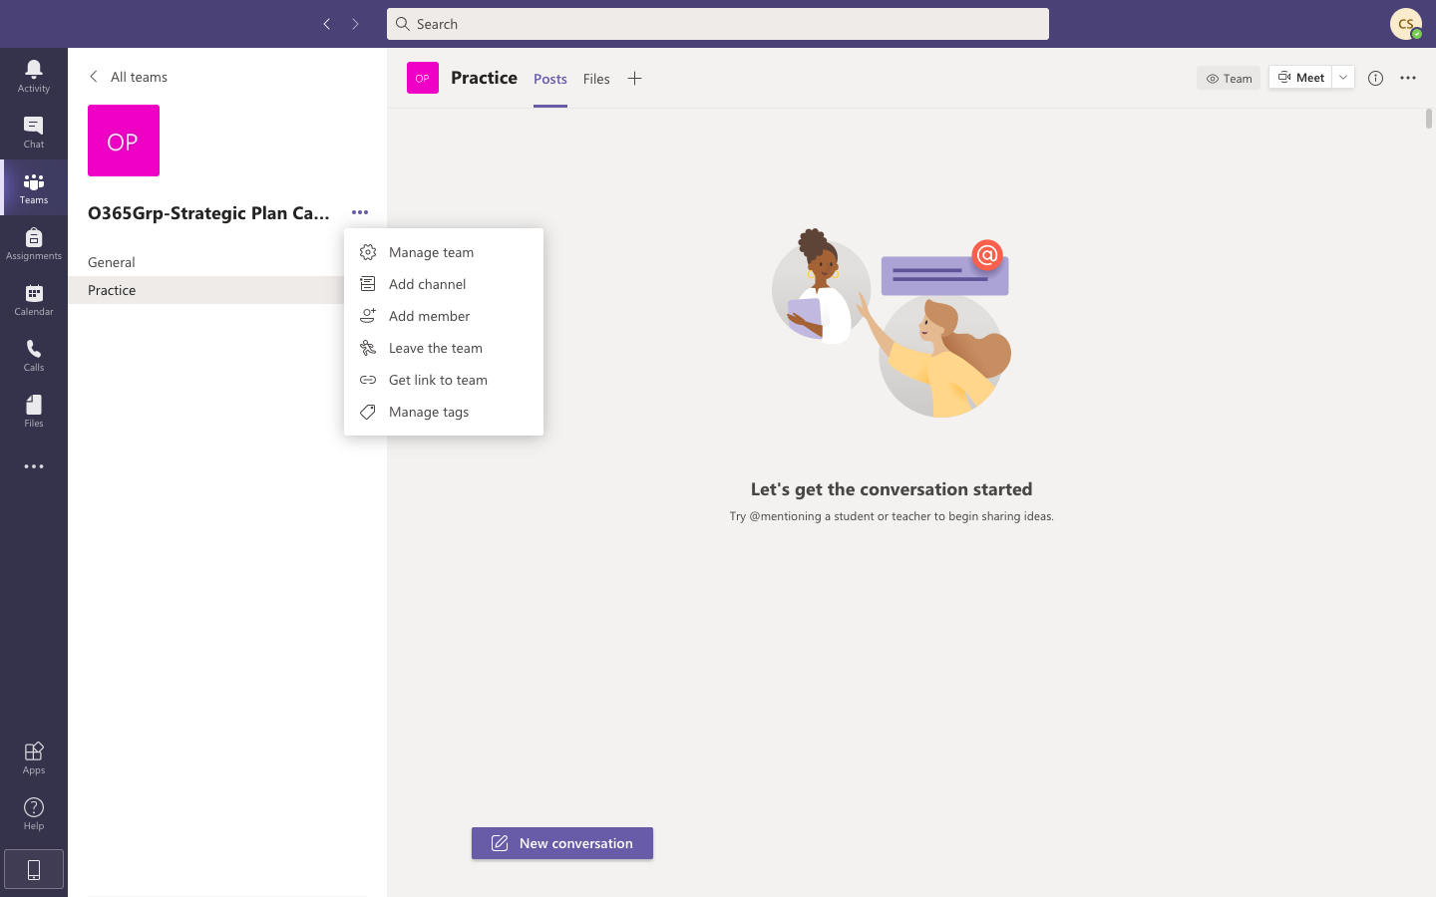
Click these three dots in order to have the options to add channel, add member, leave the team, etc.

Slide 5

Click the channel you would like to open within your team

Slide 6
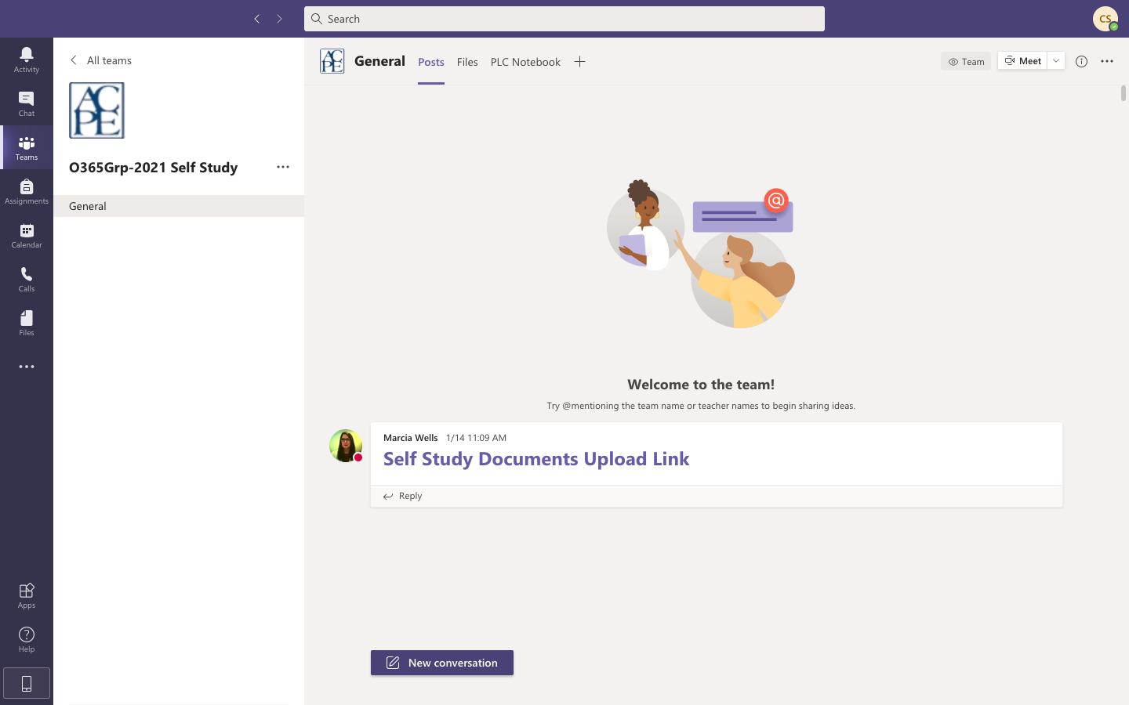
Click here to see posts from other team members
Click here to start a new post

Slide 7

Click here to access files for this Team

Slide 8
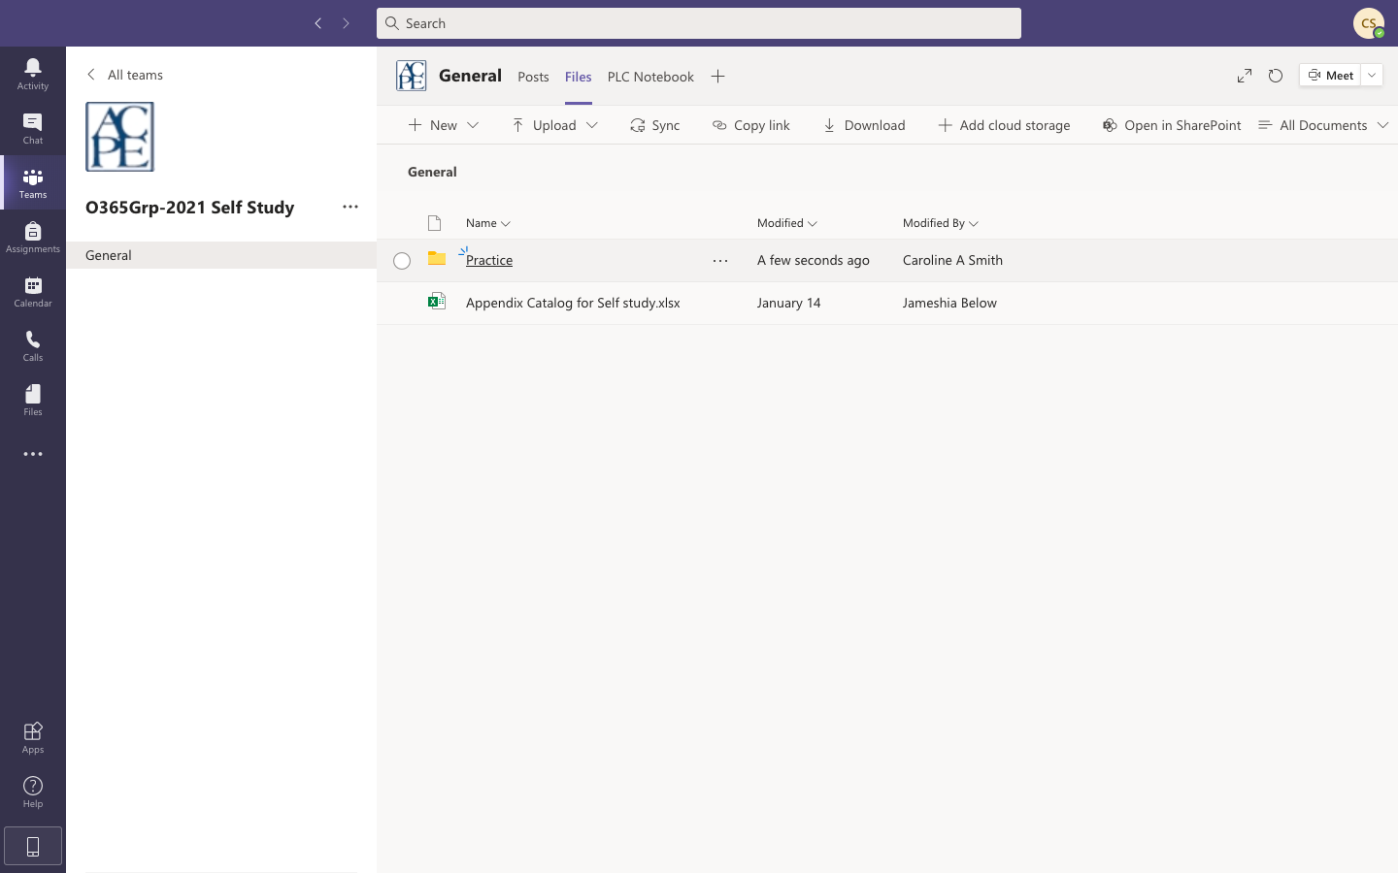
Click on the folder you would like to view.

Slide 9

Click the document you would like to view

Slide 10
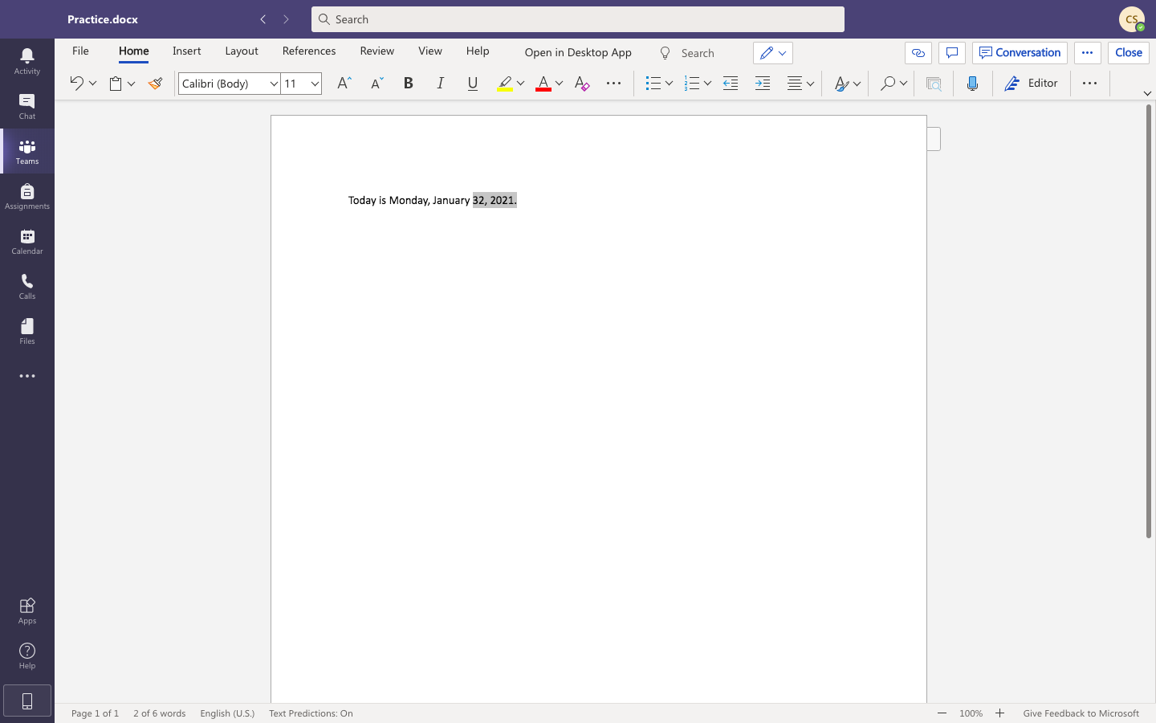
Highlight the words that you want to make a comment about

Slide 11
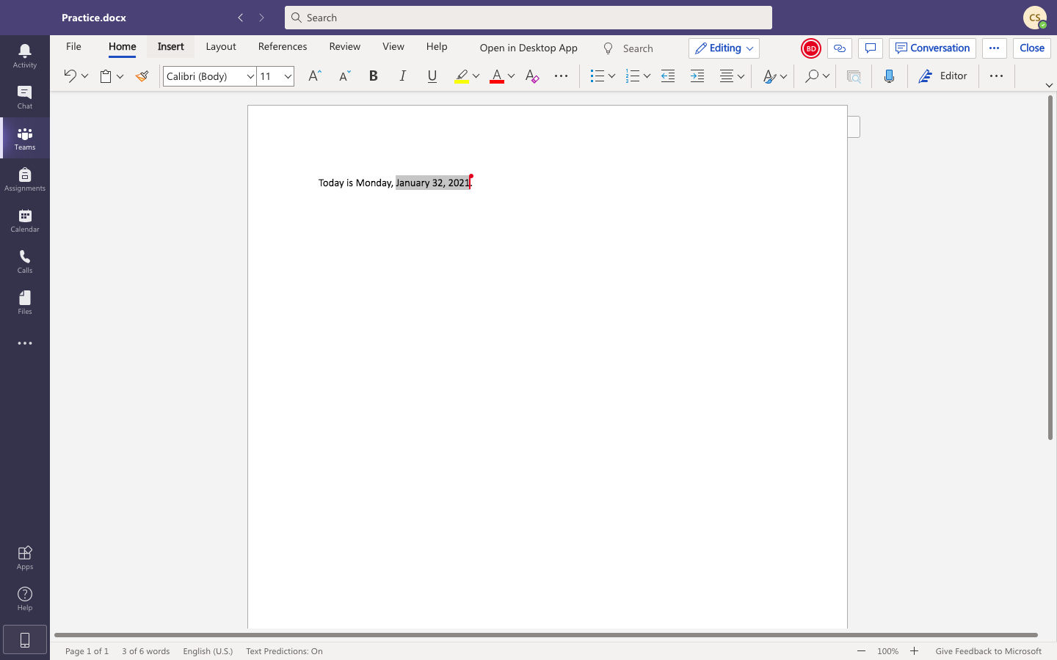
Click “Insert”

Slide 12
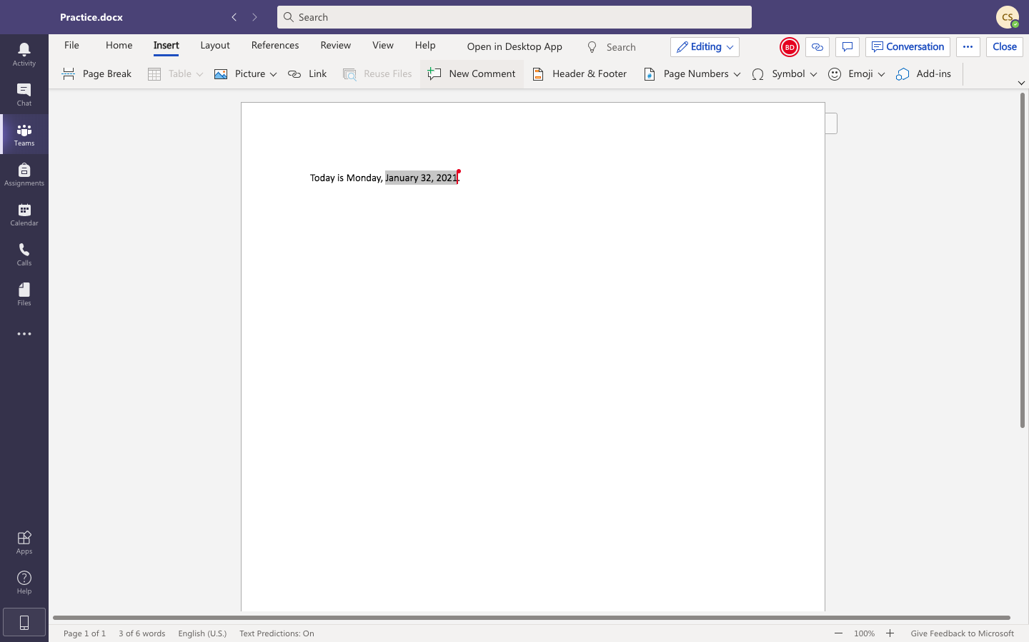
Click “New Comment”

Slide 13
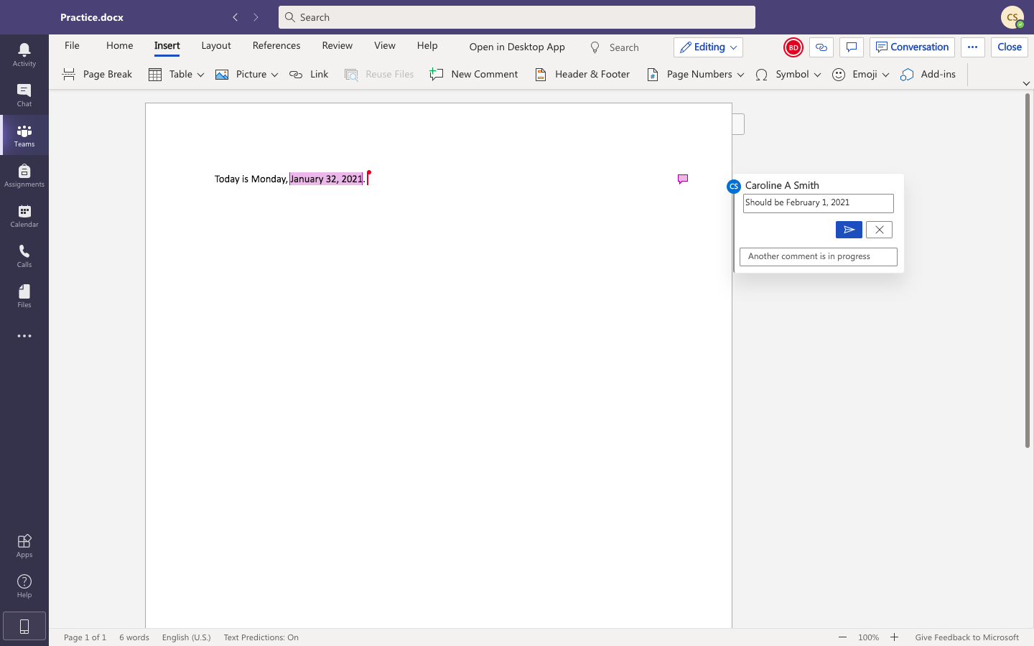
Write your comment in that box

Slide 14
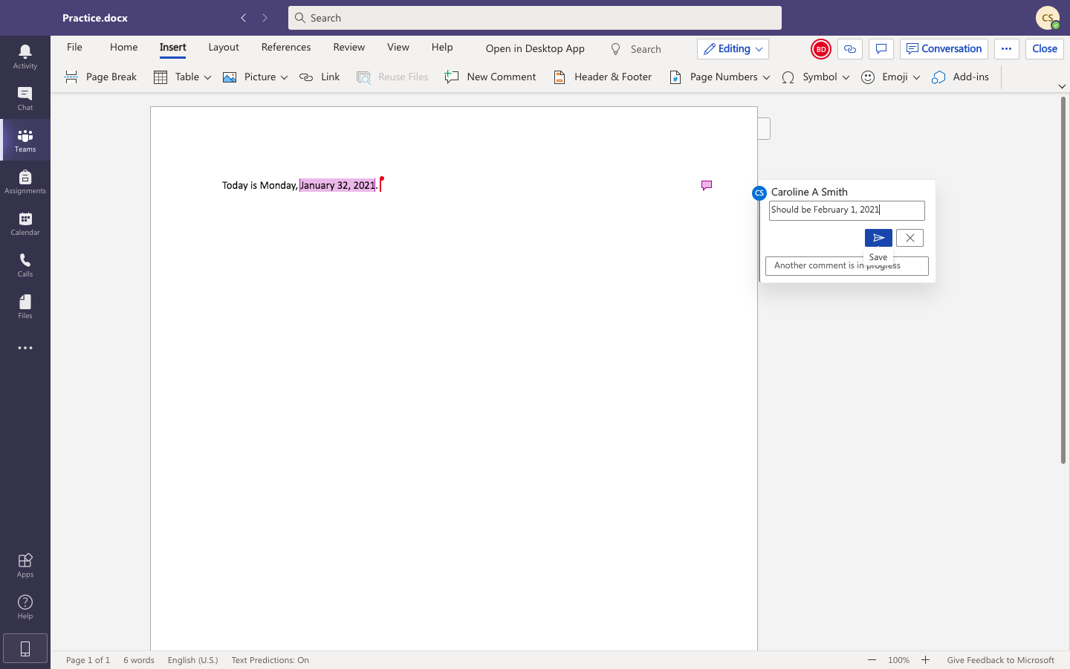
Finish writing your comment, then click save

Slide 15
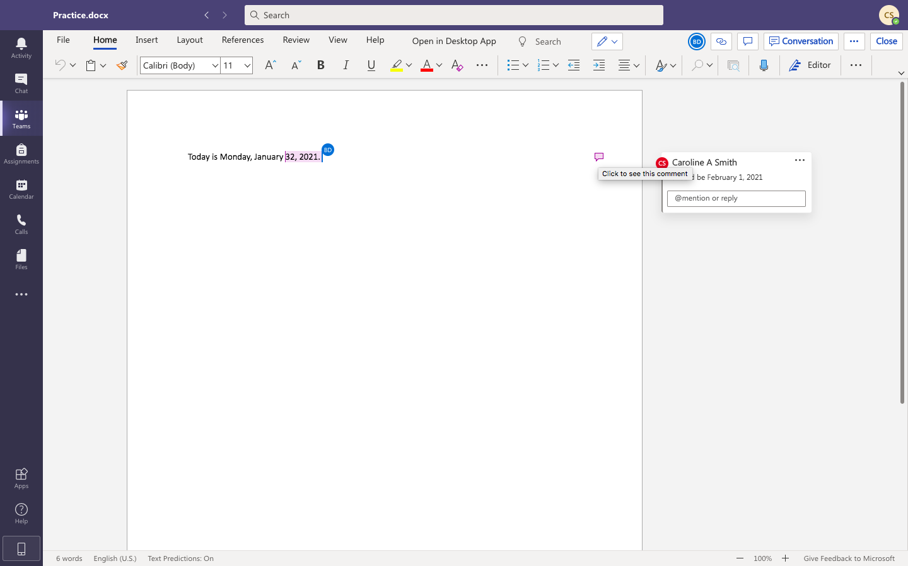
Hover over the comment icon to highlight the section where the comment refers to

Slide 16
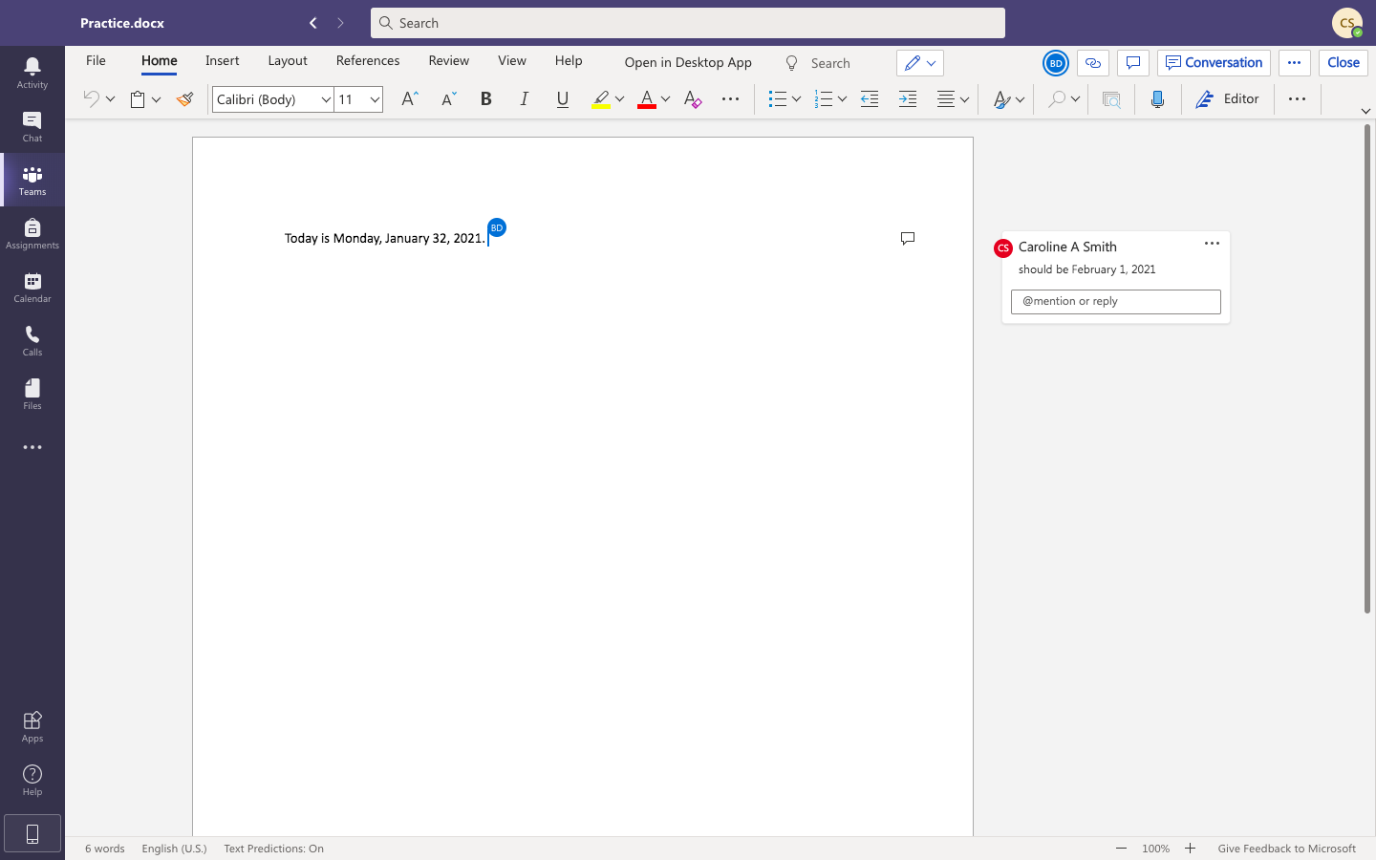
Click this back arrow to get back into the previous folder.
Click “close” to close out of the document and back to folder

